Slide 1
Submitting your Thesis/Dissertation Electronically: A Guide for Graduate Students
Your comprehensive, screen by screen guide to submitting your thesis or dissertation document electronically for review and approval.
The purpose of this document is to provide a comprehensive walk-through of your submission process.

Slide 2
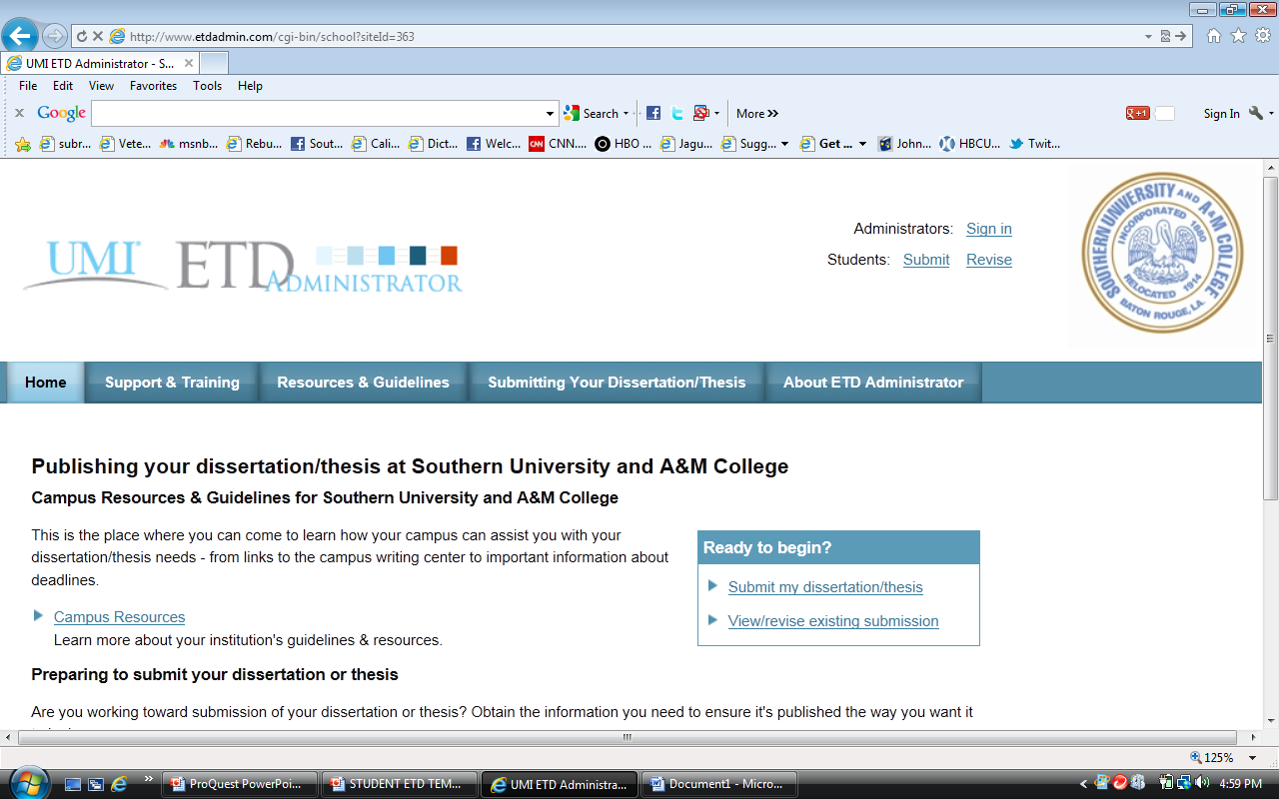
ETD stands for Electronic Thesis and Dissertation. This is the homepage located at www.etdadmin.com/subr At the top right of the page you will see “Students: Submit Revise”. If you are submitting a new ETD click “Submit”. If you are revising an existing ETD click “Revise”.

Slide 3
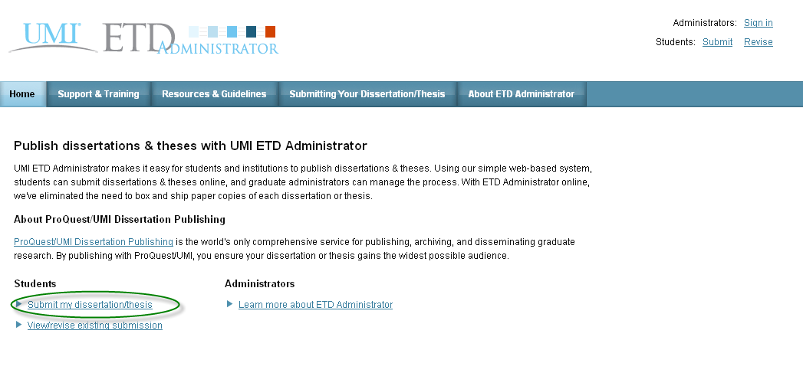
You can also click one of the links under “Students” near the bottom left.

Slide 4
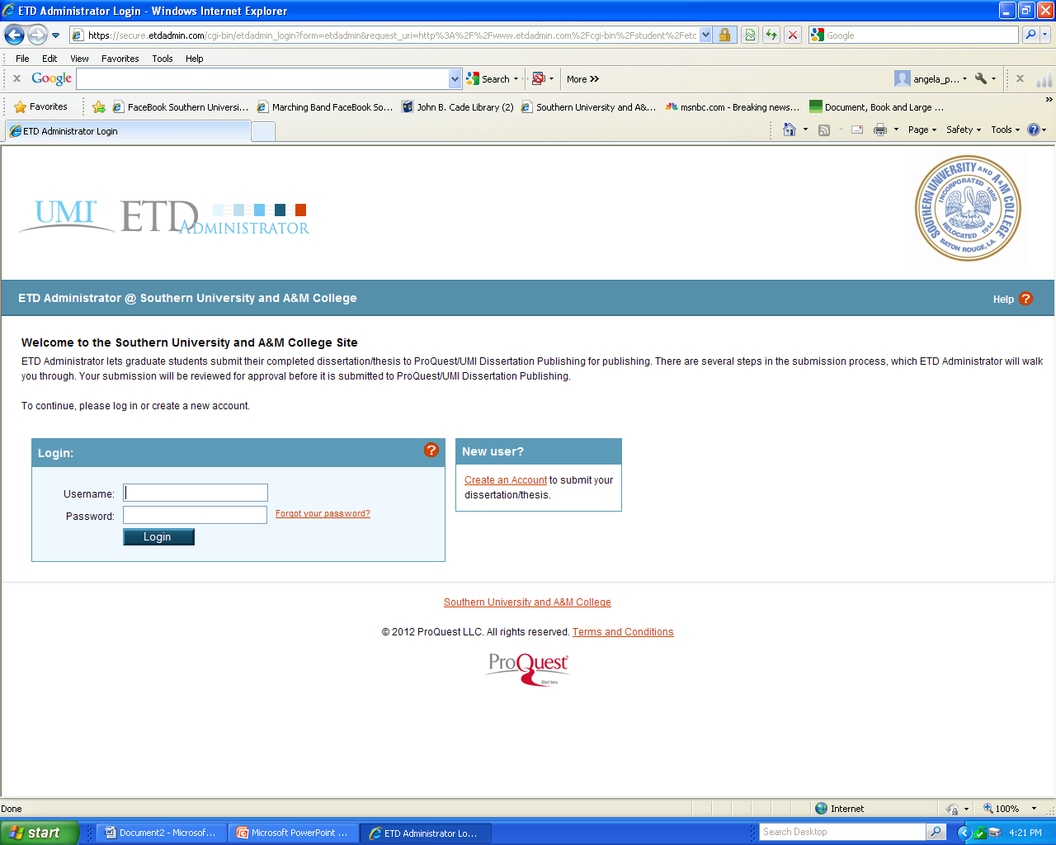
This brings you to the customized Southern University submission site. The first step requires you to set up a new account. Click “Create an account”. Once you are notified the account has been successfully created you will enter your Username and Password as indicated.

Slide 5
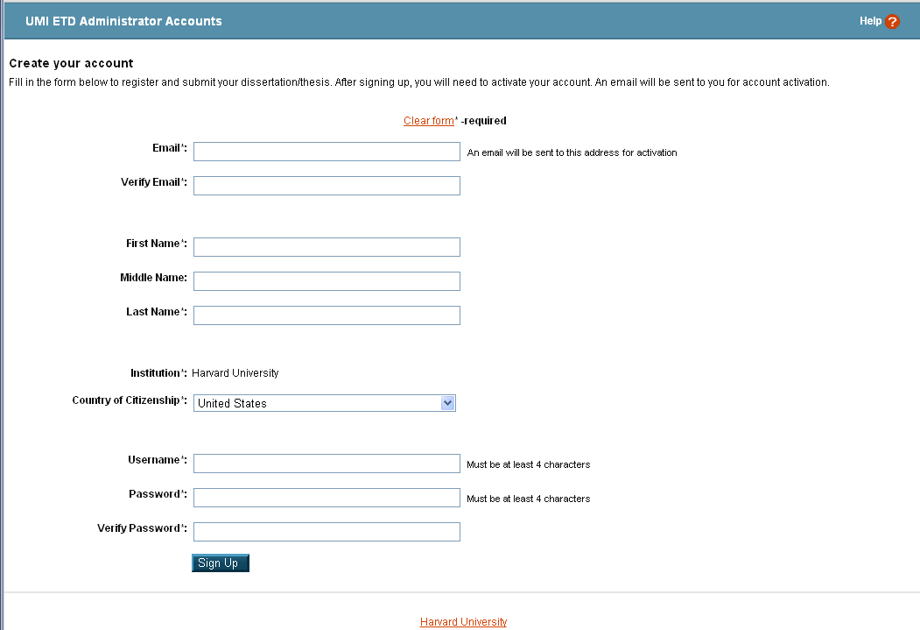
Complete the information as required. Be sure to select a username and password you will be able to remember. NOTE: DO NOT USE SOUTHERN UNIVERSITY EMAIL ACCOUNT IN THE EMAIL FIELD.

Slide 6
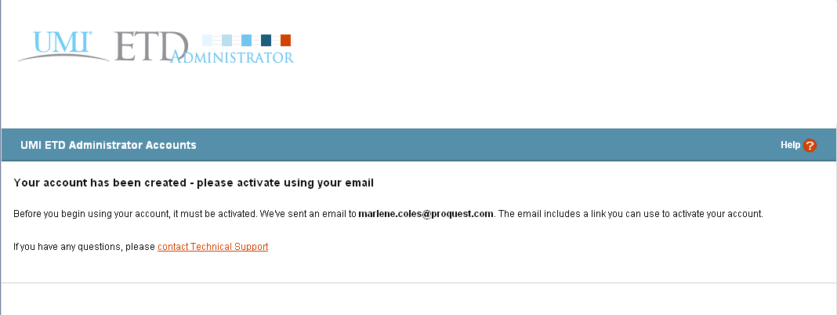
A confirmation email will be sent to the address you entered, allowing you to confirm your account.

Slide 7
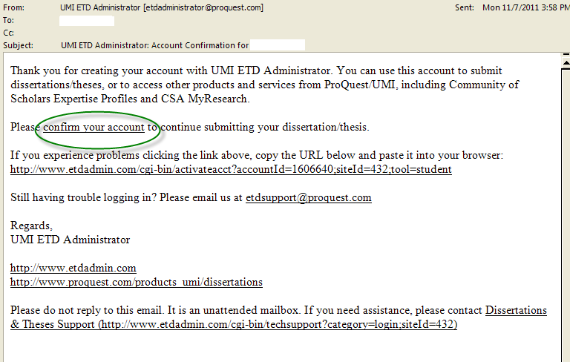
Here is what the message will look like in your email client. Click “confirm your account” to activate your ETD account. The link will take you back to the login page.

Slide 8
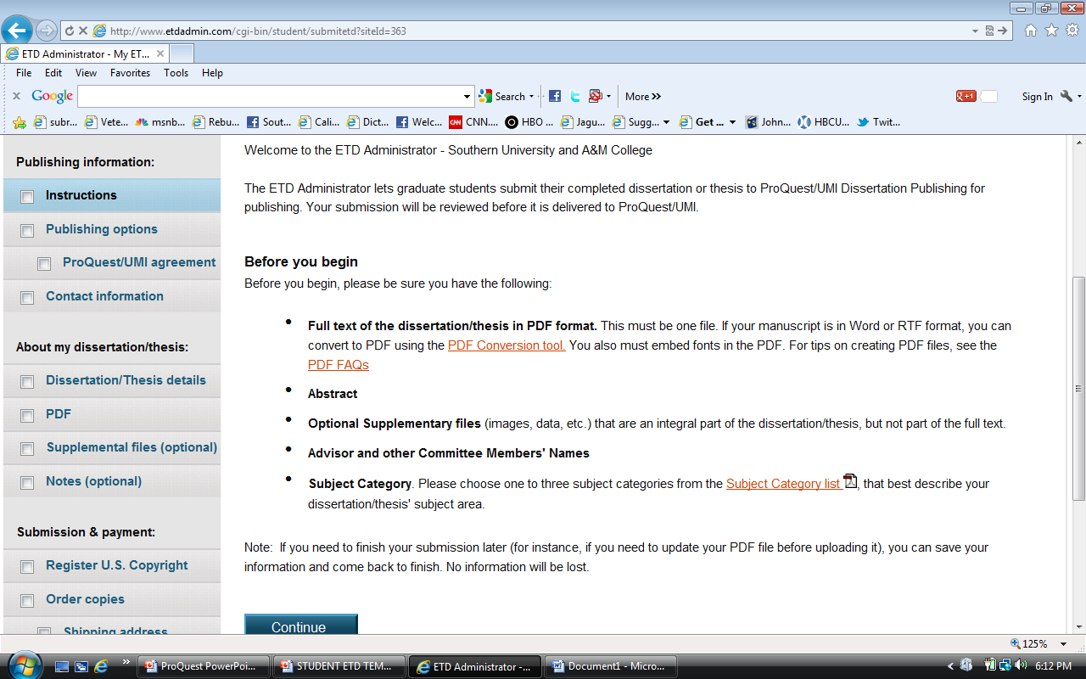
This screen reviews some of the options you will have for your account and also mentions the PDF Conversion tool. If you do not have a PDF converter to use, you may use the converter provided by the ETD Administrator. Click “Continue” after you’ve read over the information. Note: At any point you can stop and finish your submission later. No information will be lost.

Slide 9
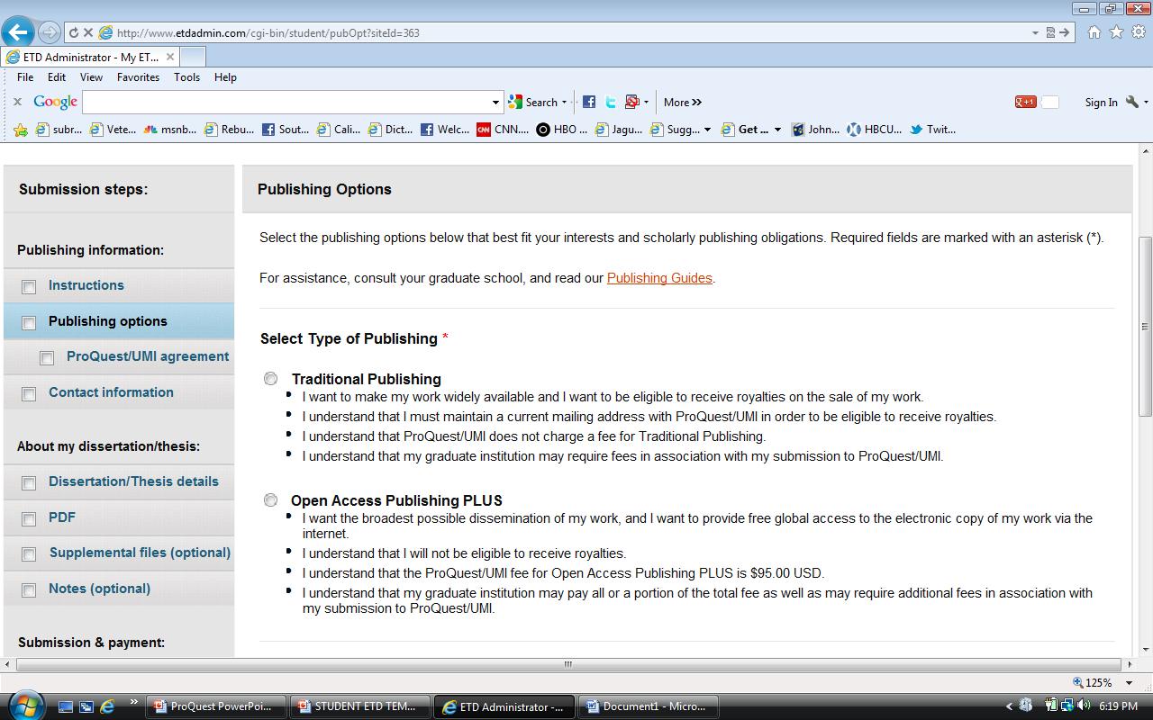
Publishing Options
On this screen you will select publishing options. Traditional Publishing has no fee attached. The Open Access option cost $95.00. (Please consult the Publishing Guides under Resources and Guidelines for more information regarding the differences between the two options).

Slide 10
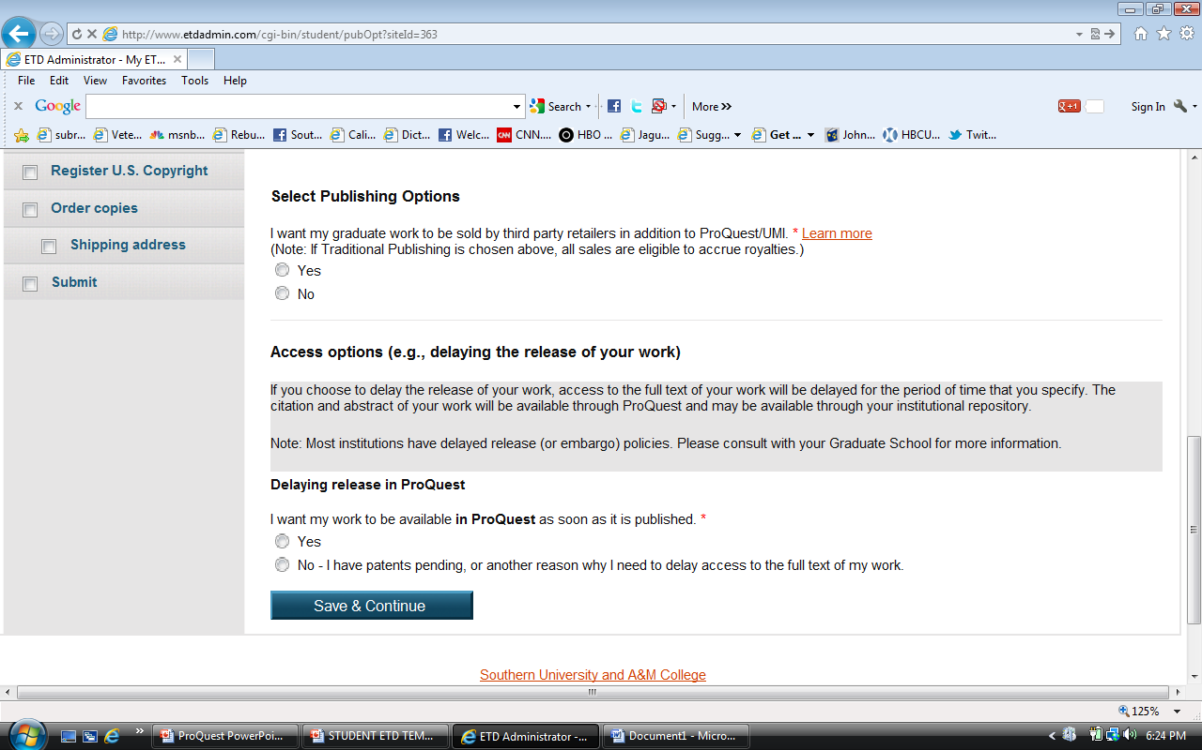
Additional Publishing Options
You may want search engine access and retail options. You may also select restrictions. Please consult the Graduate School, committee advisor and chair before deciding. Click the Radio button for your choice, then Click “Save & Continue”. Details related to these options can be found at the Resources and Guidelines tab.

Slide 11
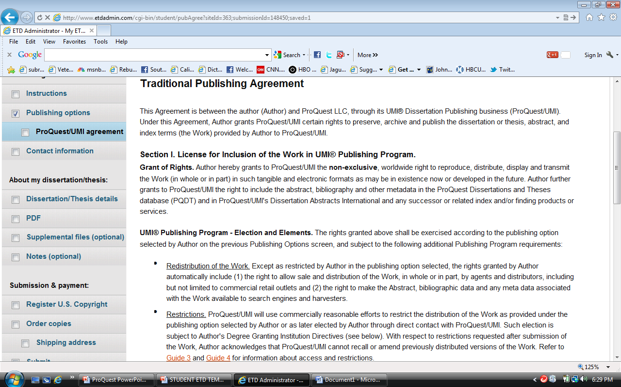
This screen explains the Publishing Agreement. This agreement is made between the author and ProQuest. If you choose “Open Access” the Open Access Agreement is presented. Click “Accept” at the bottom of the page.

Slide 12
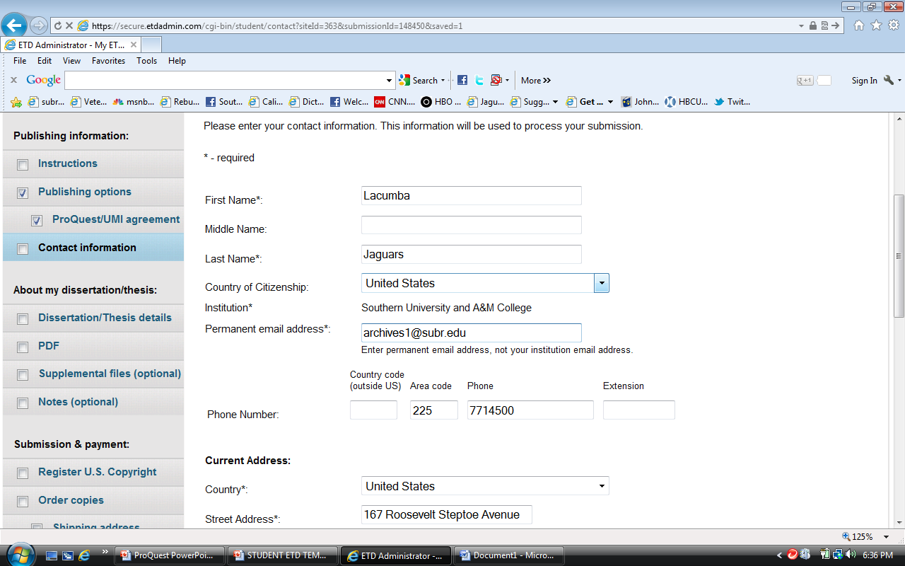
Enter your information as requested on the Contact Information screen. NOTE: DO NOT USE SOUTHERN UNIVERSITY EMAIL ACCOUNT IN THE EMAIL FIELD.

Slide 13
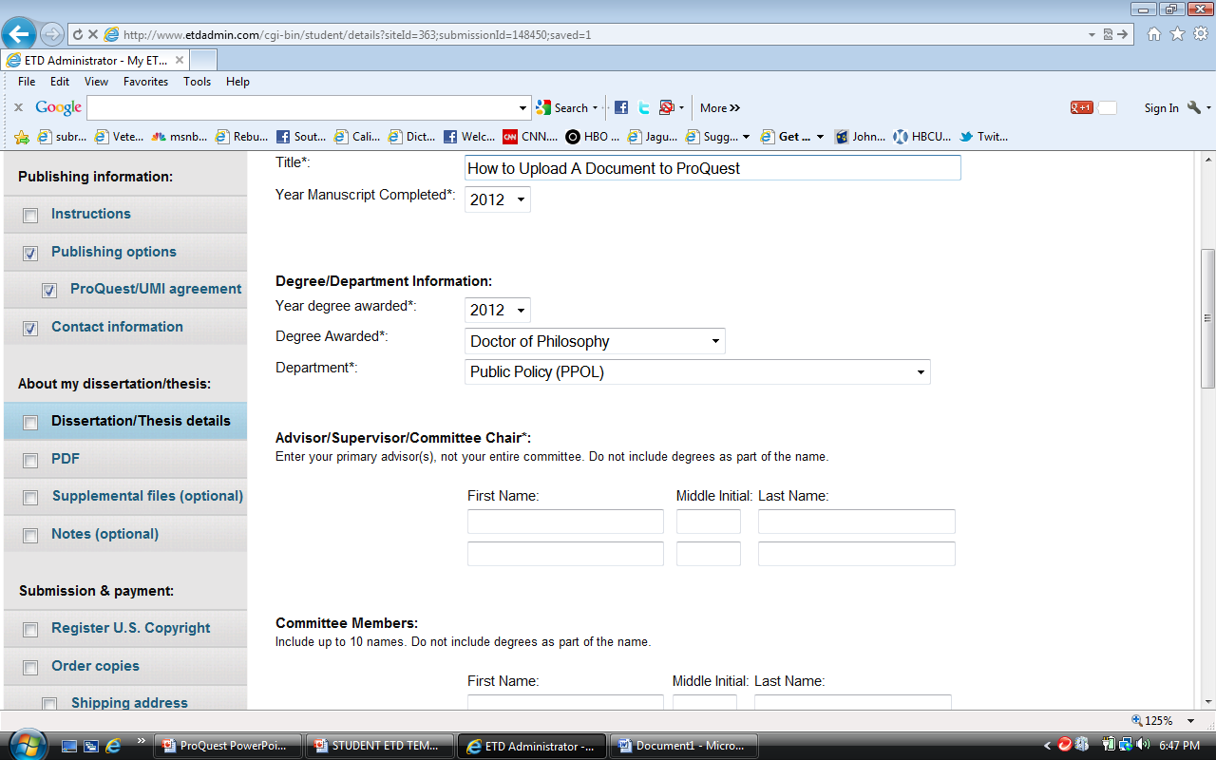
On the next screen, fill in the details for your document and committee. Begin with the title of your dissertation. NOTE: Copy the title of your manuscript from MS Word and then Paste it into the TITLE field of ProQuest. This is very important because, if there is a misspelled word in the title field there is no way to make the change once it is published. In addition, there is a fee assessed to have the manuscript deleted from the database and then republished.

Slide 14
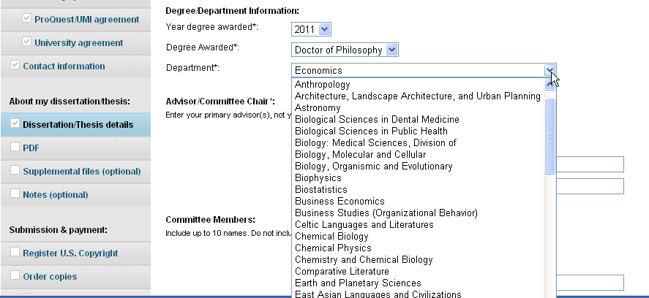
Select your degree from the drop down list. All degrees are listed. If you’re not sure what the exact title of your degree is, contact your academic advisor.

Slide 15
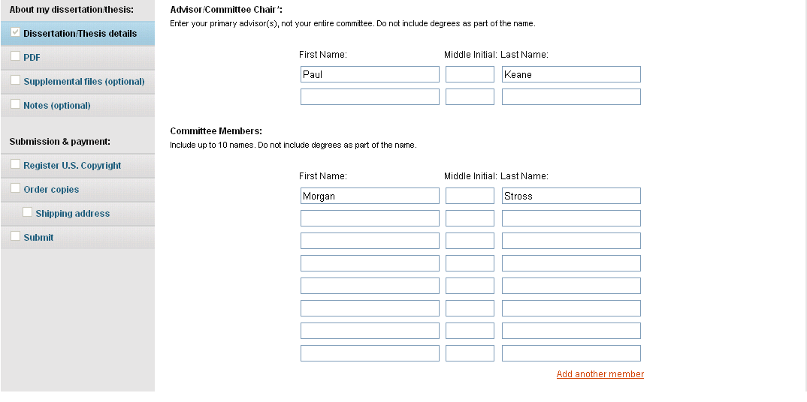
In this section, type your committee chairperson’s name. Below that, enter the names of your committee members. Committee members’ names are required by Southern University Graduate School.

Slide 16
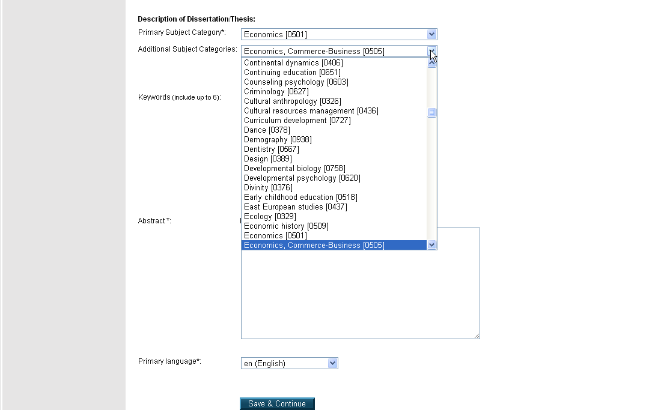
Choose your Primary Subject Category. If you do not see what your document is specifically about, choose the closest category related to it. You can contact ProQuest for assistance. They have subject-matter experts on staff. (Contact information is on the last slide).

Slide 17
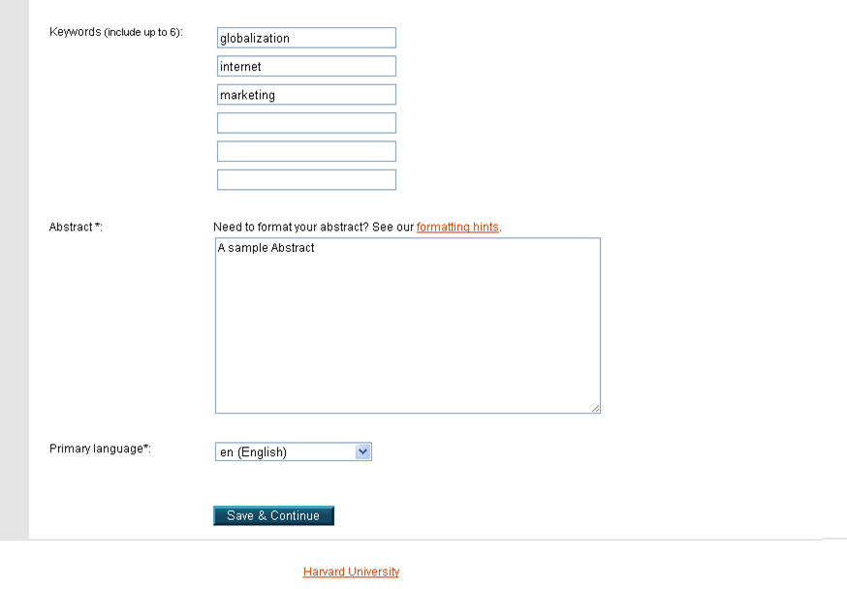
Choose some keywords about your subject matter, then copy/paste your abstract section into the box. Click “Save & Continue”. NOTE!! Copy the abstract from MS Word and then Paste it into the ABSTRACT field.

Slide 18
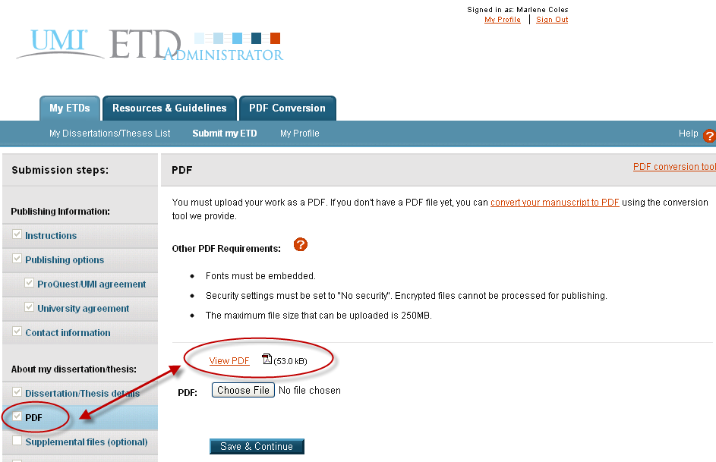
If you do not have your own method to convert your document into a PDF, you may use the converter provided. The next few slides will take you through the process of using the ProQuest PDF converter. (If you have already converted to a PDF and uploaded then skip slides 19-24).

Slide 19
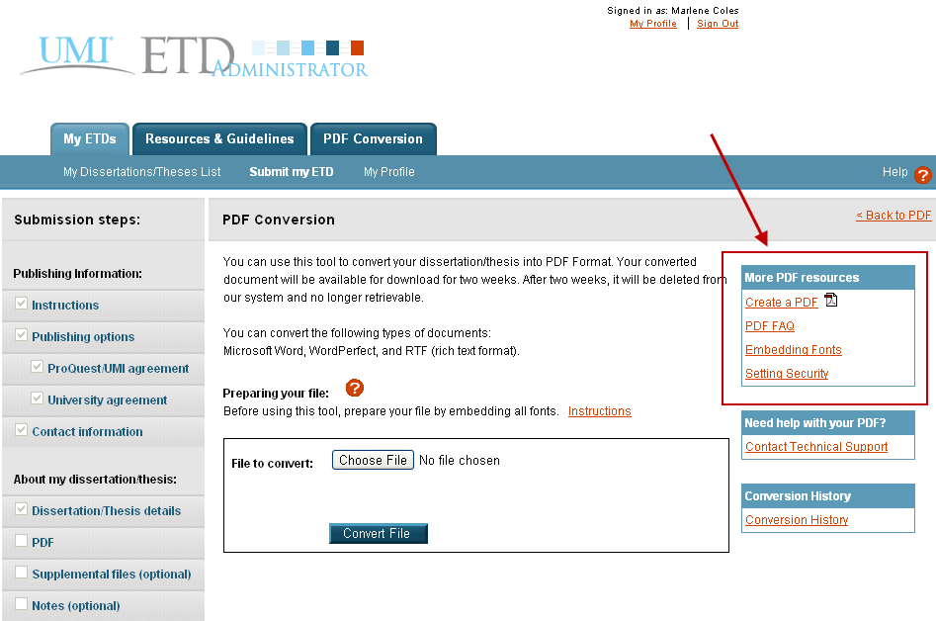
Enter the file to be converted. Click “Choose File” to find the document on your computer.
There are also help files and a FAQ page if you need assistance or have questions.

Slide 20
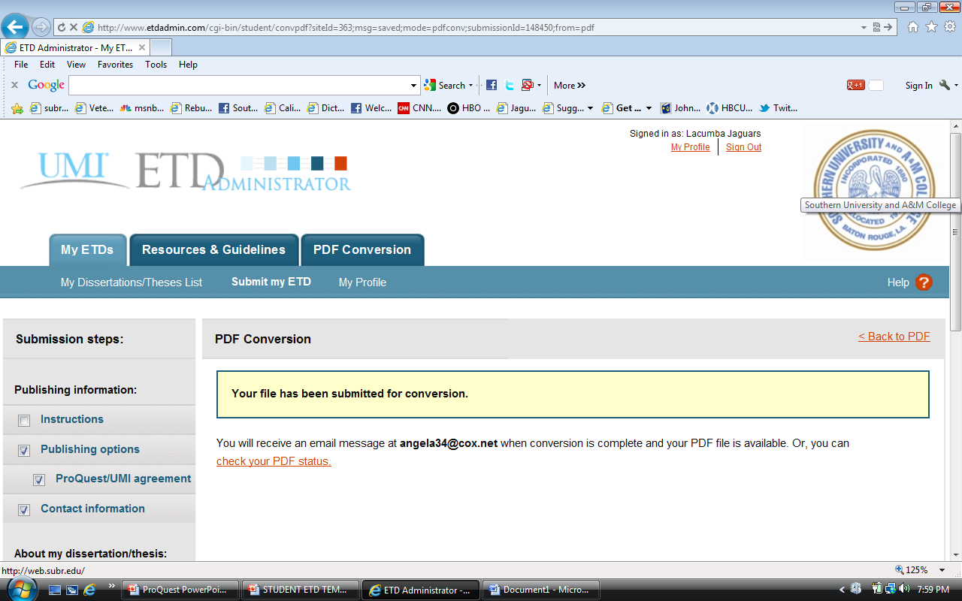
When you have entered your file for conversion and clicked “Convert File,” you will see the confirmation screen.

Slide 21
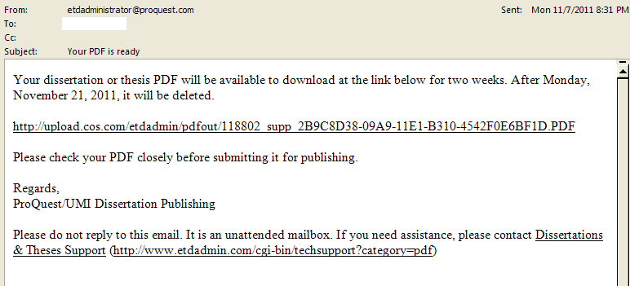
When the conversion to PDF is complete, you will receive an email that looks like the one below.
Note that receiving this email only means your document was converted to a PDF. It does NOT mean your document was submitted to the Graduate School. You must still submit the document via the ETD site.
Click on the link to view your PDF and save it to your computer.

Slide 22
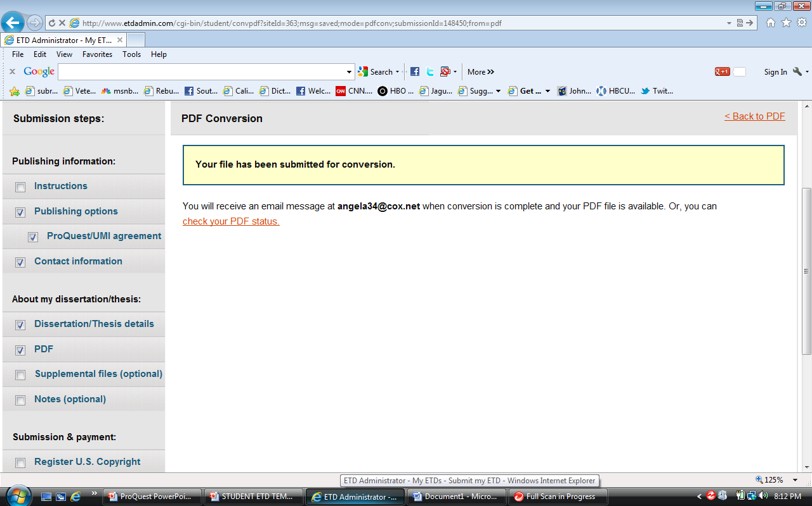
The new PDF can also be viewed through the “check your PDF status” link.

Slide 23
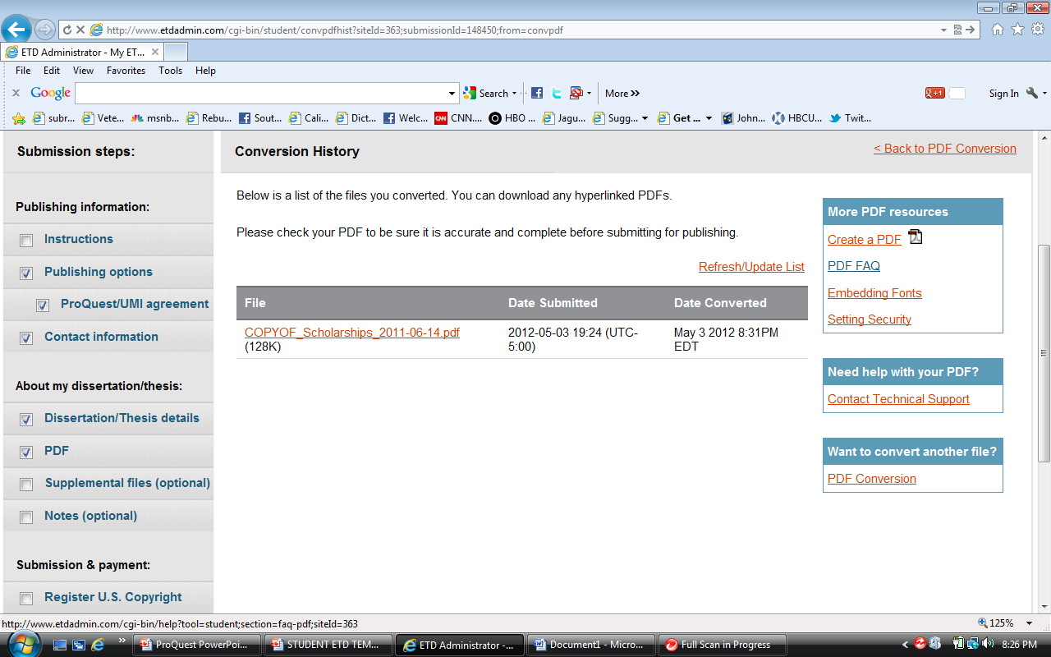
The PDF can be also viewed, downloaded and saved from this page.

Slide 24
Once you’ve saved your document on your computer, you must click the “PDF” link to send your document to the Graduate School.

Slide 25
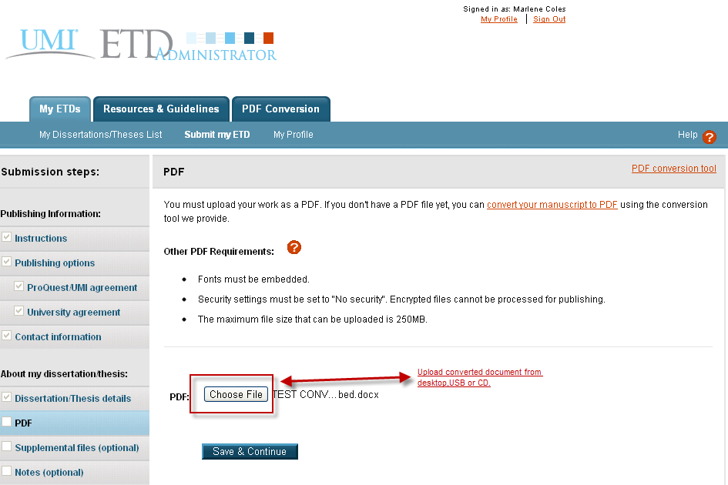
You must upload your PDF to submit it. Click on the “Choose file” button to find the document on your computer. Once it’s uploaded, click “Save & Continue”.

Slide 26
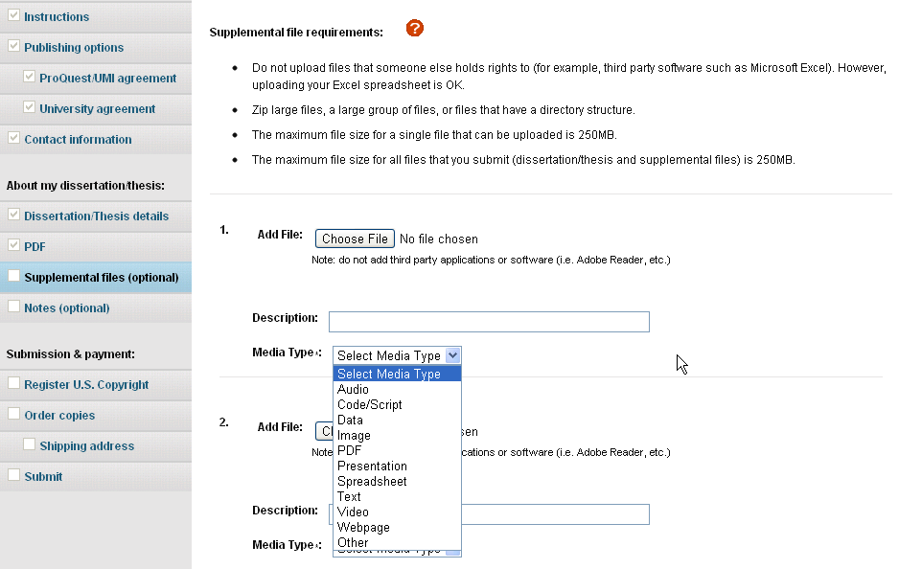
You may add supplemental files on this screen. These files can be in a variety of formats such as movie or music clips, extra graphs, maps, etc. that you want people to view but that you don’t want in your main document. If you do not have any files, click “Save & Continue”.

Slide 27
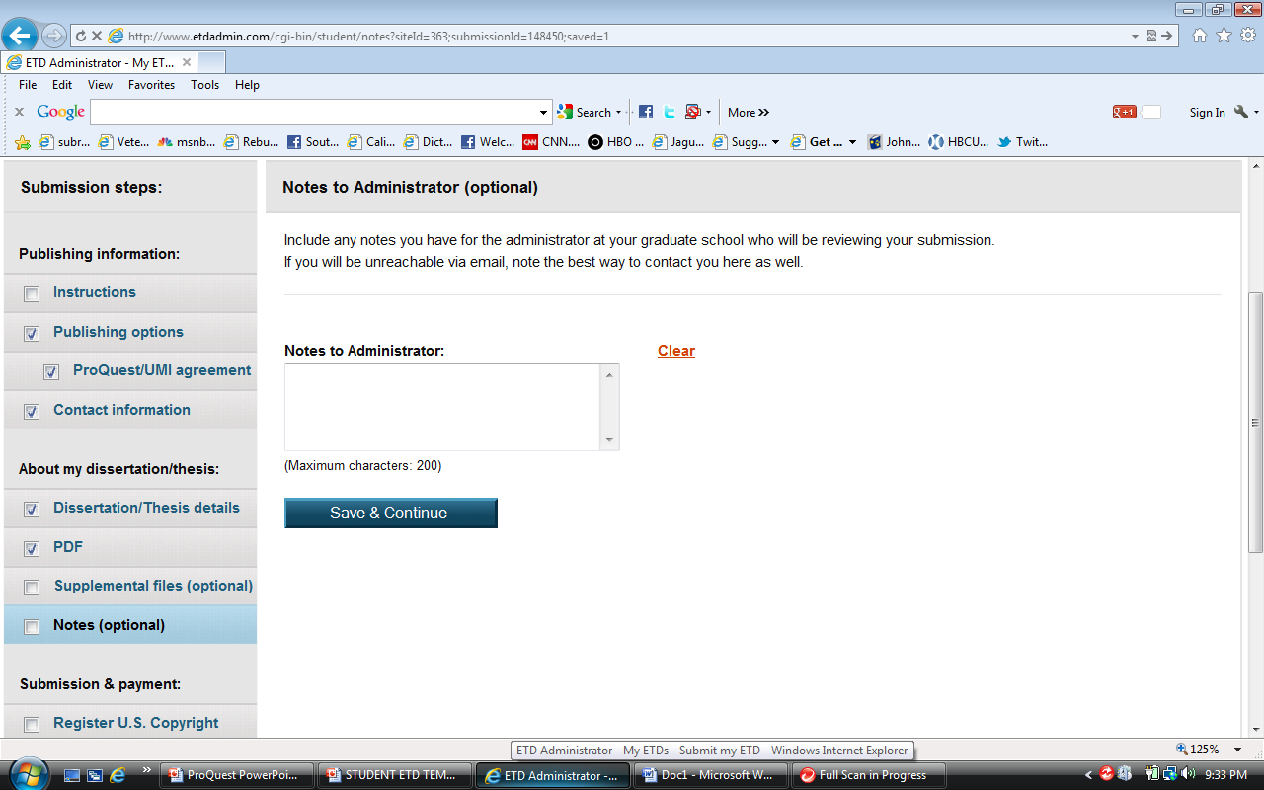
You may add any comments about anything you want to tell the graduate school advisor or the ETD administrator reviewing your manuscript on this screen.

Slide 28
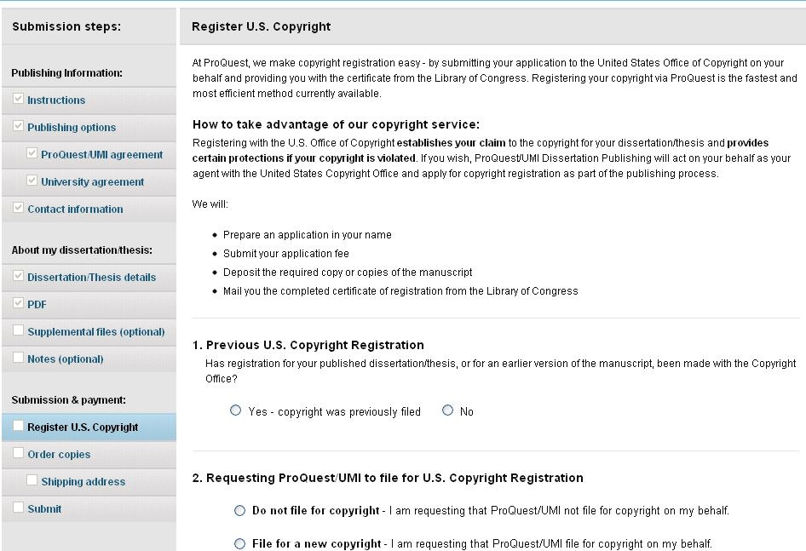
You can opt to have ProQuest file for copyright on your behalf. The fee for this is $55.00. The ProQuest publishing agreement is a non-exclusive agreement and as such, authors retain complete control over their copyright. ProQuest is providing the convenience of registering with the U.S. Copyright Office for you.

Slide 29
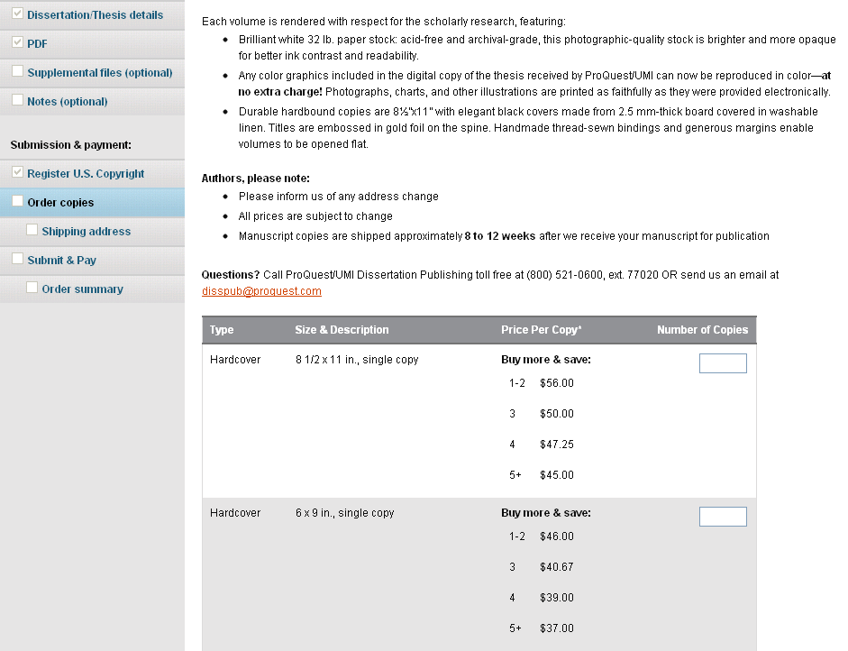
If you would like to order personal copies of your thesis or dissertation, you may do so on this screen. Your copies will be shipped to you after your degree has been conferred at the end of the semester and your document uploaded to ProQuest.

Slide 30
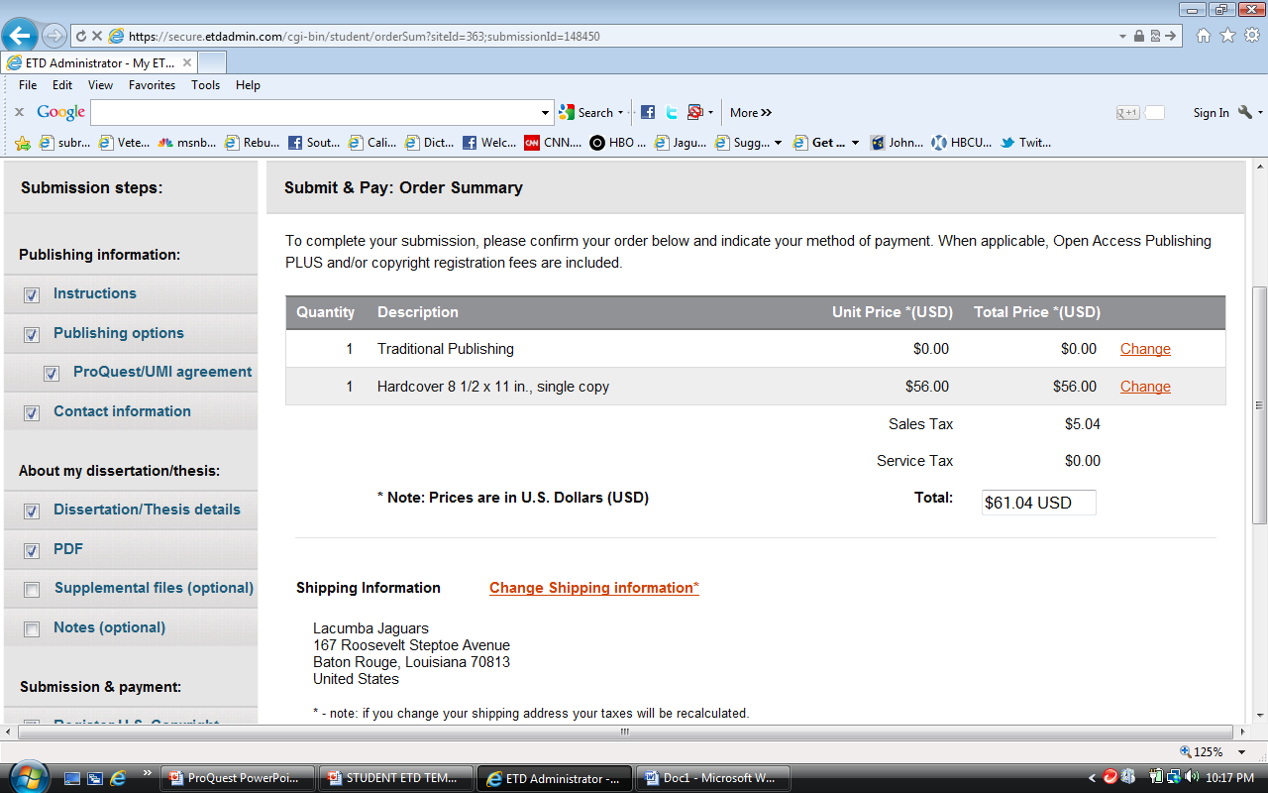
You will be given the opportunity to make changes to your submission right up through placing an order for copies. This includes dissertation/thesis details, advisor, publishing options. All of these items can be changed on previous pages. This is a summary of your order for purchasing bound copies for your review.

Slide 31
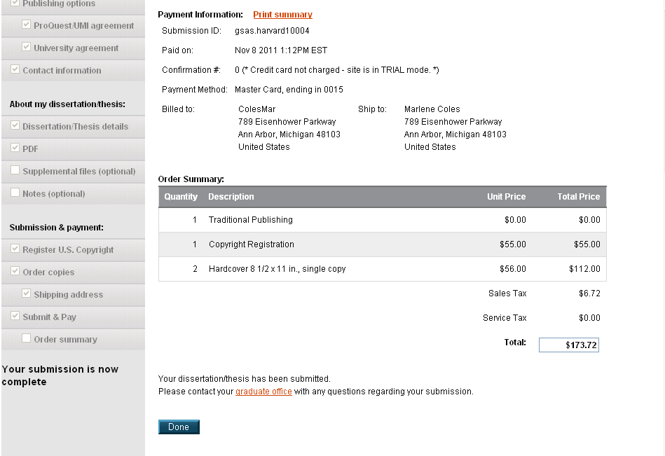
When submitted properly, the following information will be displayed. You can now click “Done”. For the purpose of this slide the address of ProQuest was used. However you will need to replace the address of ProQuest with the address of the Graduate School.
Attn: Dr. Doze Butler, Office of Graduate Studies
Southern University and A&M College
1055 Thomas H. Harris Hall
Baton Rouge, LA 70813-0001
United States

Slide 32
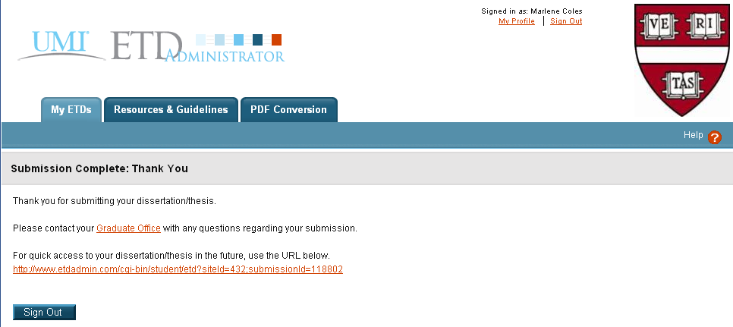
This is what you will see when finished.

Slide 33
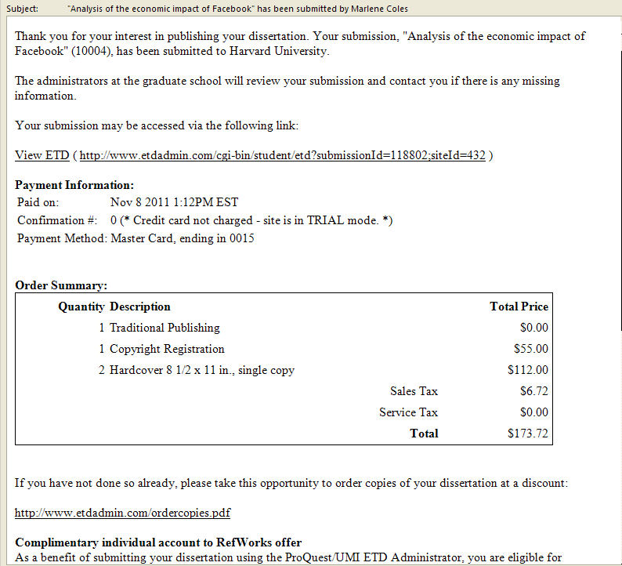
This is the confirmation email you will receive when your document is properly submitted. If you do not get this message within a few hours of submitting, your document was not submitted properly and you need to try again. It is usually delivered within minutes, if the submission was successful. Once you receive this confirmation email please forward it to Dr. Butler in the graduate school at doze_butler@subr.edu

Slide 34
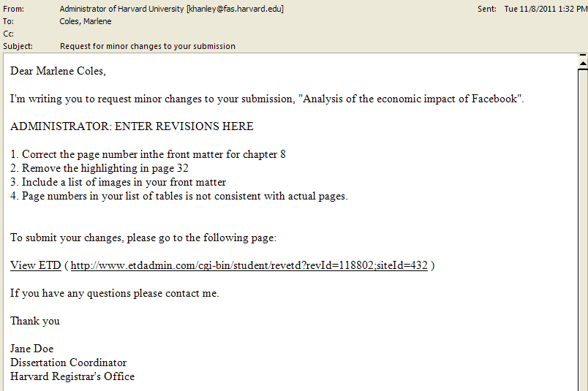
REVIEWED PDFS AND SUBMITTING REVISIONS
After the Graduate School has reviewed your document, you will receive an email letting you know what corrections need to be made. An example of the email is shown below. Make the changes listed in your original document, then re-convert it such that it is a new PDF. When you’re ready to resubmit, click “View ETD”.
From: Administrator of Southern University [carolyn_jackson@subr.edu]
To: Student (your name will be here)
Cc:
Dear, Student (your name will be here)

Slide 35
Submitting Revised Documents
Sign in to revise your document.

Slide 36
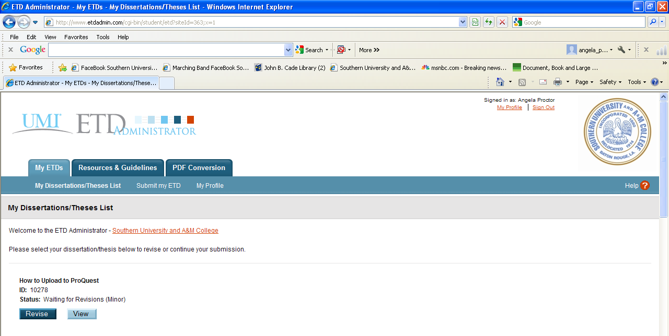
Click “Revise” to submit your new PDF for another check.

Slide 37
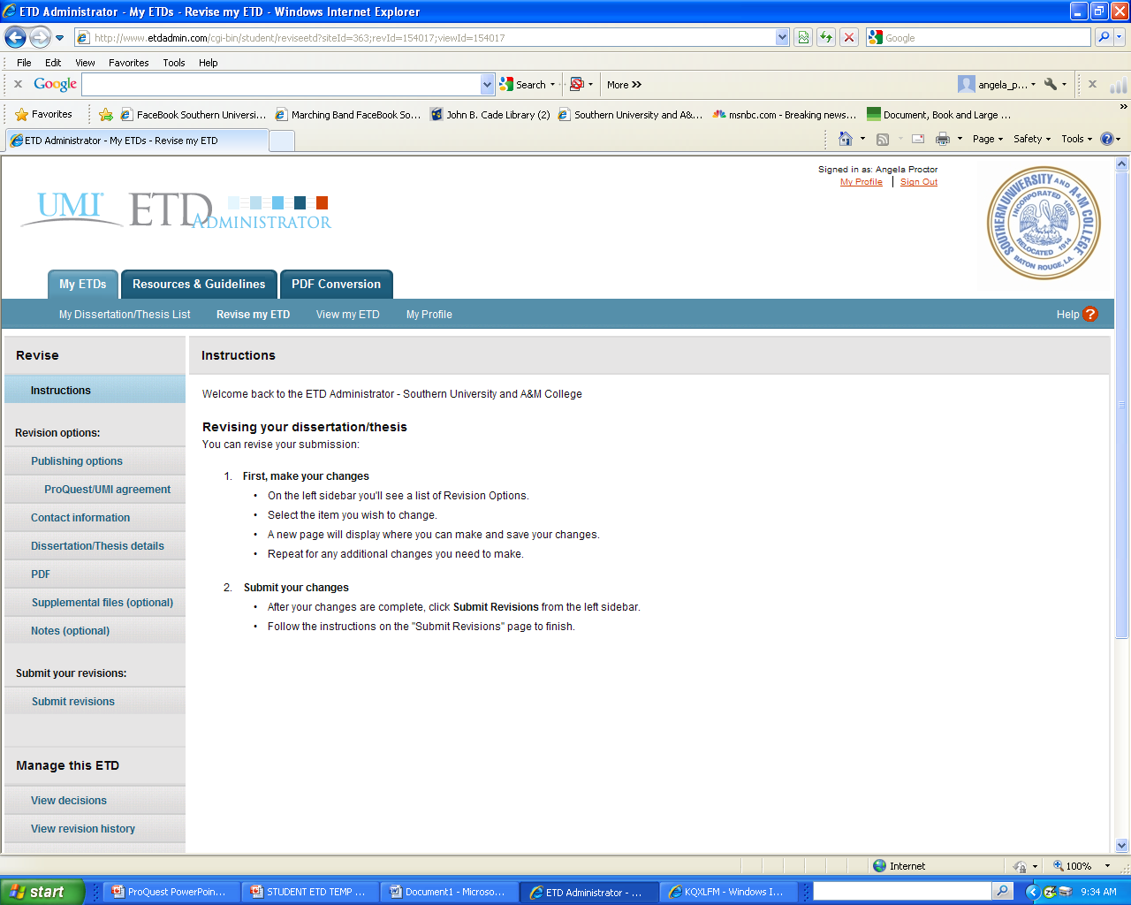
This screen will come up, it contains general information about submitting revisions.

Slide 38
You can revise several aspects of your account from this page. You will most likely just want to change your PDF. Click PDF to revise PDF.

Slide 39
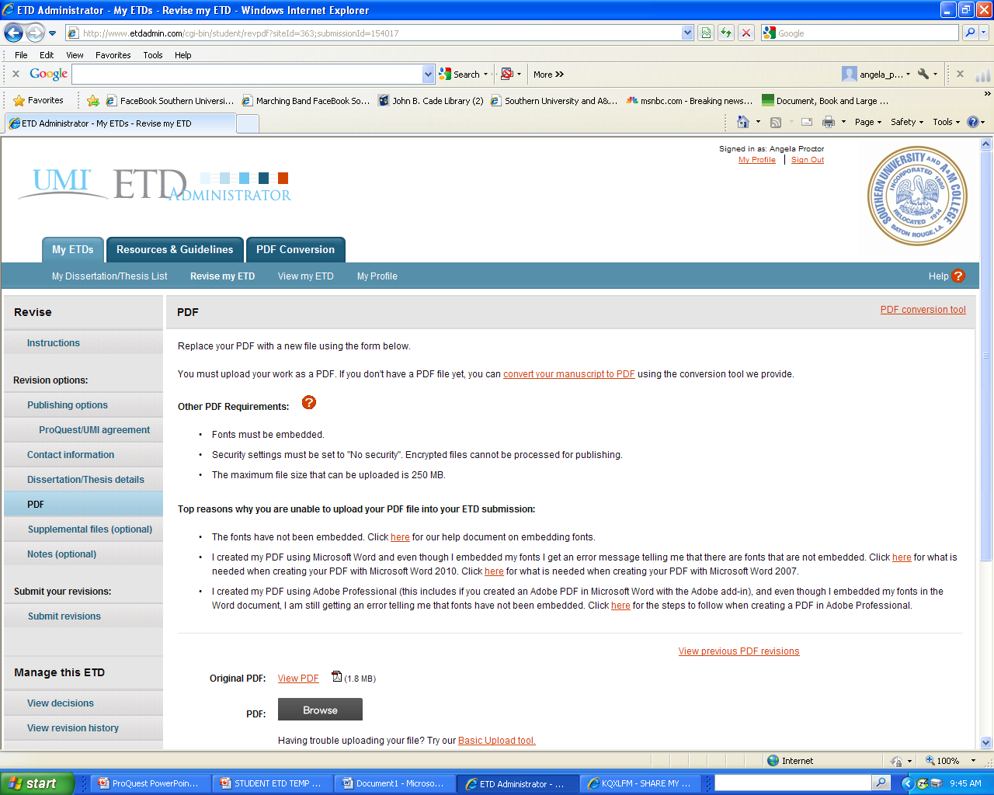
When you click on the PDF link, the following screen will appear. Here is where you upload your updated PDF file. Enter the new PDF using the “Browse” button to find it on your computer. Then click “Save Changes”.

Slide 40
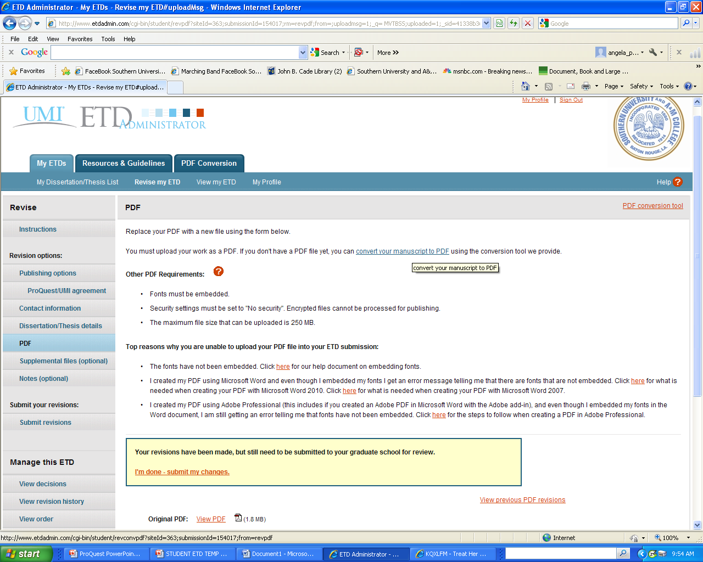
Entering the file in the box does not mean you’ve submitted your document. You must click “I’m done – submit my changes”.

Slide 41
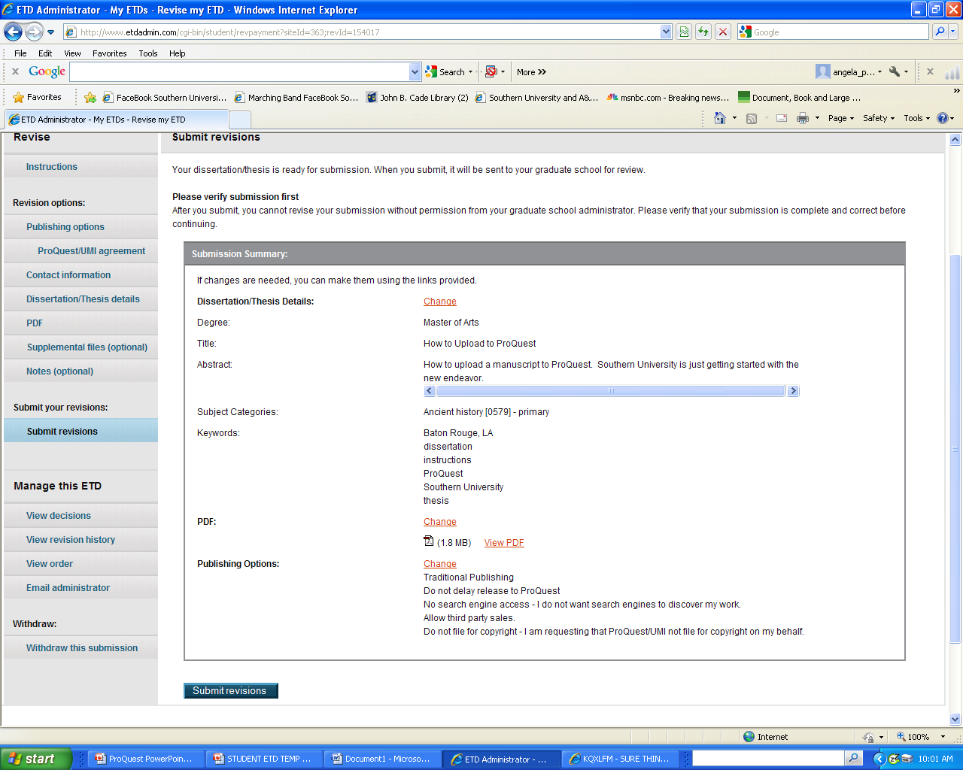
The Revisions screen comes up again. Click “Submit Revisions”. You also may change other aspects of your submission.

Slide 42
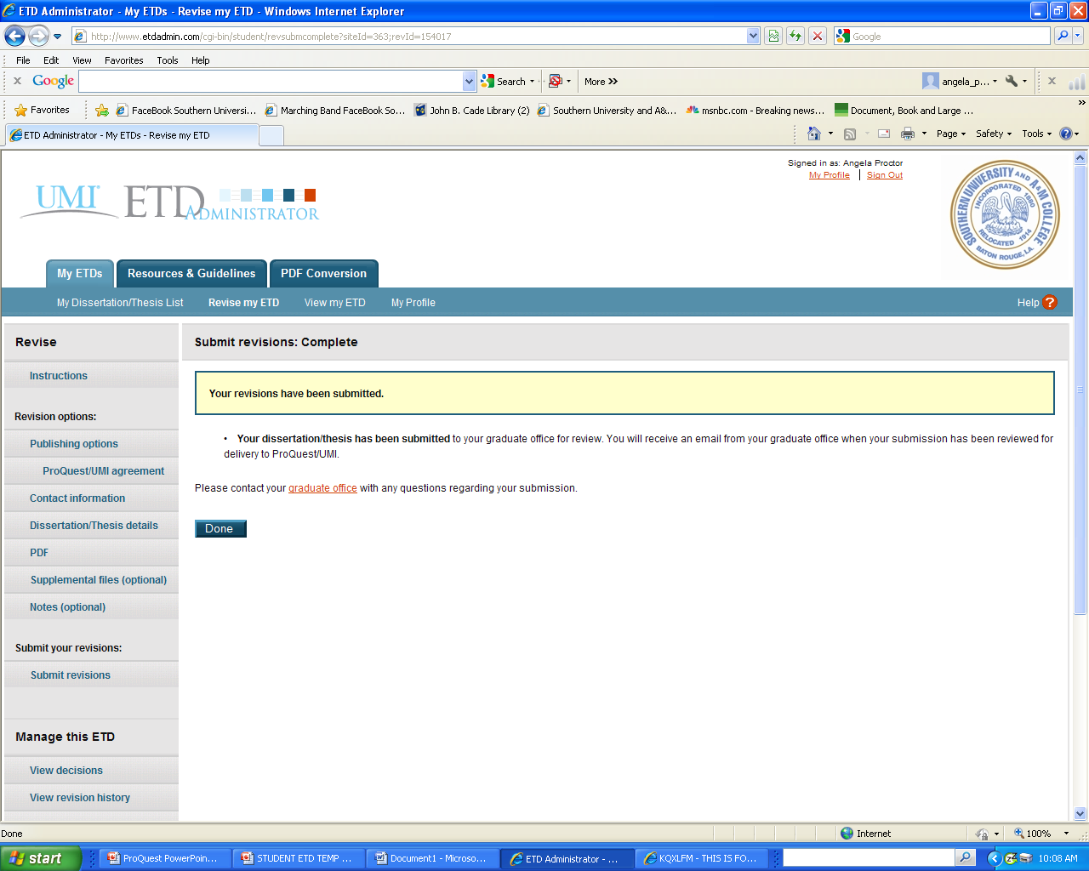
You will then see the following confirmation screen. Now click “Done”. You will receive another confirmation email as well. If you do not get an email message within a few hours of submitting, your document was not submitted properly and you need to try again.

Slide 43
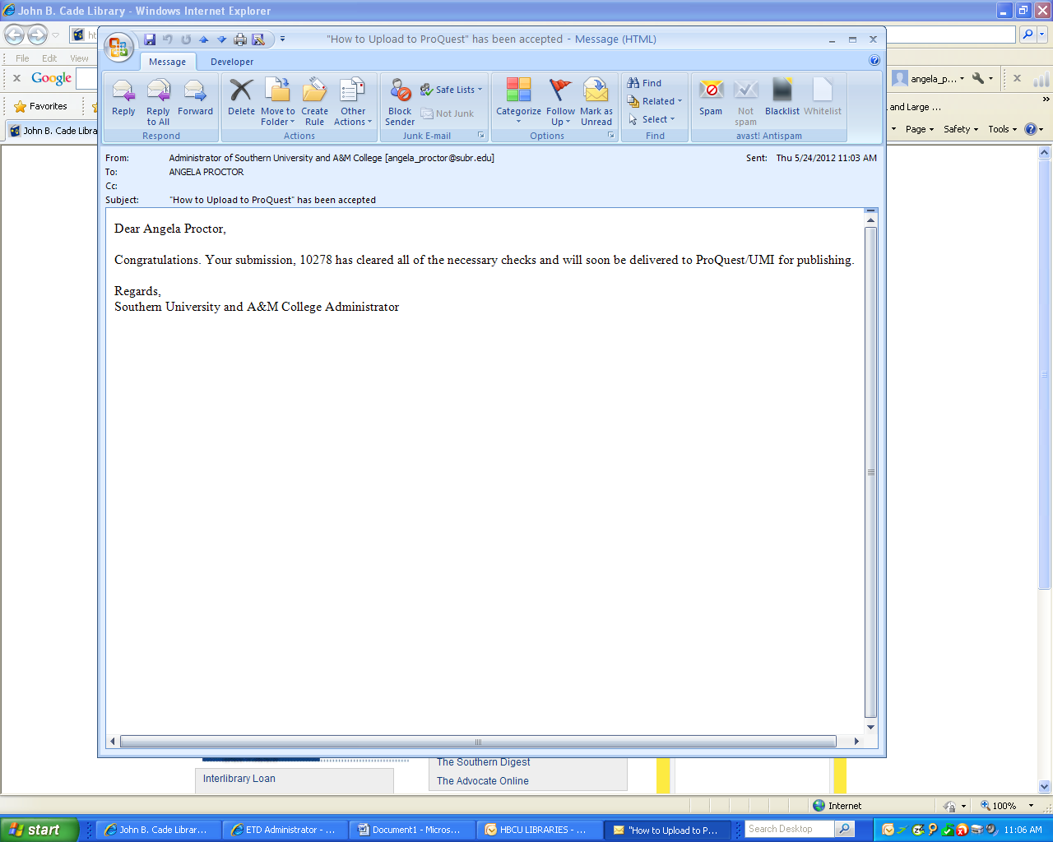
Once there are no more changes to be made to your document, you will receive an Acceptance email from the Graduate School. It will look like this:

Slide 44
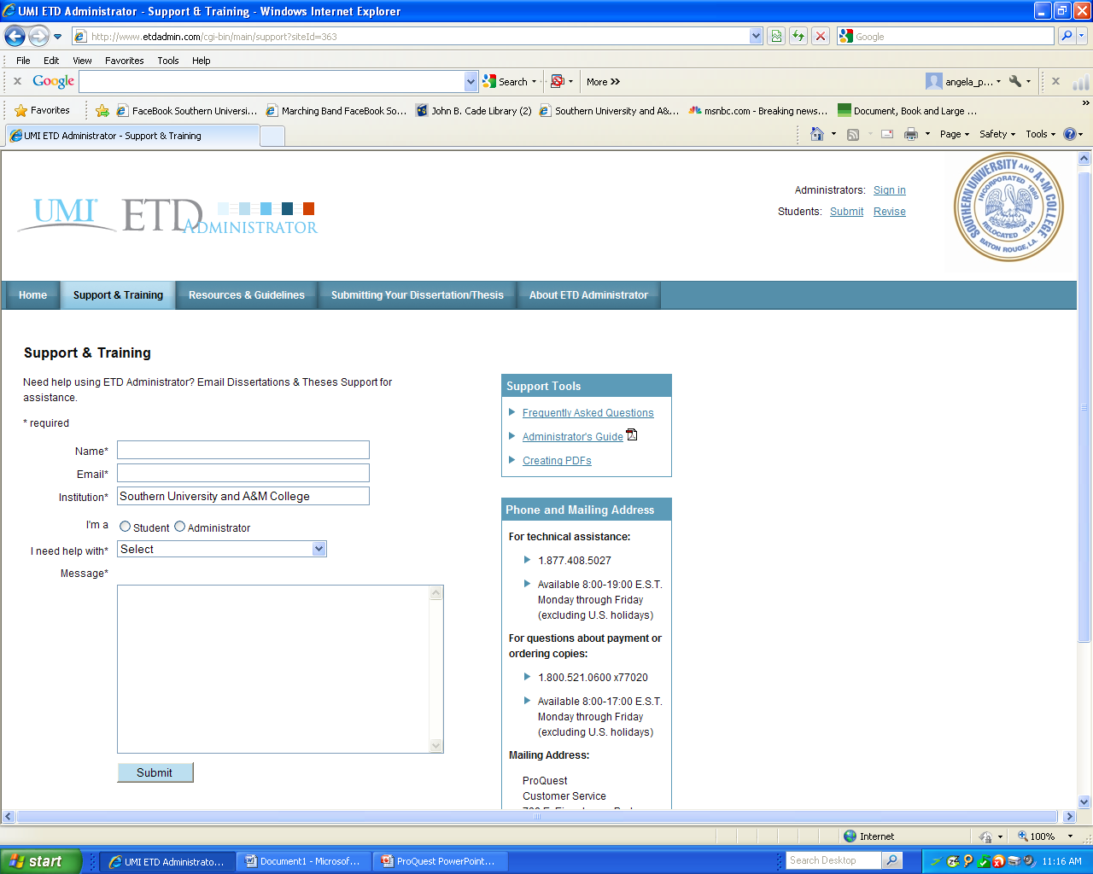
ETD Site Questions
If you have any questions regarding the ETD site or the submission process, please contact Technical Support or Author & School Relations via the Support and Training tab of the ETD site.

Slide 45
ADDITIONAL PROCESS ITEMS FOR CONSIDERATION
After Acceptance:
After your document has been accepted your submission will be locked by the Staff Administrator.
No more changes should or can be made to your document. If you find something that you absolutely must change, email and ask that your account be unlocked. Please inform the graduate school and your advisor of your recent changes and be sure to include why you want your document unlocked.

Slide 46
OTHER ADMINISTRATIVE DOCUMENTS:
Required documents for completing commencement procedures:
ALL Graduate Student must complete the University Exit survey
Ph.D Students (only) – Survey of Earned Doctorates
https://sed.norc.org/doctorate/showRegister.do
(Ph.D students only). After the completion of the Survey of Earned Doctorates please forward the confirmation completion email to Dr. Butler in the graduate school. Email address is: doze_butler@subr.edu

Slide 47
ProQuest Contact Information
For Technical Assistance:
Phone:1-877-488-5027
For Questions about Payment or Ordering Copies:
Phone: 1-800-521-0600-X77020
Mailing Address:
ProQuest
Customer Service
789 E. Eisenhower Parkway
Post Office Box 1346
Ann Arbor, MI 49106-1346
USA
If you would like to inquire about the status of your submission after it has been approved and sent by the graduate school, you may contact the Author and School Relations group at disspub@proquest.com or 800-521-0600 x77020. Please include your manuscript ID with your query; the ID was included in the confirmation email sent to you by the ETD Administrator.

