Slide 1
On-Campus Supervisor Training

Slide 2
Training Agenda
Job Posting
Review and Hire Applicants
Approved for Hire
Questions
Timesheets

Slide 3
Access JobX & TimesheetX

Slide 4
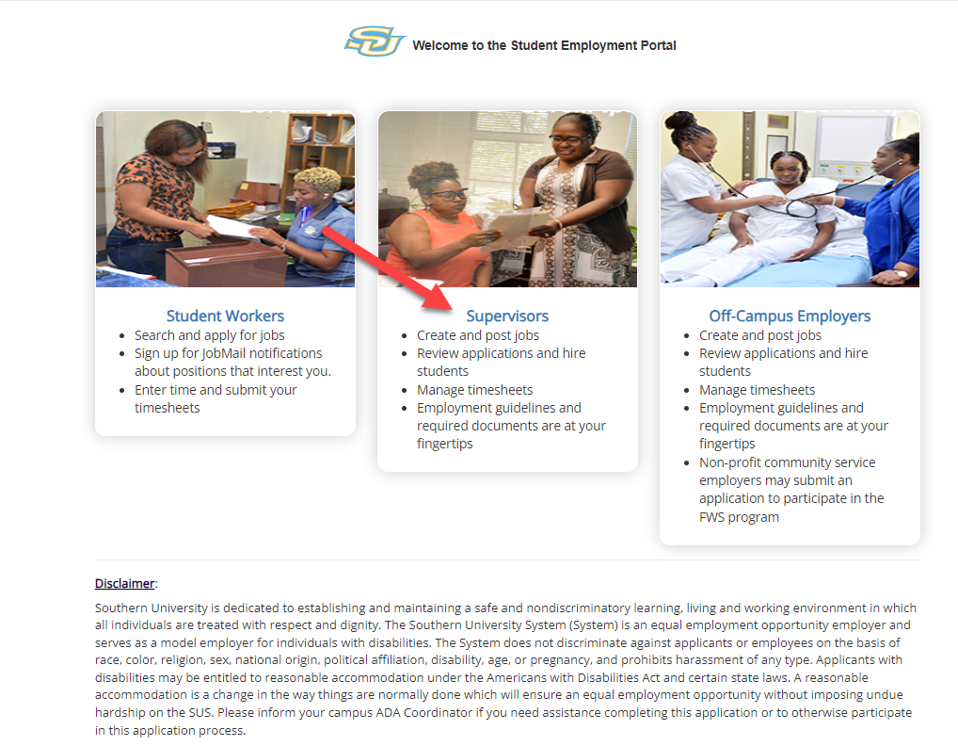
Access JobX & TimesheetX
Navigate to your school’s customized JobX/TimesheetX Site.
Then click on the
‘Supervisors’ link.
Southern University JobX/TimesheetX Site:
https://subr.studentemployment.ngwebsolutions.com/

Slide 5
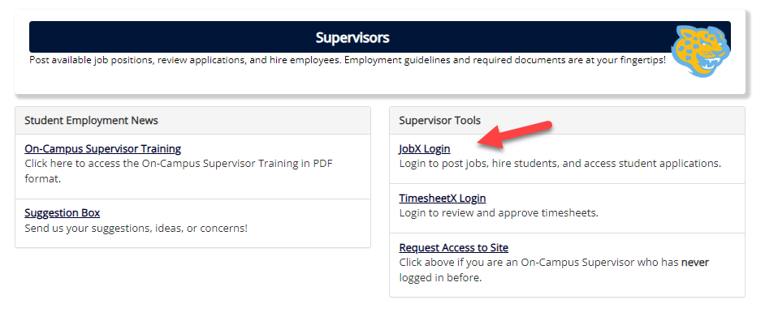
On-Campus Supervisor JobX Login
After access approval, click the ‘JobX Login’ link to login to the system to land on the Job Control Panel.

Slide 6
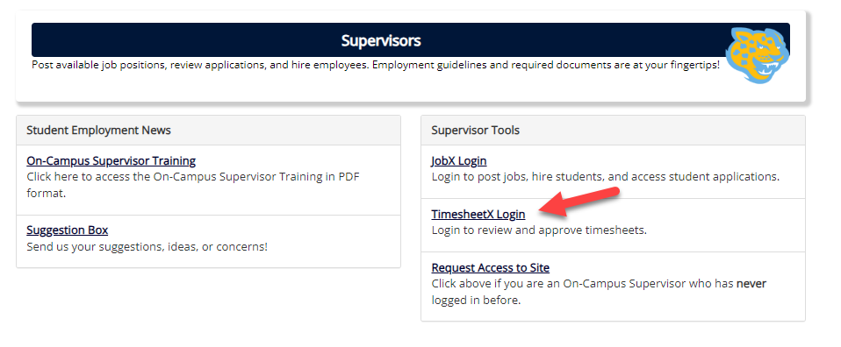
On-Campus Supervisor TimesheetX Login
After access approval, click the ‘TimesheetX Login’ link to login to the system to land on the Timesheet To Do screen.

Slide 7
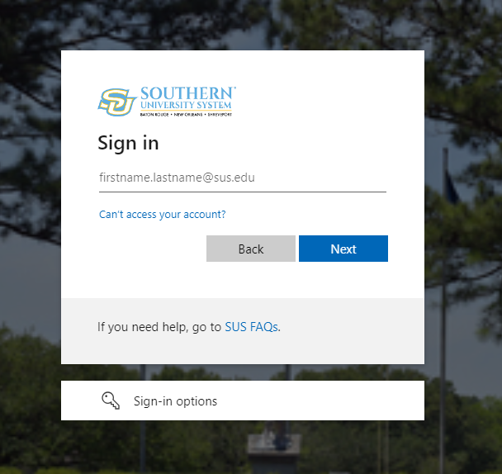
On-Campus Supervisor Login to JobX & TimesheetX
Login utilizing your Southern University ‘SSO ID’ and ‘Password’.

Slide 8
Job Postings

Slide 9
Create a Job Posting
How do I post a job in JobX?

Slide 10
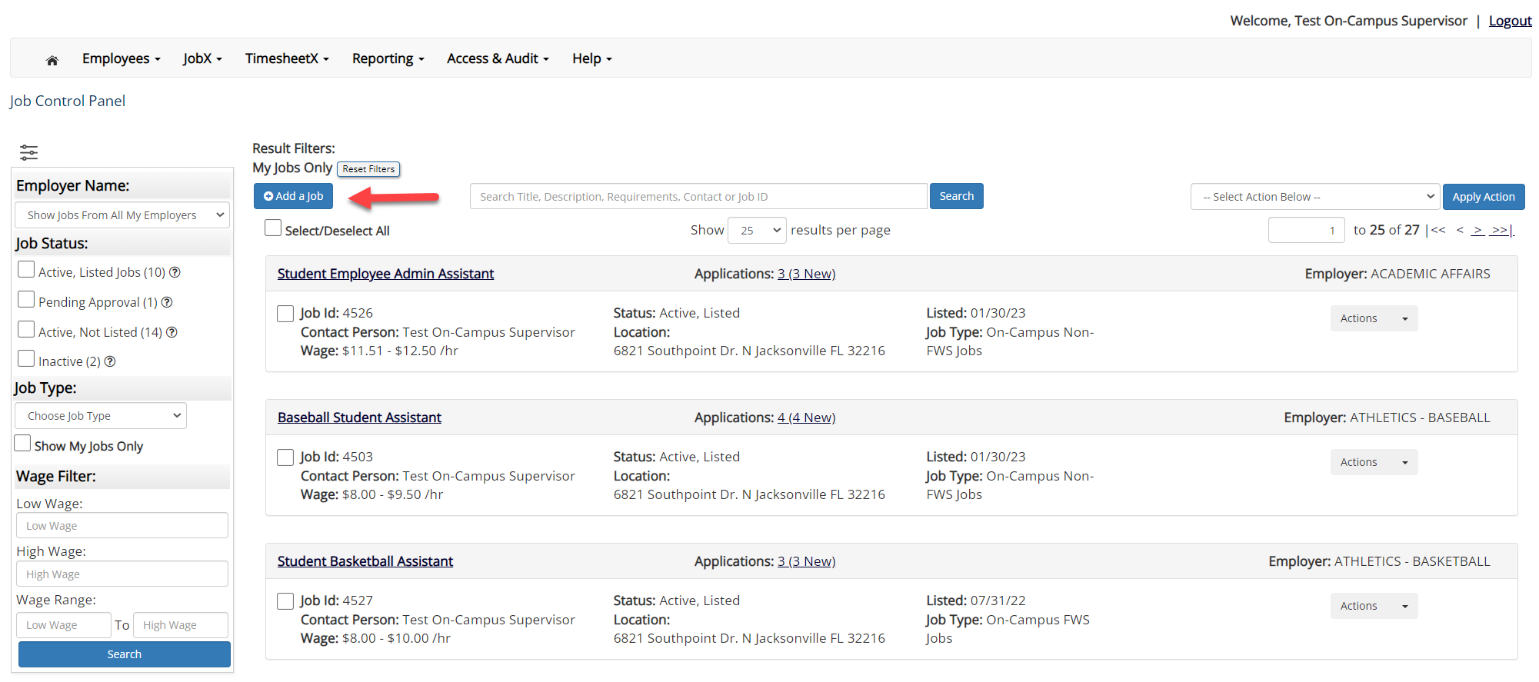
Create a Job Posting – Add a Job
On the Job Control Panel, click ‘Add a Job’ button to start the process to create an on-campus job.

Slide 11
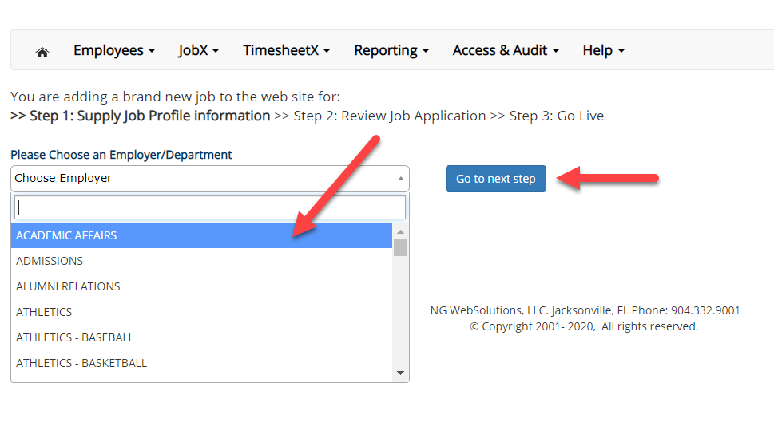
Create a Job Posting - Department
If you have posting permissions for more than one department, Select the department for which you want to post a job from the ‘Employer/Department Name’ drop down list.
Next click ‘Go to next step’ button to proceed.
Note: If you only have permissions to post for one department, please proceed to the next slide.

Slide 12
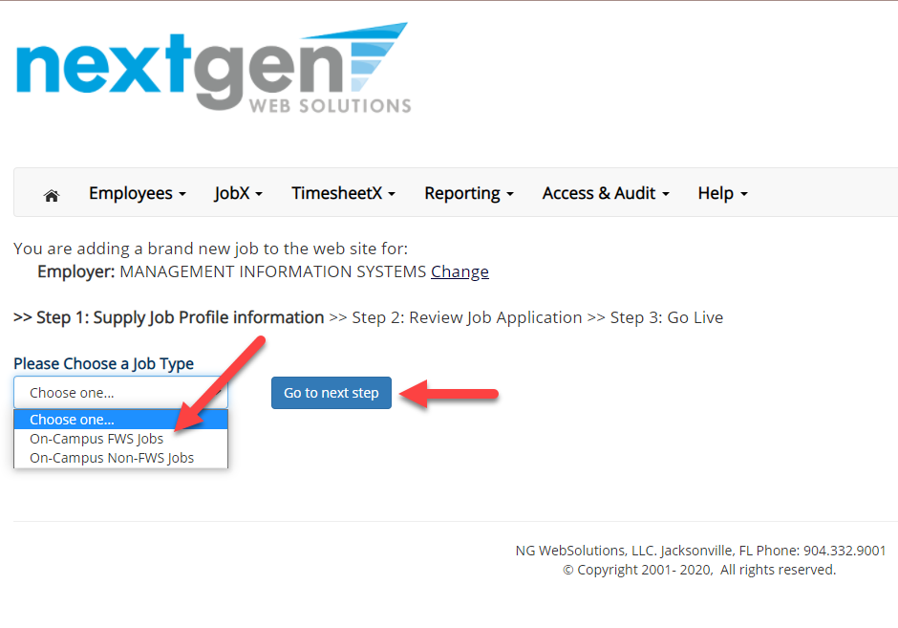
Create a Job Posting – Job Type
If you have posting permissions for more than one job type, you will select the job type for which you want to post a job from the ‘Job Type’ drop down list.
Then click ‘Go to next step’ to proceed.

Slide 13
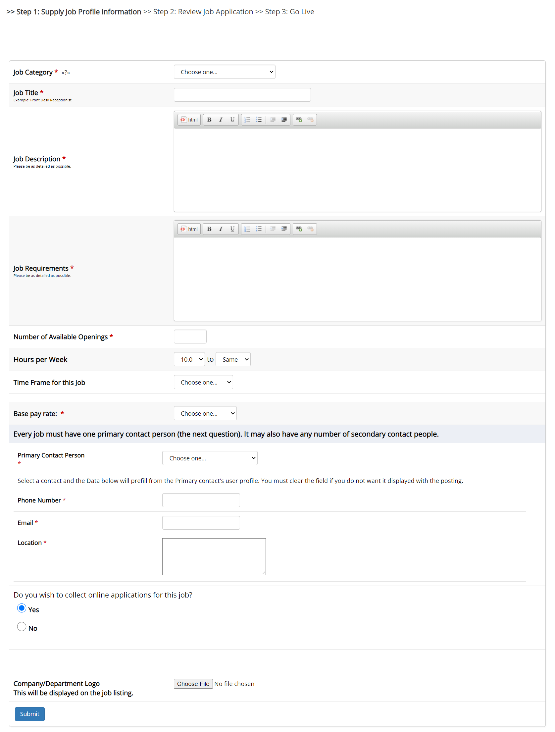
Create a Job Posting – Complete Job Posting Template
Complete the Job Posting Template.
The Job Posting Template may vary depending on the job type selected.
Fields denoted with a red * are required fields.
Lastly, click ‘Submit’ to continue the next steps in the process.
Important Note: If your school has loaded your contact information (e.g. Phone Number, Fax Number, & Office Address), these fields will be pre-filled systematically. If not, you may optionally enter your Phone Number, Fax Number, E-Mail Address, and Location so an applicant can contact you, if desired.

Slide 14
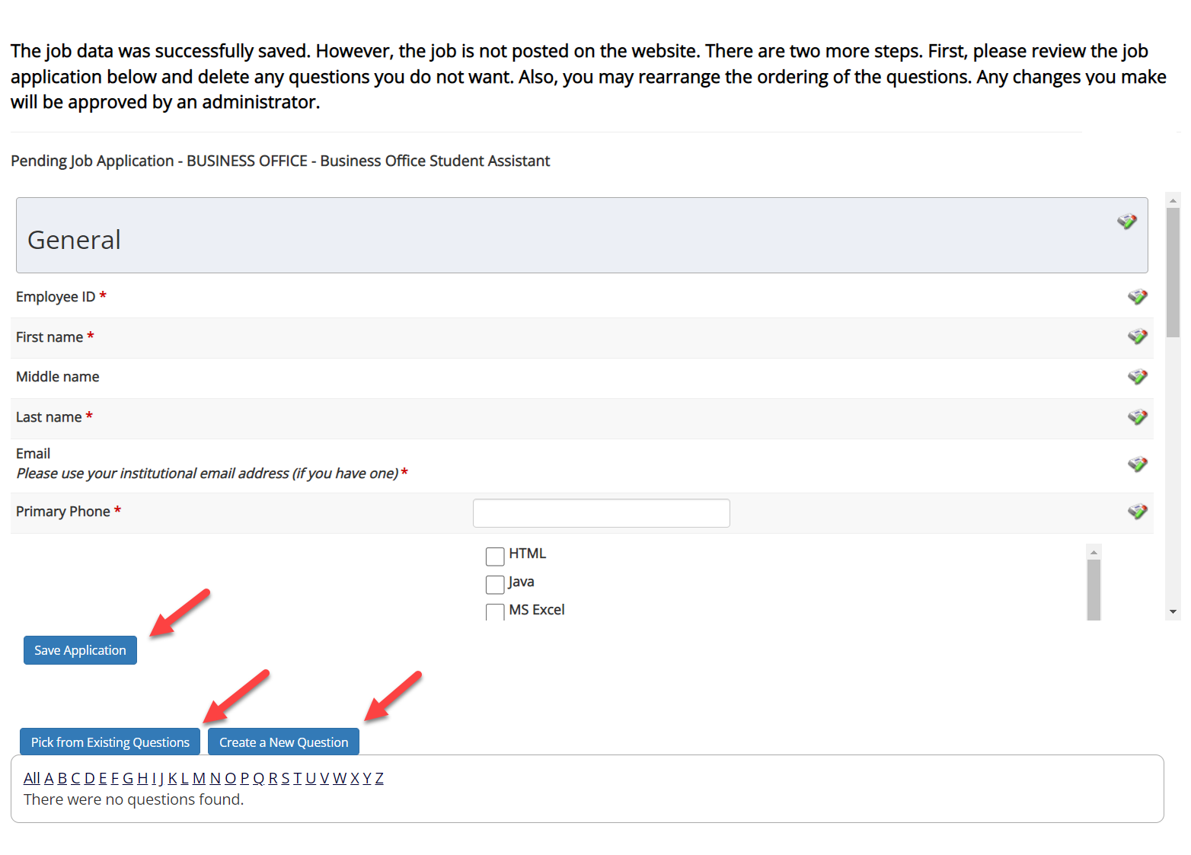
Create a Job Posting – Review Default Application

Slide 15
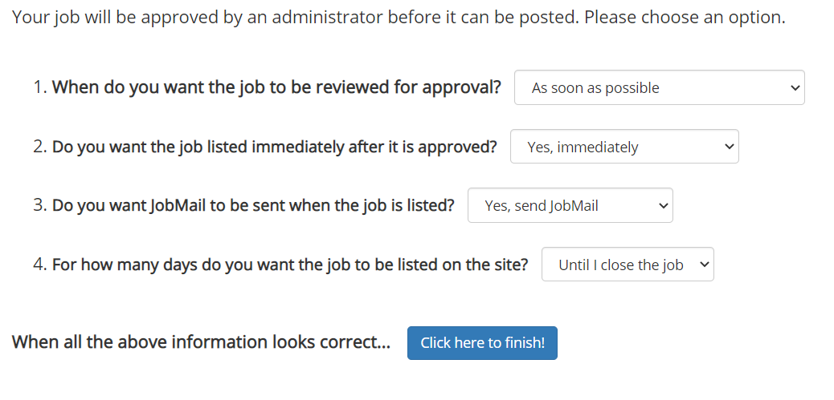
Create a Job Posting – Finalize Job Posting – Step 1
When do you want the job to be reviewed for approval?
Select ‘As soon as possible’ from the list if you want the job to be reviewed for approval immediately.
Select ‘Later – I need to review it myself first’ if you wish to review the job further before approval. The job will be placed in Active, Not Listed until you are ready for approval.
Do you want the job listed immediately after it is approved?
Select ‘Yes, immediately’ from the list if you wish upon approval for the job status to be Active, Listed.
Select ‘No, put it in inactive for me’ from the list if you wish upon approval for the job status to be Inactive.
Select ‘No, put it in Active, Not Listed for me’ from the list if you wish upon approval for the job status to be Active, Not Listed.
Do you want JobMail to be sent when the job is listed?
Select ‘Yes, send JobMail’ from the list is you want this posting to be included in JobMail that will send a notification to students if your job is in an Active, Listed status.
Select ‘No, do not send JobMail’ from the list is you do not want this posting to be included in JobMail notification student message.

Slide 16
Create a Job Posting – Finalize Job Posting – Step 2
4. For how many days do you want the job to be listed on the site?
If you want the job to be posted until you close the job, select ‘Until I close the job.’
If you want to designate a specific period of time the job should be posted, select the applicable duration from the drop-down list.
Click the “Click here to Finish!” button.
Your job will be submitted to the Student Employment Office for review/approval.

Slide 17
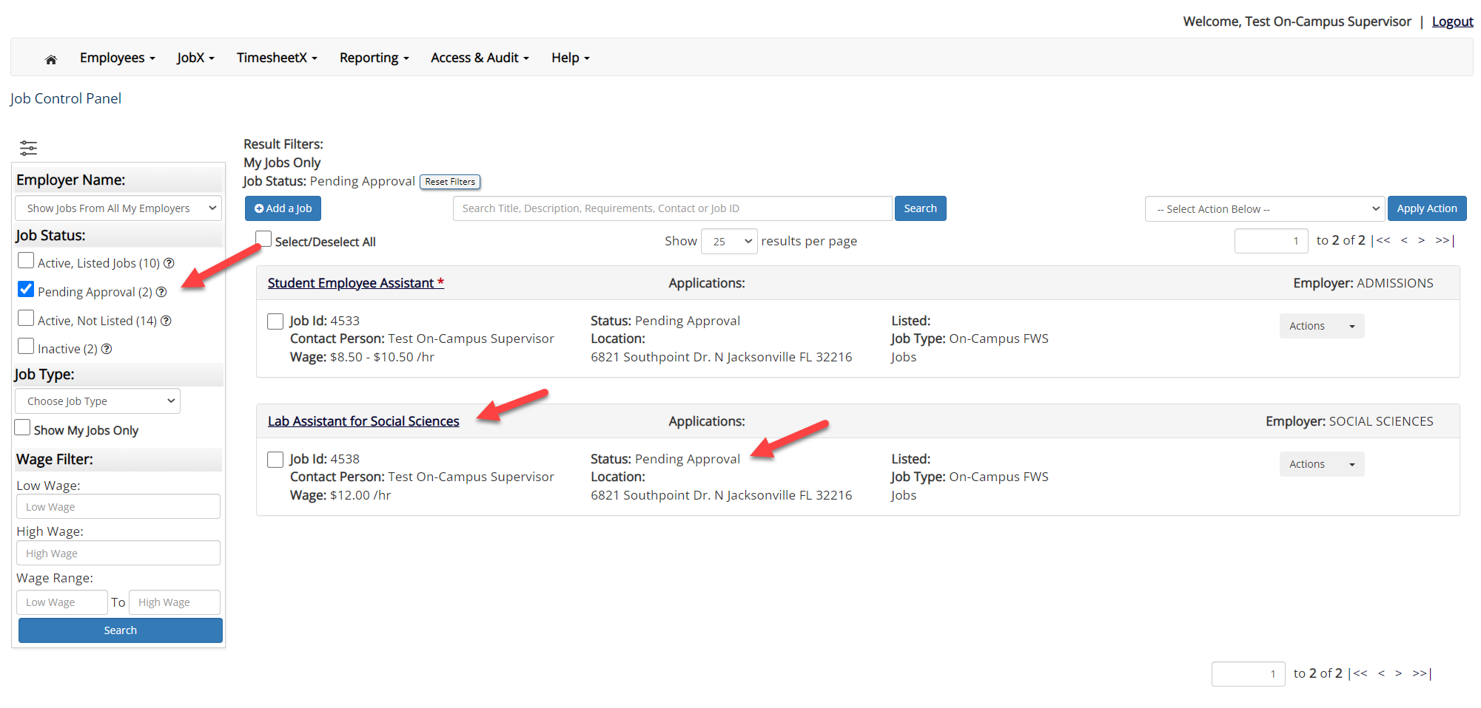
Create a Job Posting – Pending Approval
You may either print your job details or click ‘Return to your control panel’ to view and/or manage your jobs further.
If you choose to return to the control panel, the job you just added can be located in the ‘Pending Approval’ queue.

Slide 18
Edit a Job Posting
What steps do I take if my Job Posting needs updating?

Slide 19
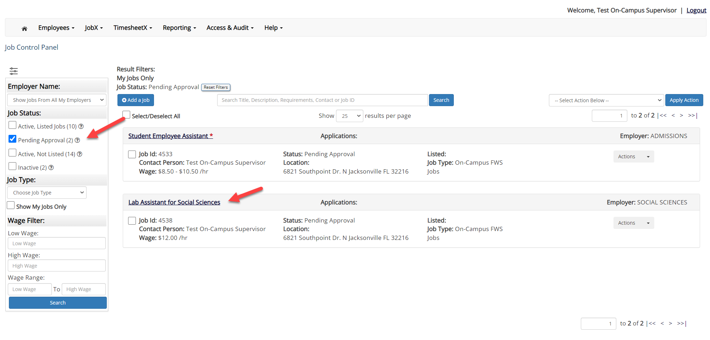
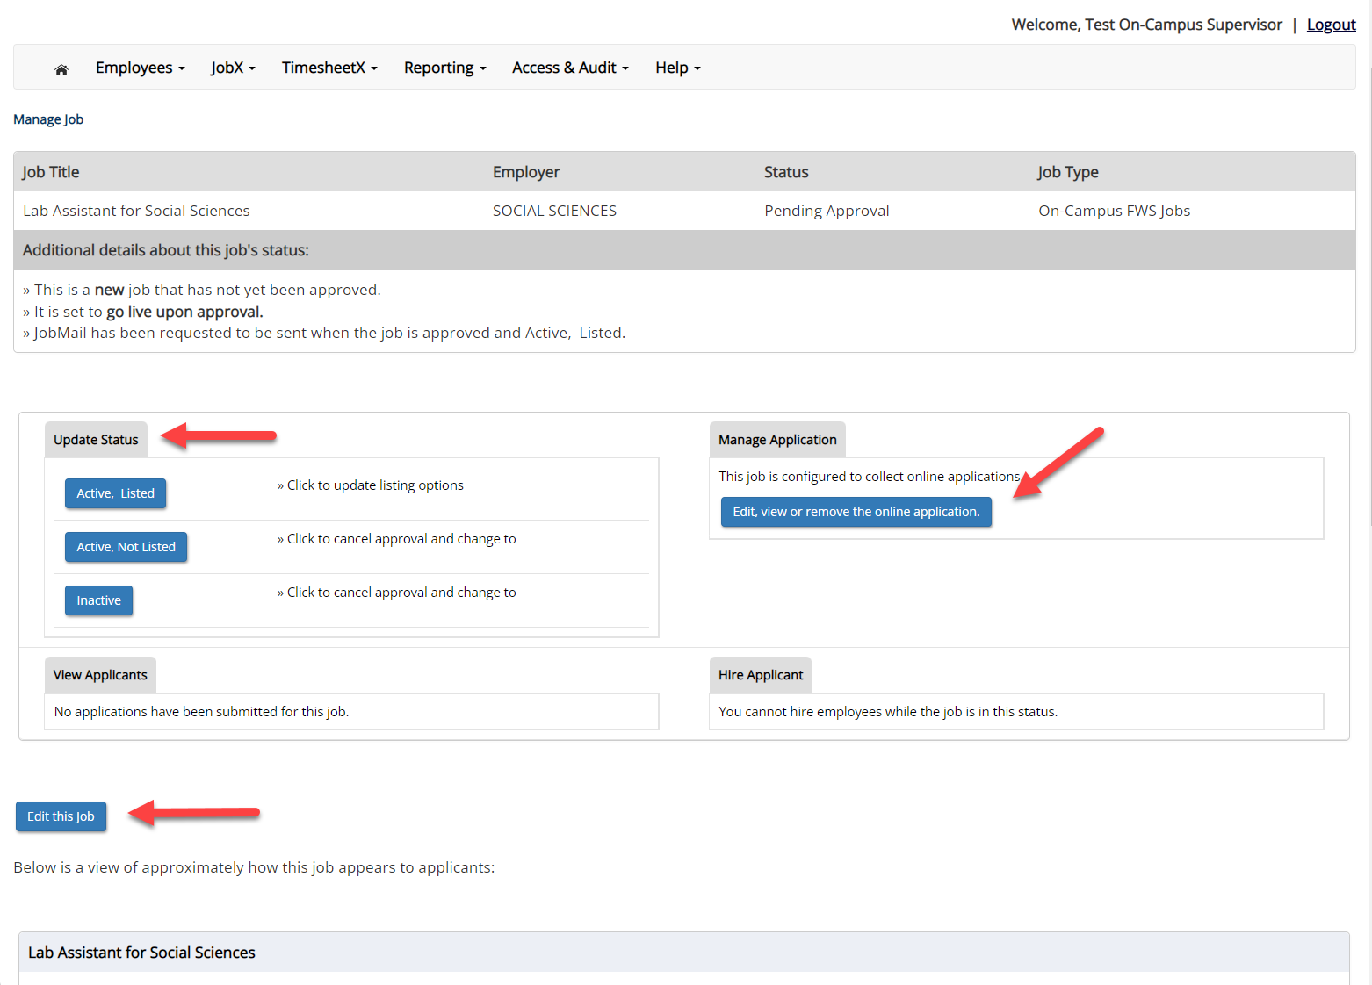
Edit a Job Posting
You may view the job and/or application details or request the job status be changed by simply clicking on the Job Title link.
To edit the job, click ‘Edit this Job’ button on the ‘Manage Job’ page.
To edit the application tied to your job, click ‘Edit or View the Online Application’.

Slide 20
Review & Hire Applicant(s)

Slide 21
Job Posting Approved - Next Steps
Manage Applications
Interview and Selection
Hire Applicant
Decline Application

Slide 22
Manage Applications
How do I review applications for my job posting?

Slide 23
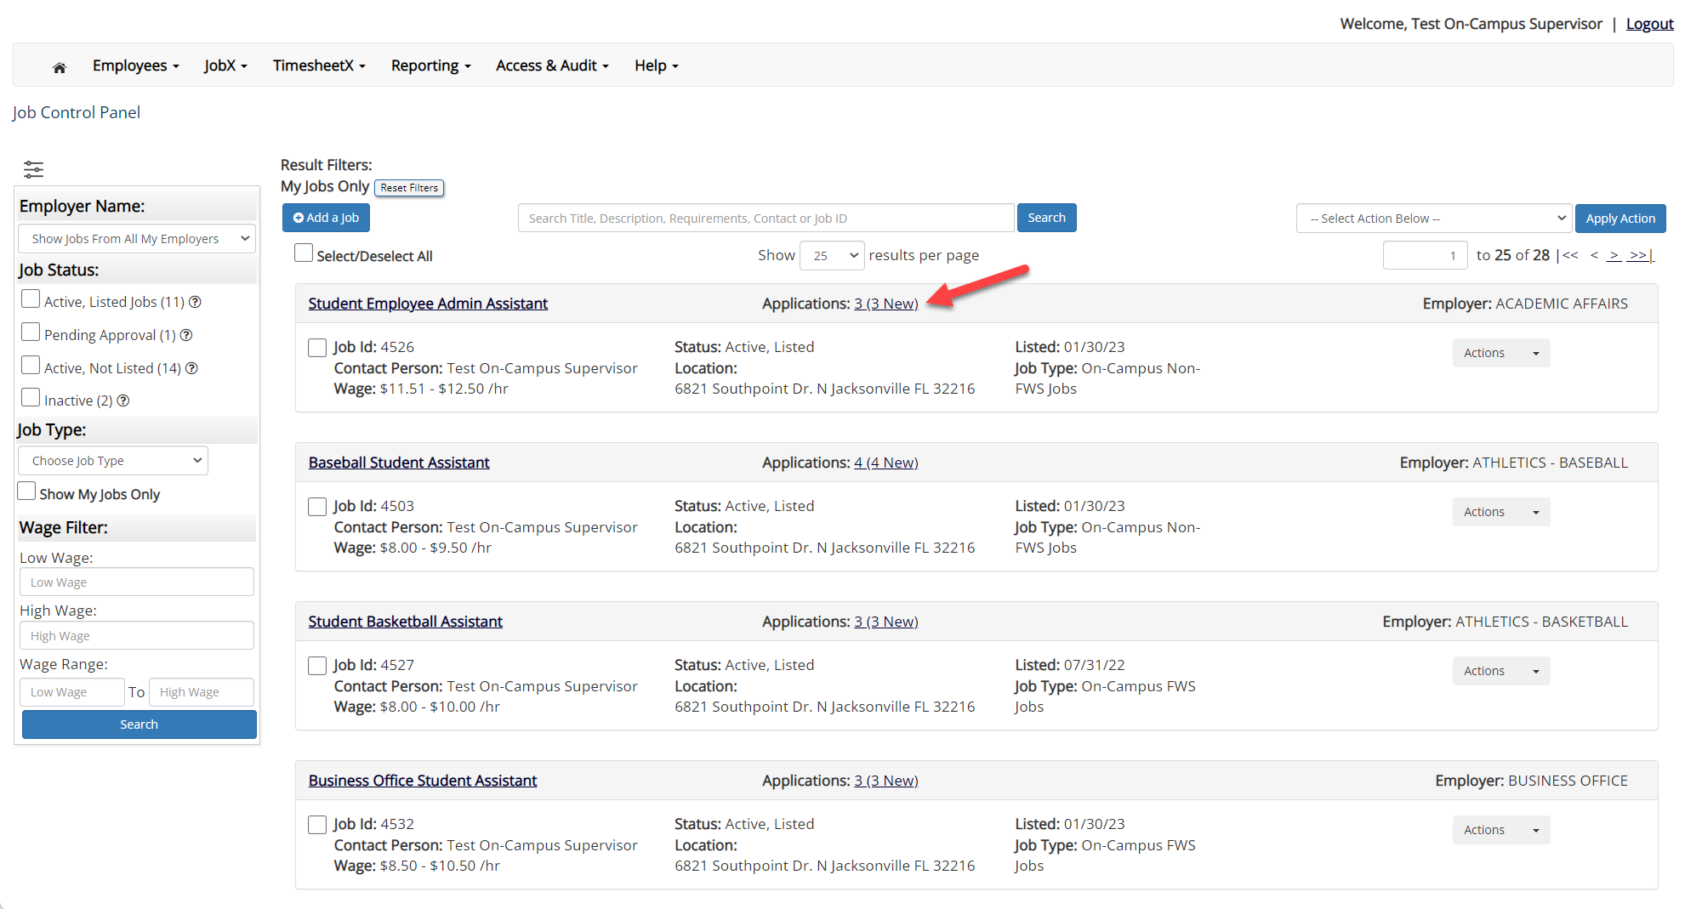
Manage Applications
You may hire an online applicant by clicking the ‘Applications’ link next to the job title or ‘Hire Applicant’ from the action drop down menu.

Slide 24
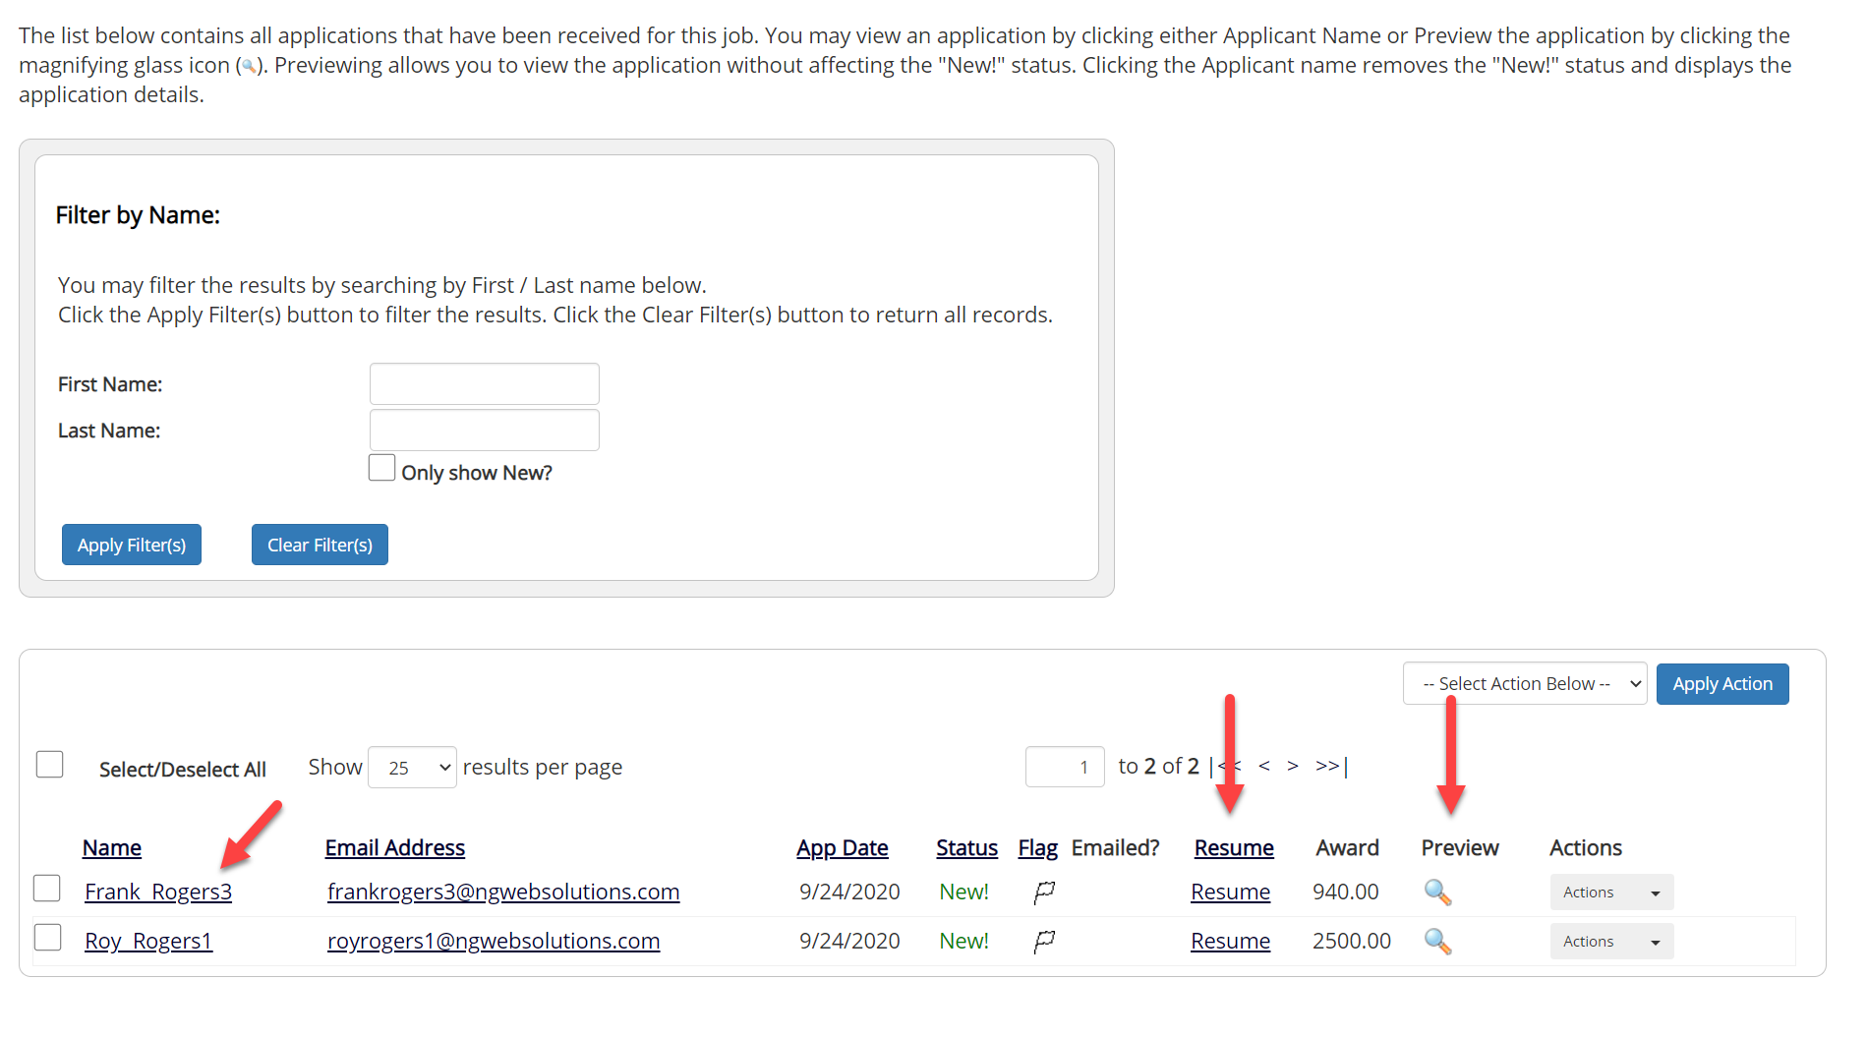
Manage Applications
Click the Applicants Name link to view the application in a full screen view.
Click the magnifying glass next to the student’s name to get a quick view format of the application.
If the student has provided a resume, click on the “Resume” link next to their name.

Slide 25
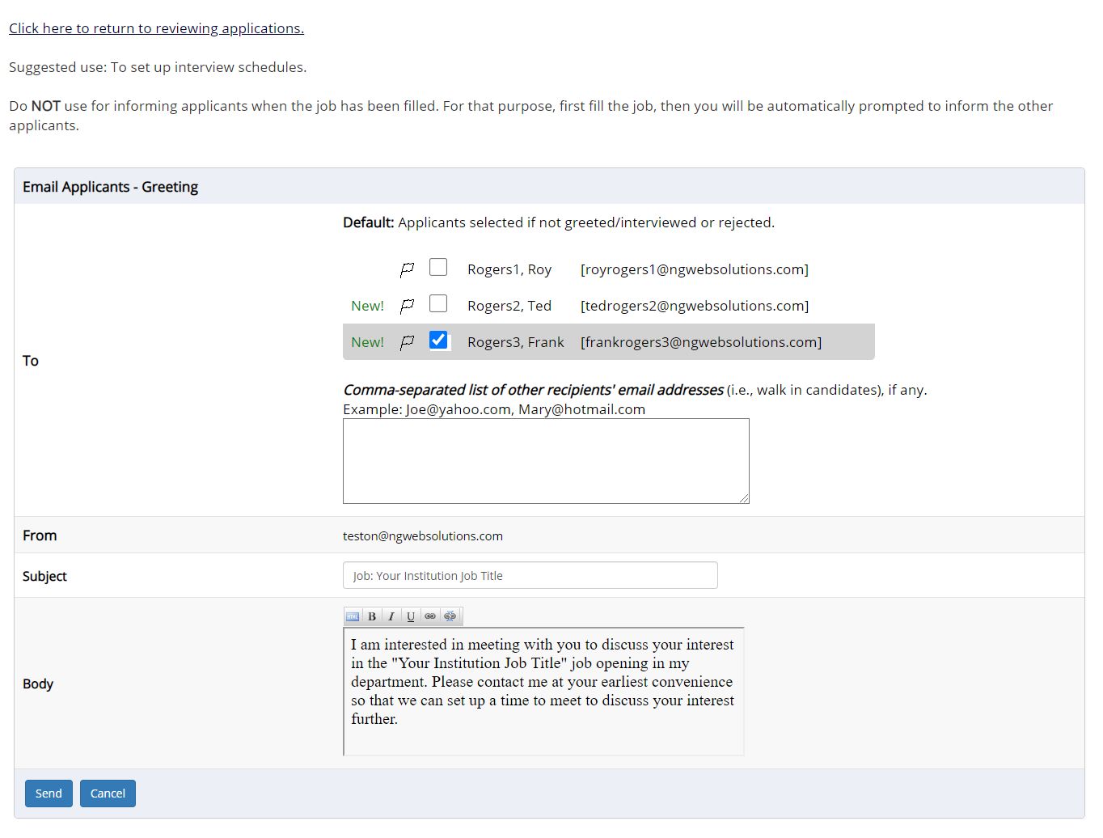
Schedule an Interview
This feature is utilized to reach out to one or more students.
If you select more than one student to interview, individual e-mails will be sent to each student selected. If you don’t wish to interview an applicant, please be sure the box next to that candidate is not checked.
You may change the text in the body of the e-mail or add other email recipients in the ‘To’ box, then click on the “Send” button.

Slide 26
Decline Applicants
How do I decline an applicant or applicants who will not be hired for the job?

Slide 27
Notify applicant(s) they were NOT Selected
Click the box next to one or more applicants you would like to send a rejection email.
Next, select the ‘Send Reject Email’ action.
Finally click, ‘Apply Action’

Slide 28
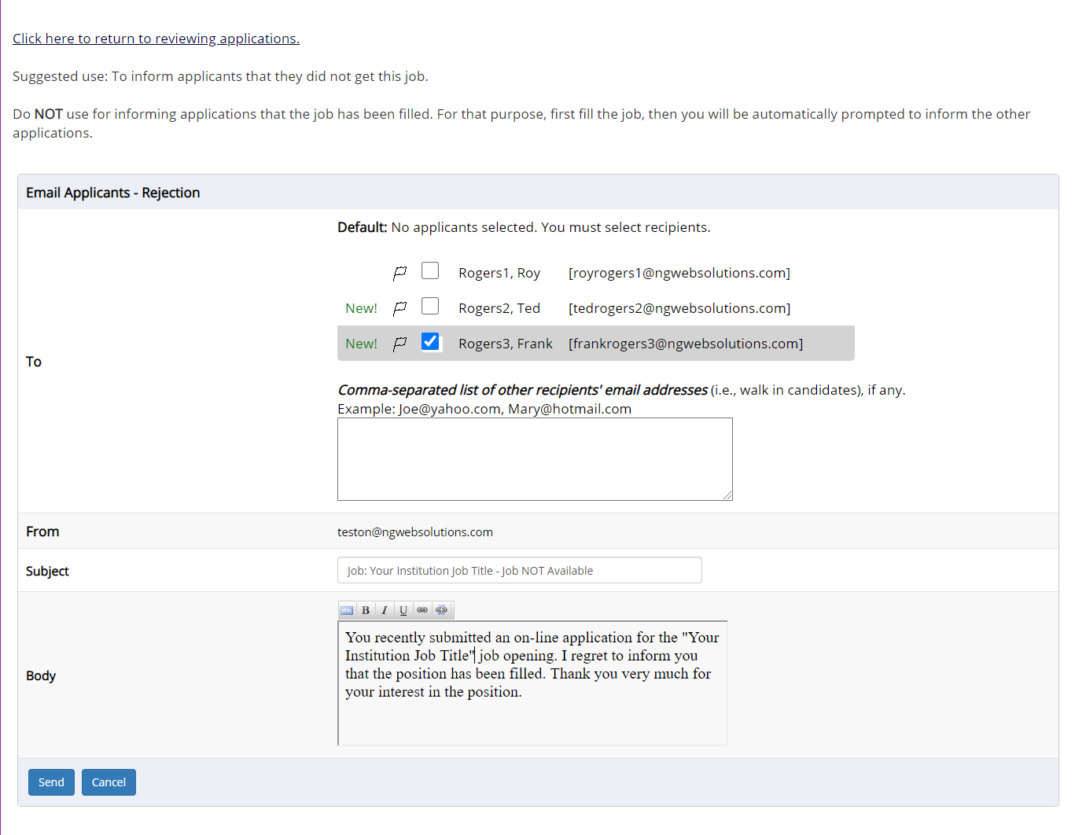
Notify applicant(s) they were NOT Selected
This feature is utilized to inform one or more students they did not get this job.
If you select more than one student to reject, individual e-mails will be sent to each student selected. If you don’t wish to reject an applicant, please be sure the box next to that candidate is not checked.
You may change the text in the body of the e-mail or add other email recipients in the ‘To’ box, then click on the “Send” button.

Slide 29
Hire Applicants
How do I hire an applicant or applicants?

Slide 30
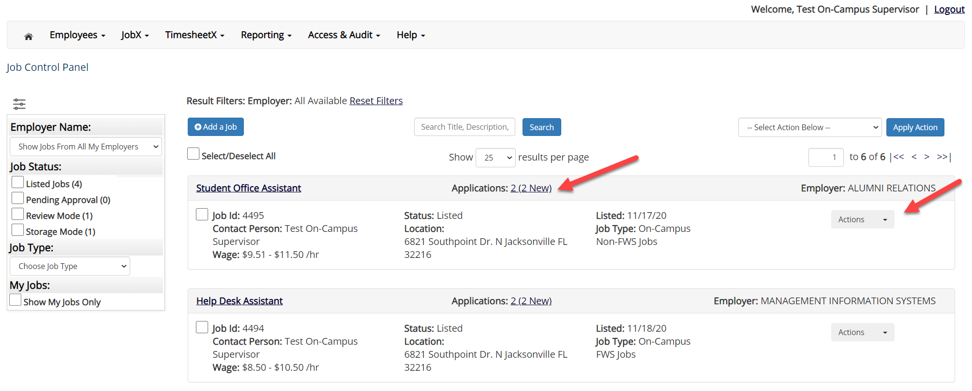
Hire an Applicant – Select Applicant
To hire an applicant, click on the ‘Applications’ link or select ‘Hire Applicant’ from the action drop down menu. This is also used to hire or rehire an applicant that did not submit an application.

Slide 31
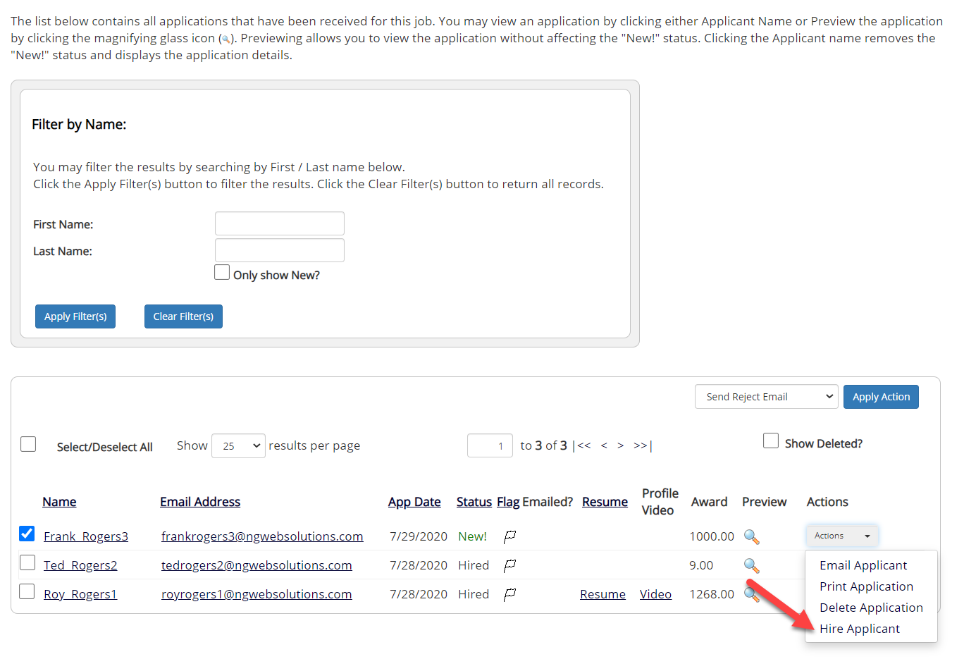
Hire an Applicant – Select Applicant who Applied
If you wish to hire the applicant, please select ‘Hire Applicant’ from the Actions dropdown list next to the applicant’s name you wish to hire.

Slide 32
Hire an Applicant – Applied to Job Posting
The applicant’s name will be automatically selected for you if you are hiring from an application. Otherwise, to hire an applicant who did not apply you will need to enter their information manually.
Next, click ‘Go to Step 2’.

Slide 33
Hire an Applicant – Verification of Student ID
The Employee’s ID provided by the applicant in their job application will be defaulted into the ID field. If the applicant mis-keyed their student ID, you may correct their ID by typing over the pre-filled ID.
Please note: If their ID has been mis-typed, they will likely fail the hire process as the system validates against the Employee ID provided to JobX by your institution.
Next, click ‘Check Employee ID’ to launch the hire validation service for this employee.

Slide 34
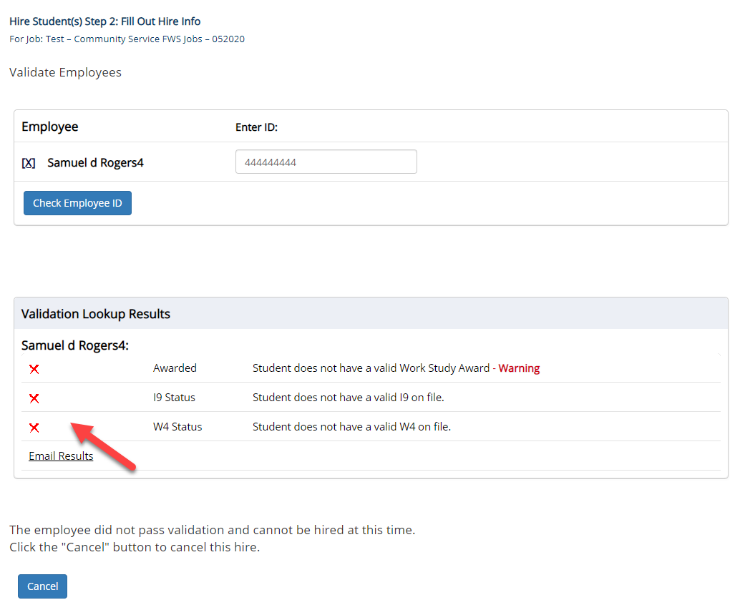
Hire an Applicant– Compliance Validation - Warning
The system will validate the employee’s account to ensure they are eligible to be hired.
If the employee does NOT pass one or more of the employment eligibility checks, the system will present a red X next to each eligibility requirement the employee did not meet.
If the supervisor wishes to email the employee regarding the employment eligibility results in an effort to get them resolved, they can click the ‘Email results’ link to open an email. The results of their validation check will be pre-filled in the body of the email. The supervisor can type additional text in the body of the email and add other recipients of the email in the cc or bc fields.
The supervisor will need to click the ‘Continue’ button to save their hire request or Cancel if the employee cannot be hired at that point in time.

Slide 35
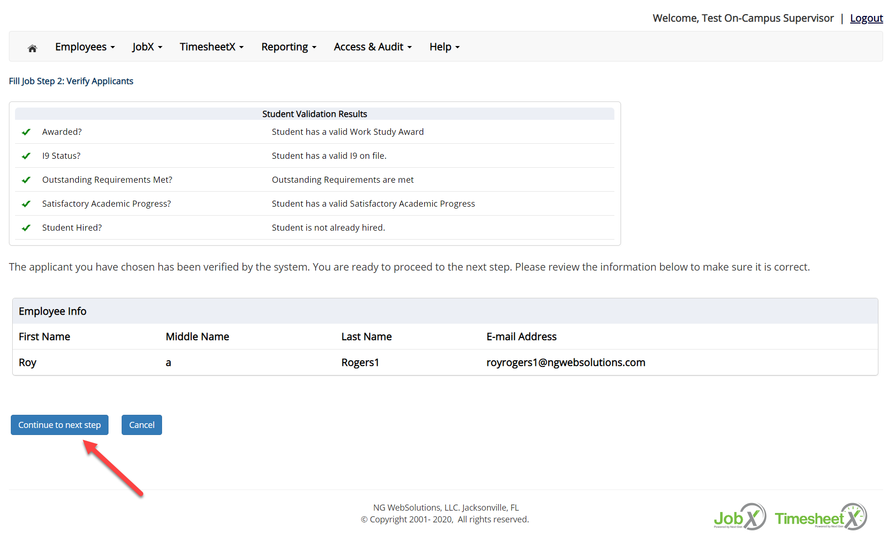
Hire an Applicant– Compliance Validation - Pass
If all the employment eligibility requirements have been successfully met, green check marks will be presented next to each eligibility requirement and a “Continue” button will be presented to continue the hire process.

Slide 36
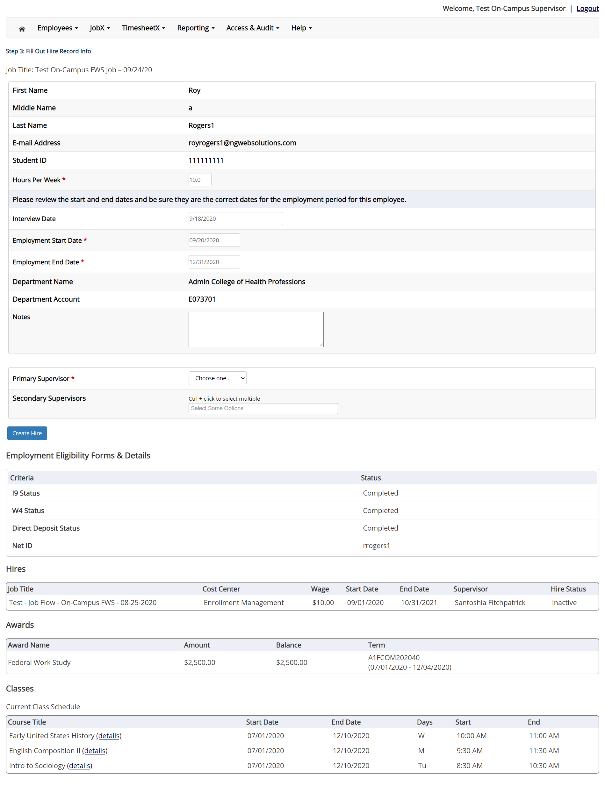
Hire an Applicant – Hire Approval Request
Data from the original job listing will be pre-filled in the Hire Request Form to reduce your data entry efforts.
You may edit the information prior to establishing the hire.
Click on the “Create Hire” button.

Slide 37
Hire Request - Pending
Where do I view Pending Hire Requests?

Slide 38
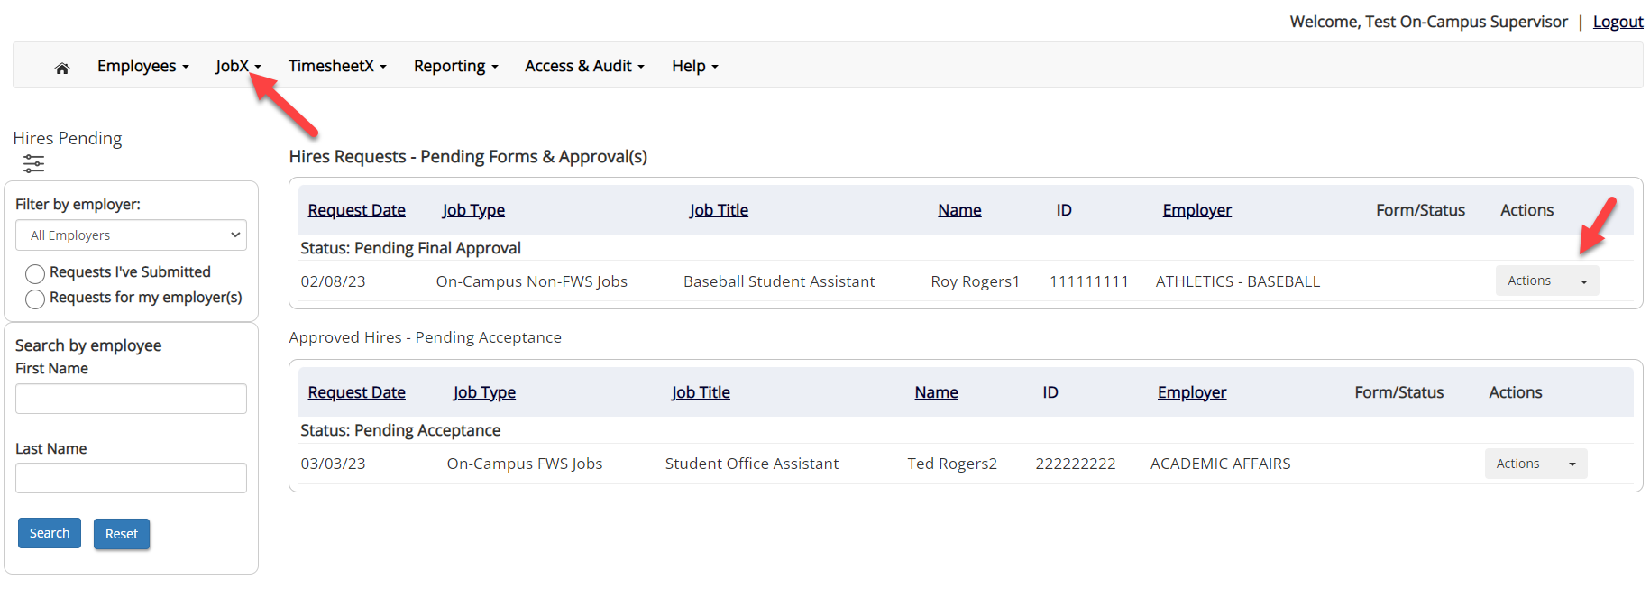
Hire Requests – Pending Approval
To view pending hire requests, you may click on the ‘JobX’ menu drop down and select ‘Hire Requests’.
In the ‘Action’ drop down, you have the option to ‘Preview’ the hire information, ‘Cancel’ the hire, or send a follow-up ‘Email’ to the student from this dashboard.

Slide 39
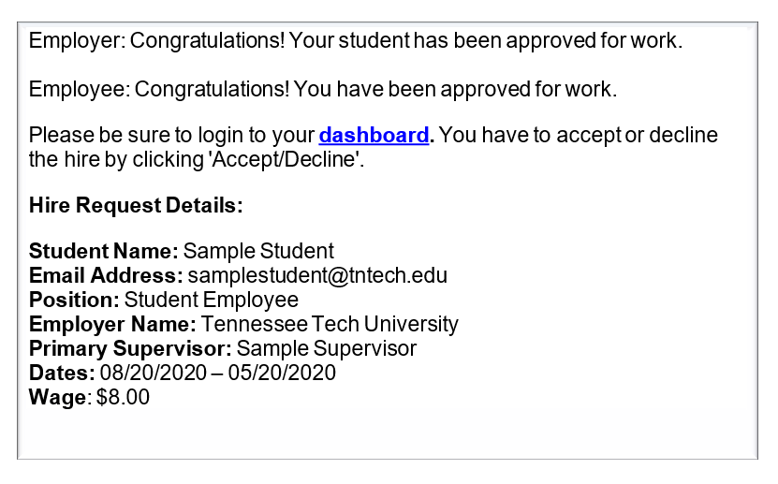
Hire Approval Email – Pending Acceptance
When the student has been approved to work you will receive the following email.
The student will need to accept the offer before they are officially hired.
You may follow up with these students on acceptance of the position through the ‘JobX’ menu item ‘Hire Requests’

Slide 40
Final Approval
Students are not approved to work, until they receive a Hire Approval e-mail stating they may begin work.

Slide 41
Questions?
Please contact the Human Resources at:
studentemployments@subr.edu

