Slide 1



Student Training

Slide 2

Login JobX & TimesheetX

Slide 3
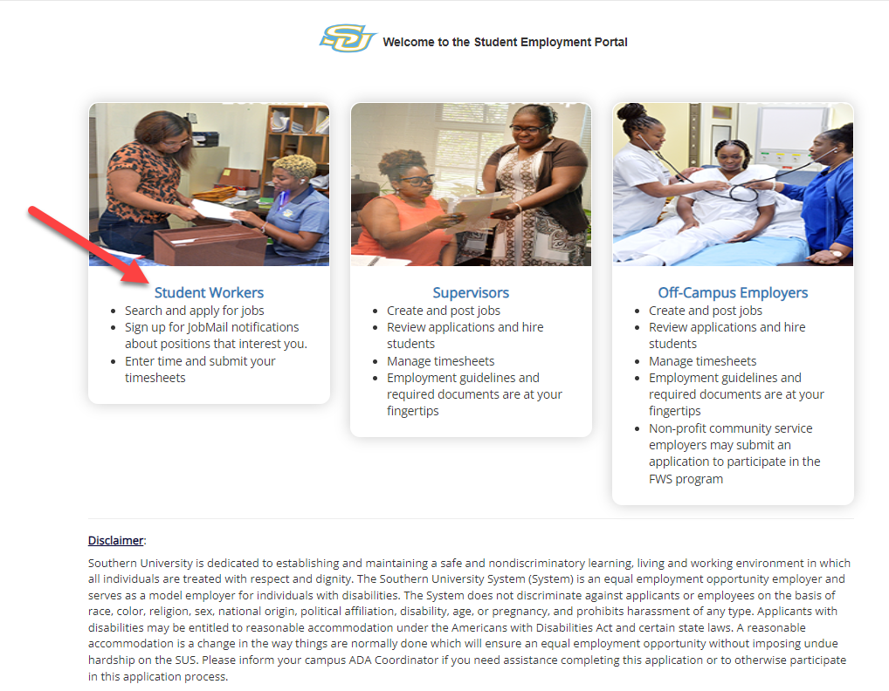
Login to JobX & TimesheetX
Navigate to your school’s customized JobX Site
Then click on the
‘Student Worker’ link to access the area of your choice.
Southern University JobX/TimesheetX Site:
https://subr.studentemployment.ngwebsolutions.com/

Slide 4
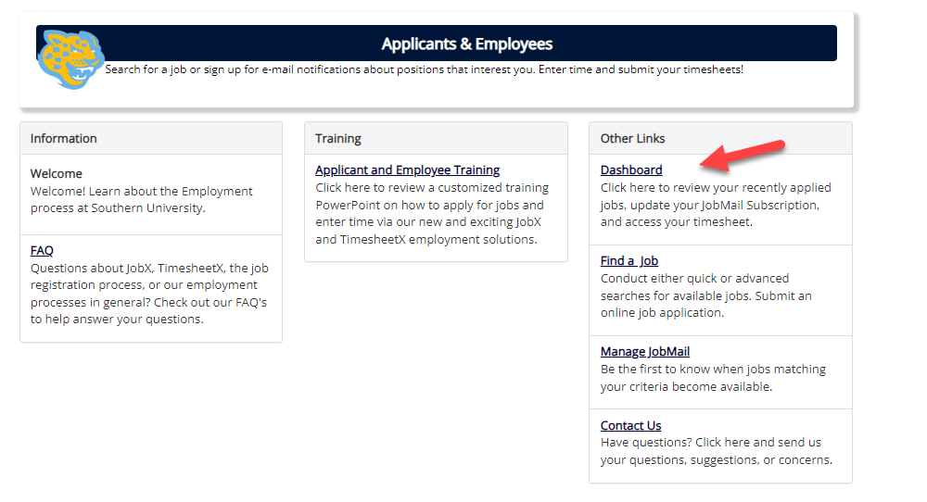
How to Login to JobX & TimesheetX
Step 1: Click ‘Dashboard’ for access to your dashboard and timesheets.

Slide 5
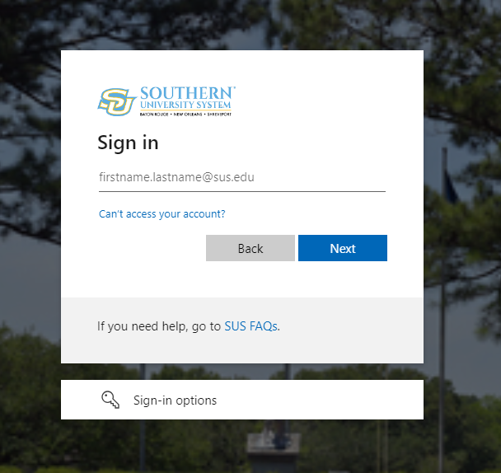
Student Employee
Login to JobX & TimesheetX
Login utilizing your Southern University ‘SSO ID’ and ‘Password’.

Slide 6

Timesheet Entry

Slide 7
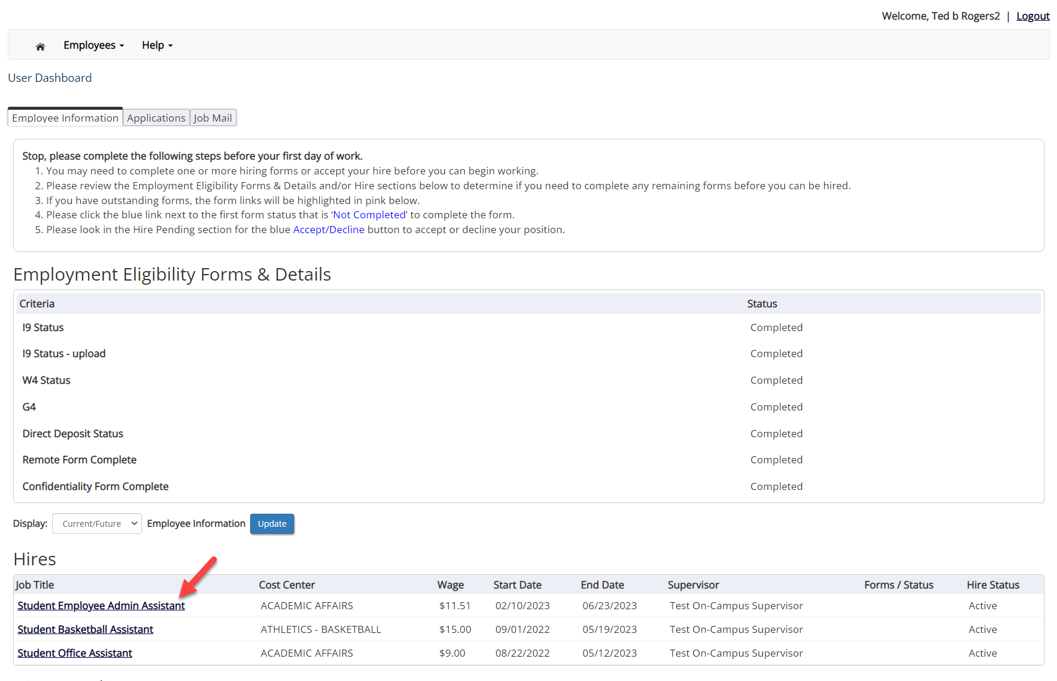
Enter My Time Worked
First, select ‘My Dashboard’ from the Employees menu.
Next, click the ‘Job Title’ link to access your timesheets.

Slide 8
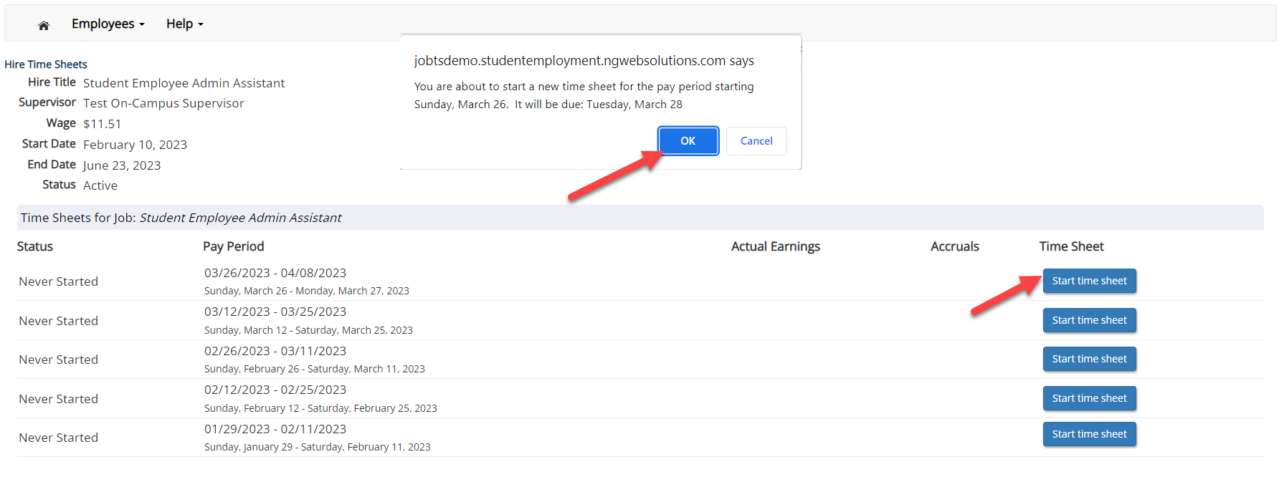
Start My Time Sheet
If this is the first time you are entering a timesheet for the current pay period, click the ‘Start Time Sheet’ button to the right of the pay period you wish to enter time. Click ‘OK’ button in the pop-up window.
Please Note: If a timesheet has already been started, the link will say ‘Go to time sheet’ instead.

Slide 9
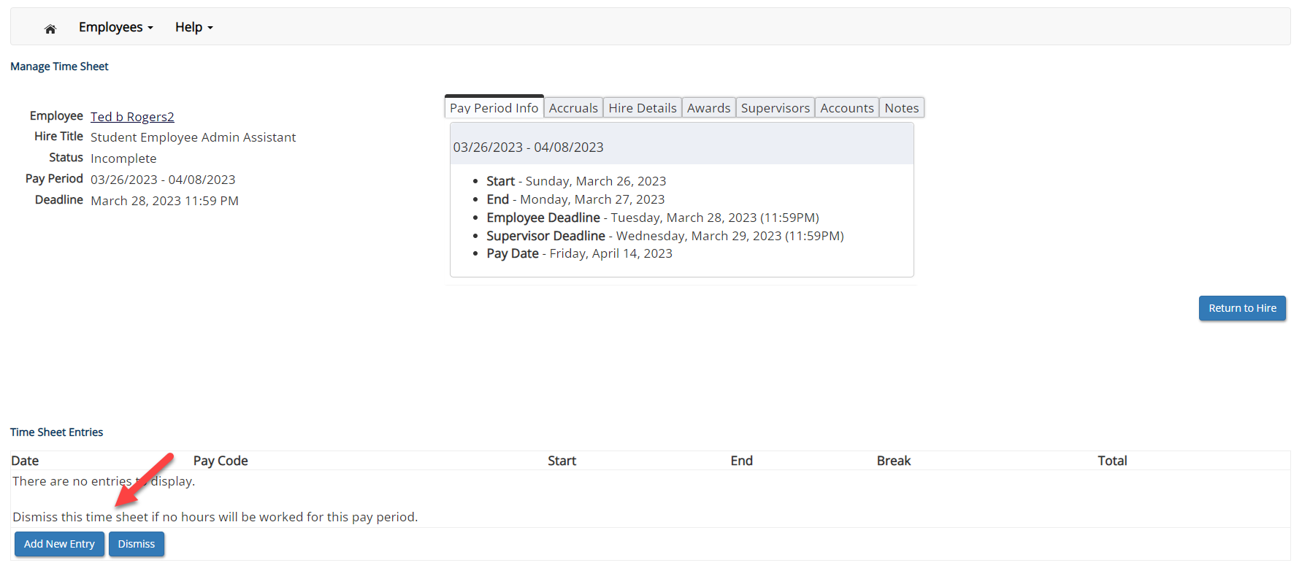
Add a New Timesheet Entry for Time Worked
Click ‘Add New Entry’ to enter your time.

Slide 10
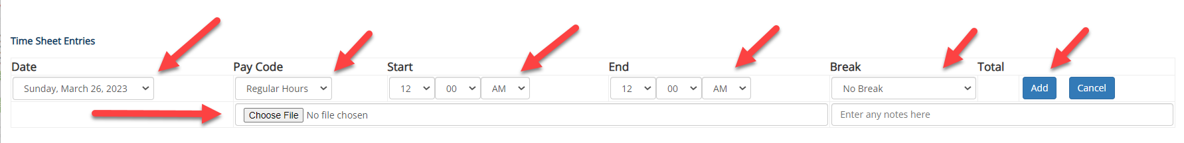
Add a New Timesheet Entry for Time Worked
Select the ‘Date’ of the time worked in the Date column.
Select the ‘Pay Code’ for the time reported, such as Sick Time, in the Pay Code column.
Select the ‘Start’ time of the time worked using the hour, minute and am/pm in the Start column.
Select the ‘End’ time worked using the hour, minute and am/pm in the End column.
You may optionally add break minutes, notes, and attachments if applicable.
Click ‘Add’ to save the timesheet entry.

Slide 11
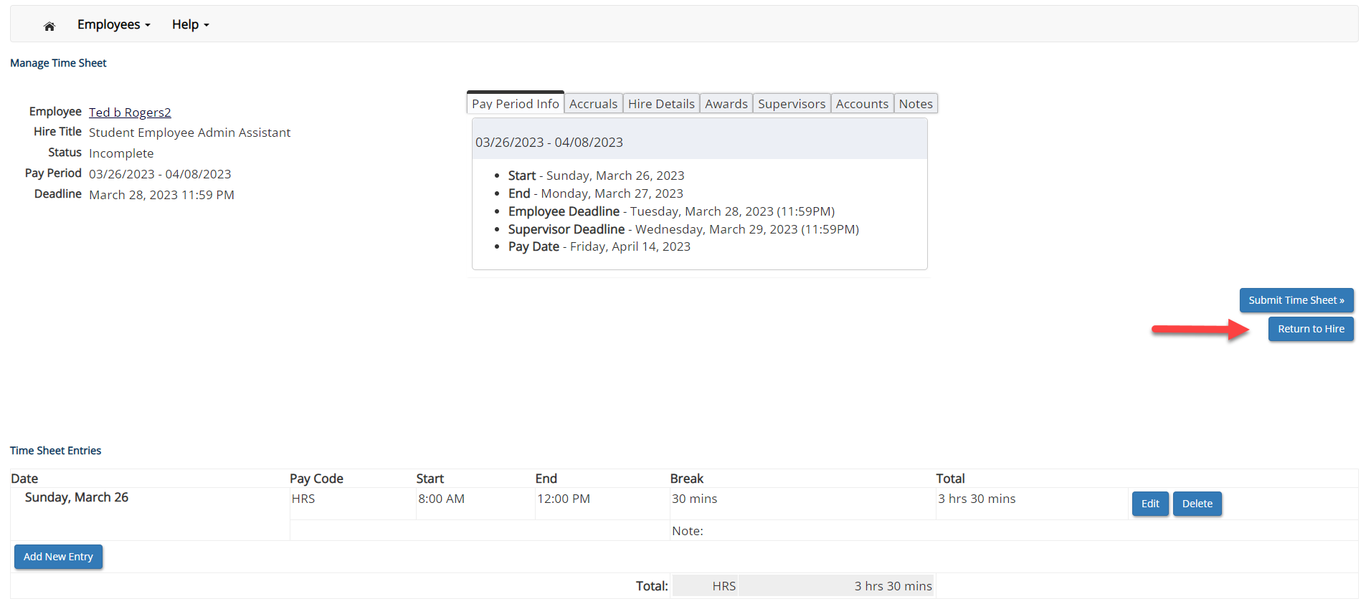
Add a New Timesheet Entry for Time Worked
If you’re finished entering time worked, click ‘Return to Hire’ to return to your list of job(s).
If you wish to log out, click the ‘Log out’ button and you will return to the JobX TimesheetX Home page.

Slide 12

Submit Timesheet

Slide 13
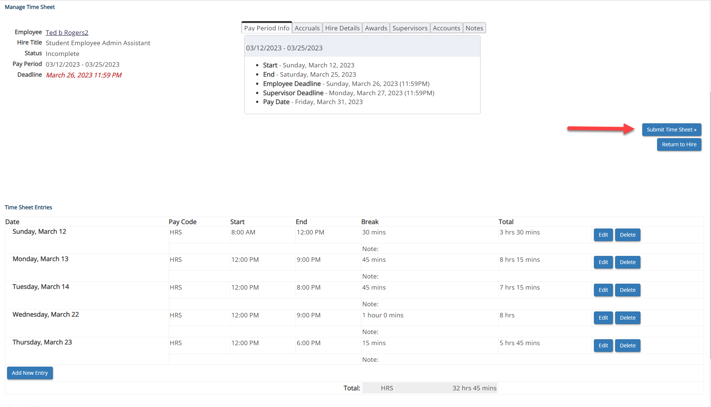
Submit Time Sheet to Supervisor
At the conclusion of the Pay Period, the employee will need to click the ‘Submit Time Sheet’ link to systematically pass their electronic time sheet to their supervisor for review and approval.

Slide 14
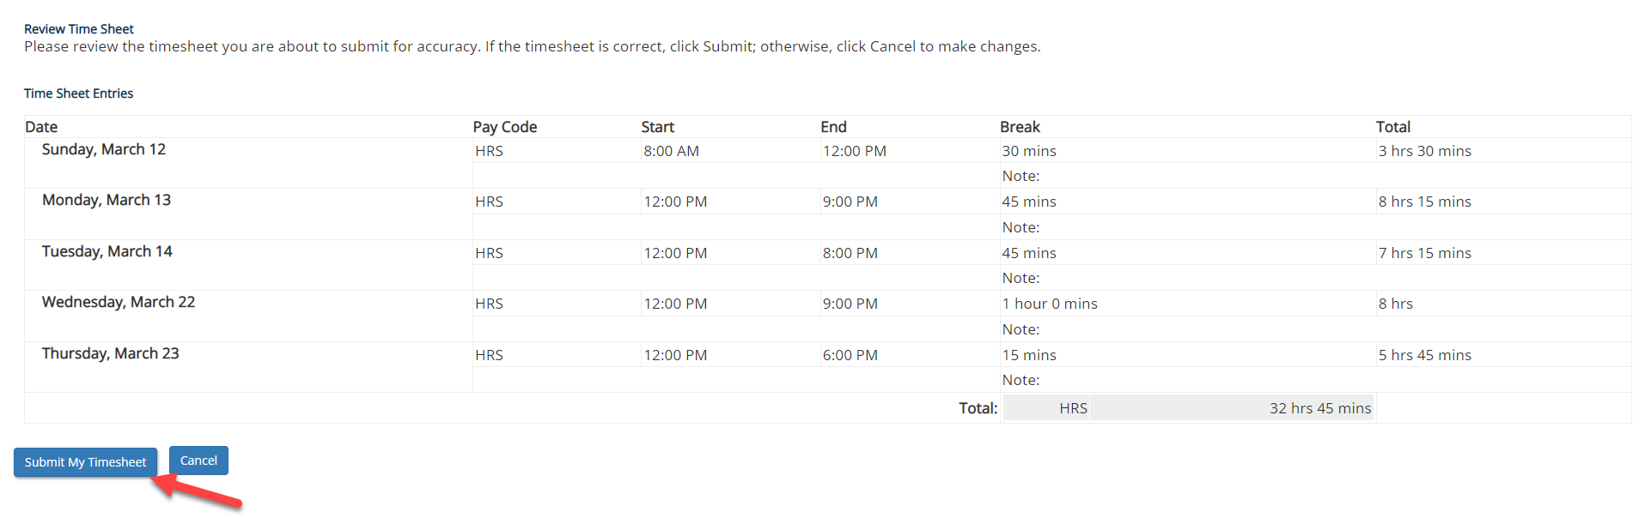
Submit Timesheet to Supervisor
Review the timesheet for accuracy then click the ‘Submit My Timesheet’ button.

Slide 15
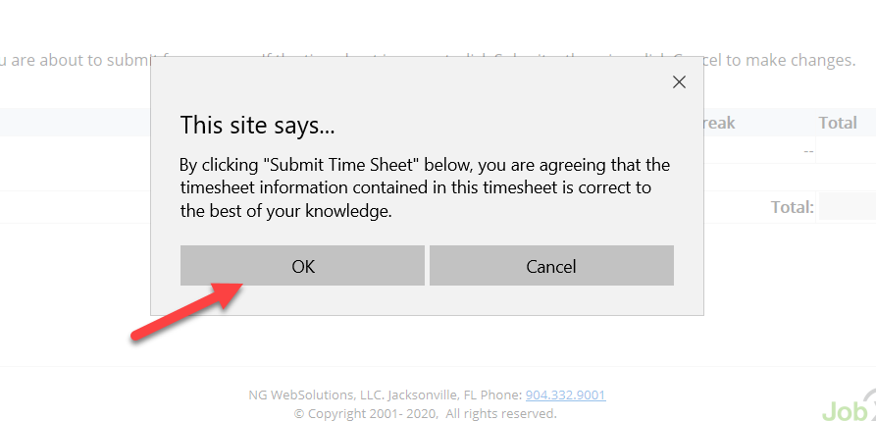
Submit Timesheet to Supervisor
Click ‘OK’ to confirm. By clicking the ‘OK’ button, the employee is agreeing the time sheet information they’ve entered is correct to the best of their knowledge.
This step replaces the wet signature on a paper time sheet with an electronic signature on this paperless time sheet.

Slide 16
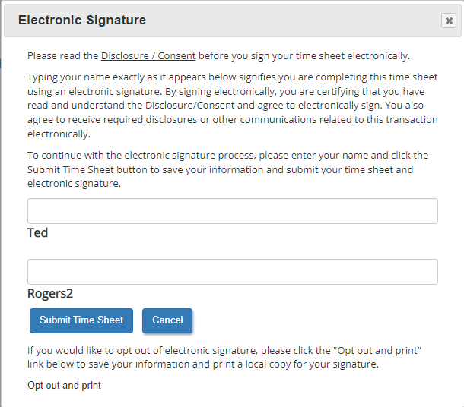
Submit Timesheet to Supervisor (Esign)
Electronically sign the popup Electronic Signature window, agreeing that the timesheet information entered is correct to the best of your knowledge.
This step replaces the wet signature on a paper timesheet with an electronic signature on this paperless timesheet.

Slide 17
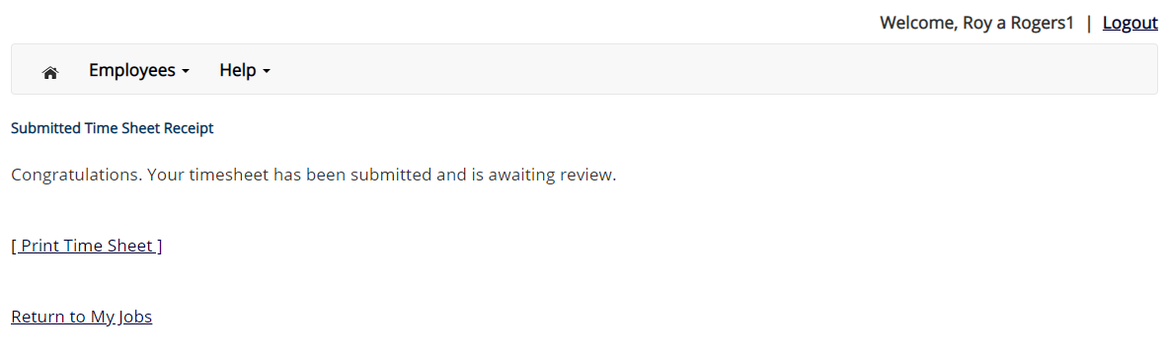
Submit Timesheet to Supervisor
Your timesheet has been placed in your Supervisor’s TimesheetX pending approval queue awaiting his/her review and approval.
You will not be able to access your timesheet again unless your supervisor rejects it back to you during his/her review process.

Slide 18
Other Timesheet Features
What Else Can I view in My timesheet?

Slide 19
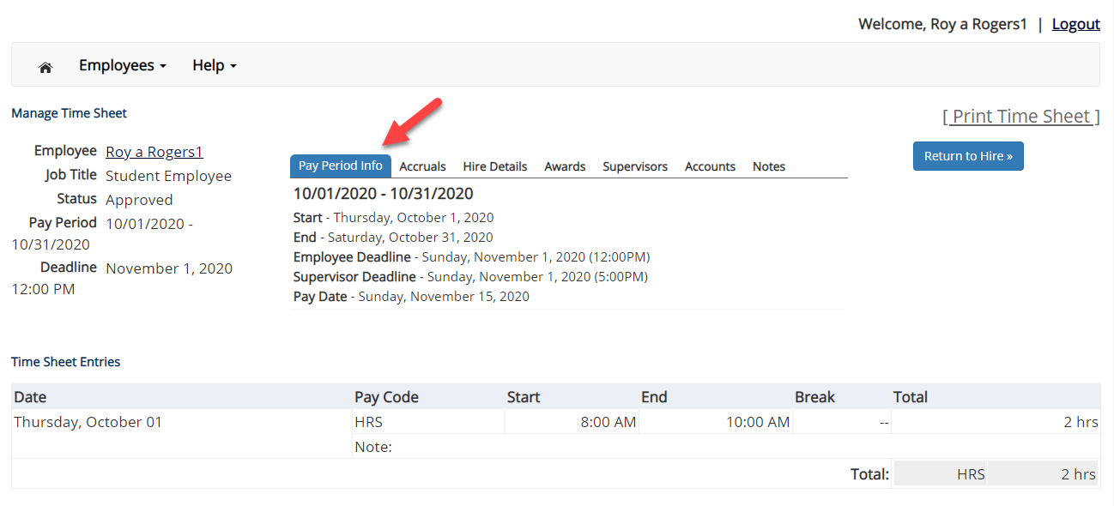
Pay Period Information

Slide 20
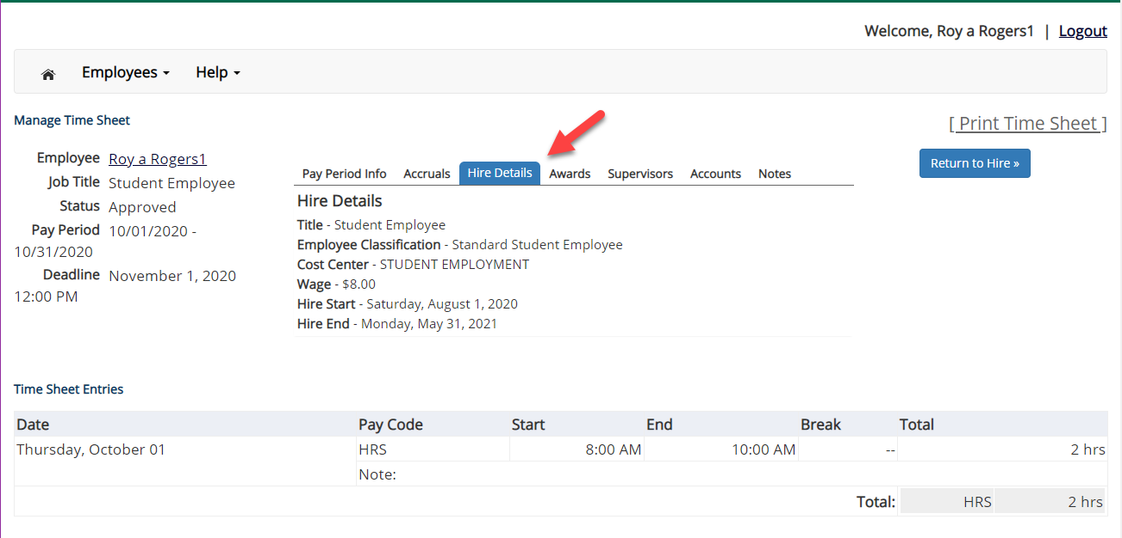
Hire Details

Slide 21
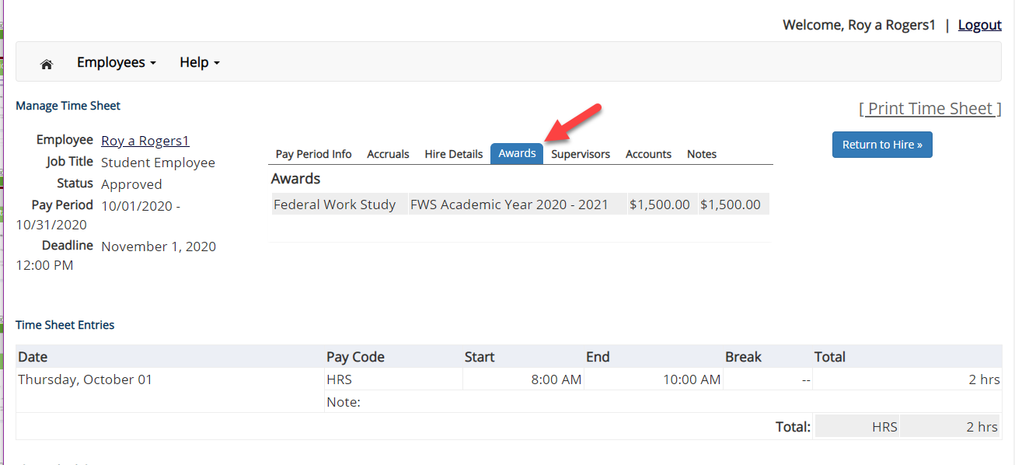
Awards

Slide 22
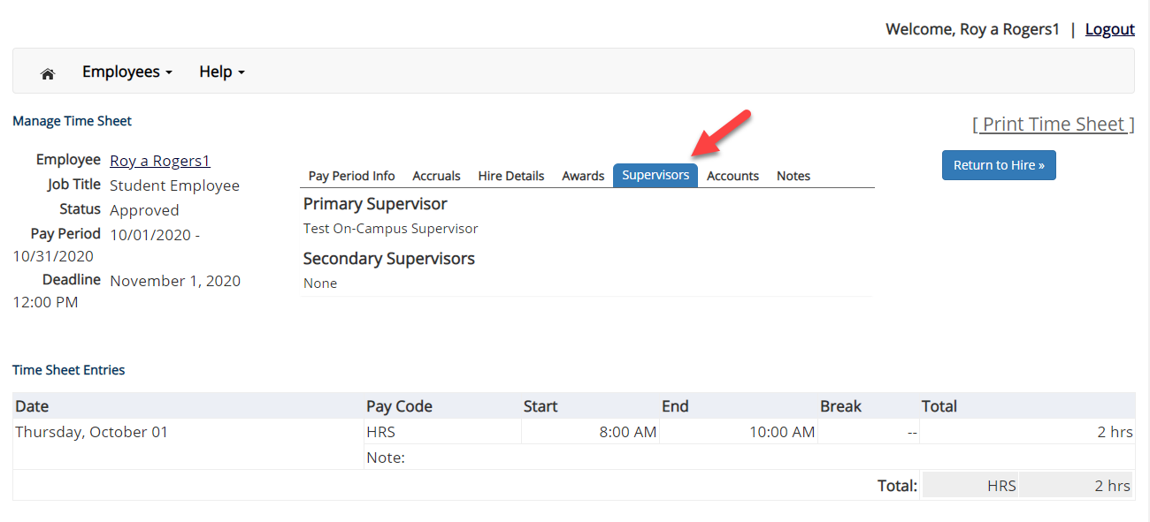
Supervisors

Slide 23
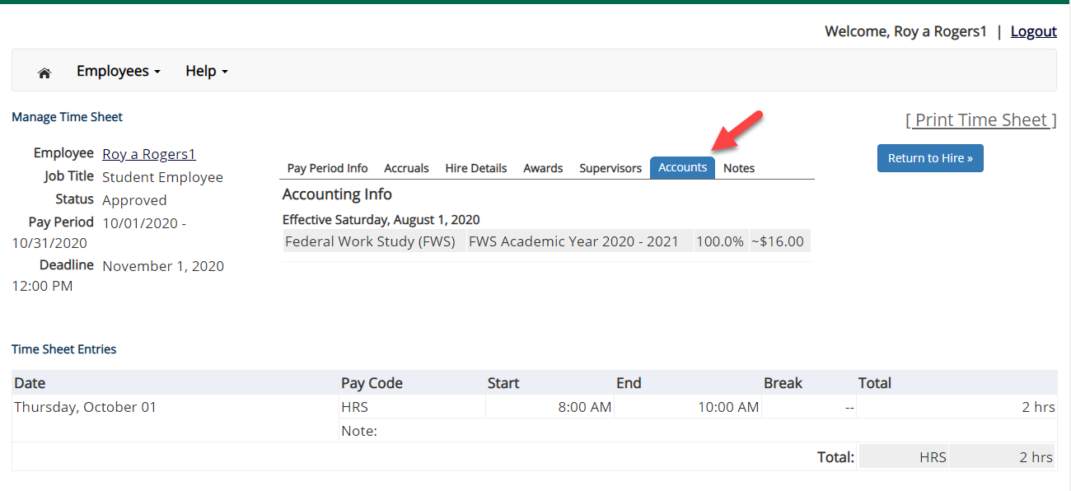
Accounts

Slide 24
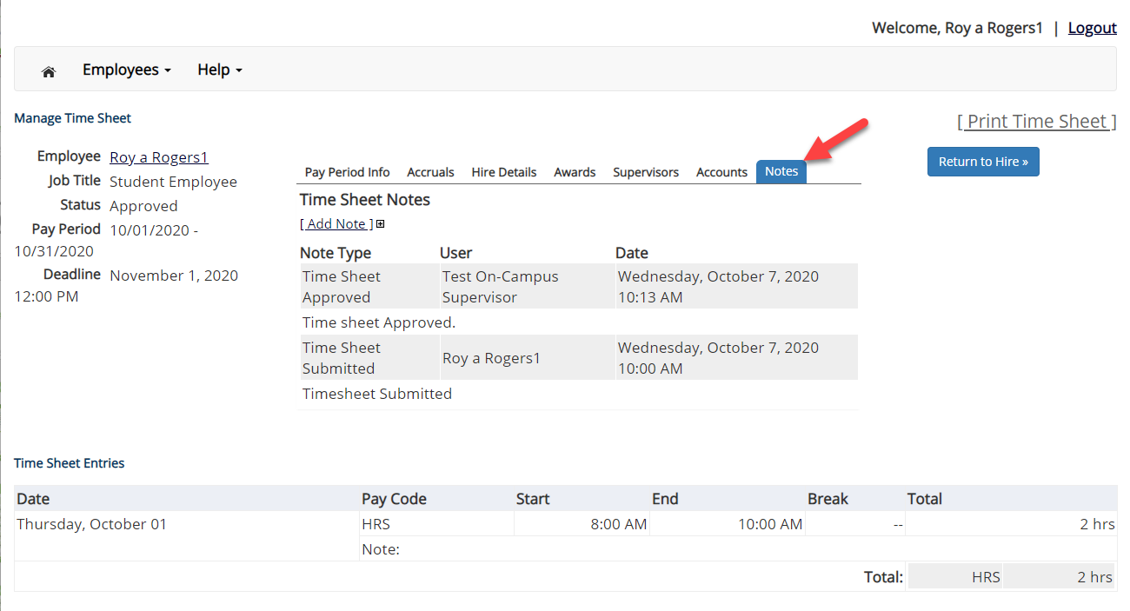
Notes

Slide 25

Questions?
For Support Contact
Non Federal Work-Study Student and Graduate Assistants:
studentemployment@subr.edu
Federal Work-Study Students:
financialaid@subr.edu

