Slide 1

Login JobX & TimesheetX

Slide 2
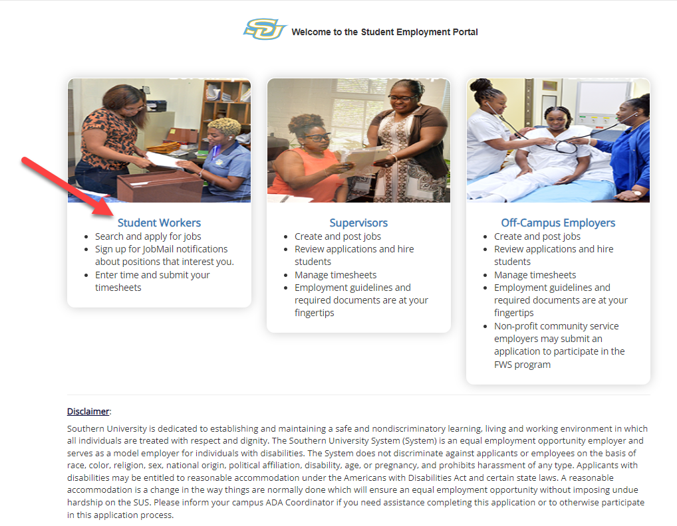
Login to JobX & TimesheetX
Navigate to your school’s customized JobX Site
Then click on the
‘Student Worker’ link to access the area of your choice.
Southern University JobX/TimesheetX Site:
https://subr.studentemployment.ngwebsolutions.com/

Slide 3
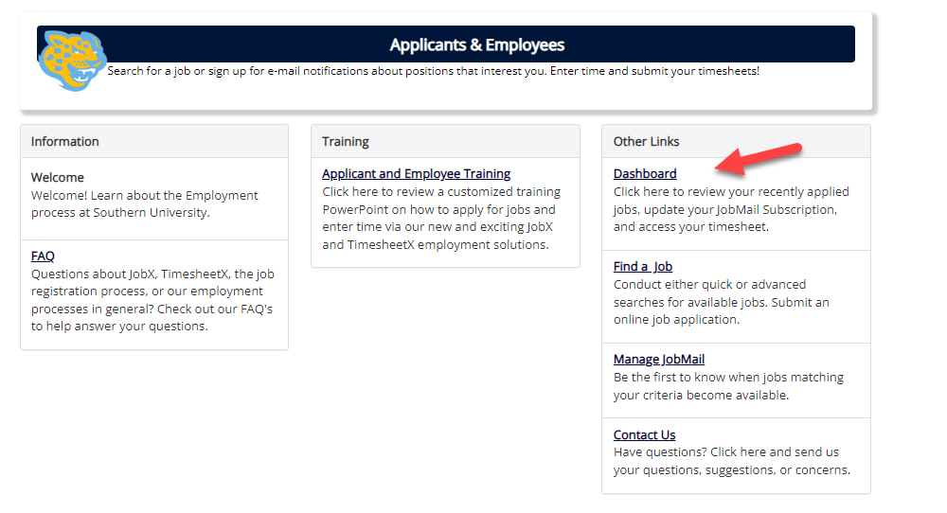
How to Login to JobX & TimesheetX
Step 1: Click ‘Dashboard’ for access to your dashboard and timesheets.

Slide 4
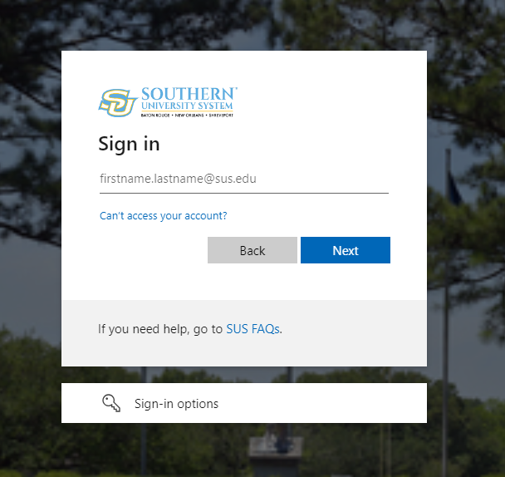
Student Employee
Login to JobX & TimesheetX
Login utilizing your Southern University ‘SSO ID’ and ‘Password’.

Slide 5

JobMail

Slide 6
What is JobMail?
JobMail notifies you about potential job matches based on your interest
Must complete a JobMail Subscription to receive notifications
After JobMail setup you will receive notifications on new job listings that interest you
The email will provide all details about the job to assist you in identifying a great job opportunity
NGWeb Solutions, LLC - Confidential and Proprietary –
Do not share without permission

Slide 7
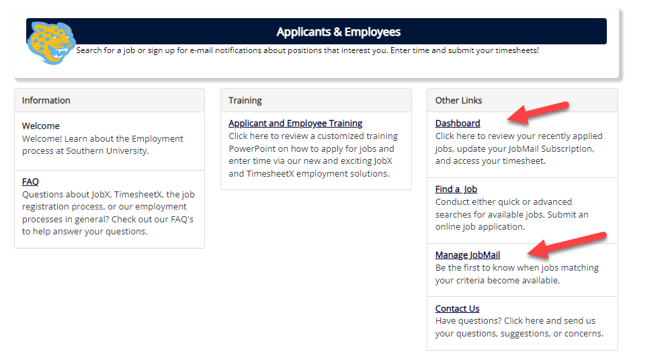
How to Access JobMail
Step 1: Click ‘Dashboard’ or ‘Manage JobMail’ link on the Federal Work Study Students or Service Scholarship Students home page.

Slide 8
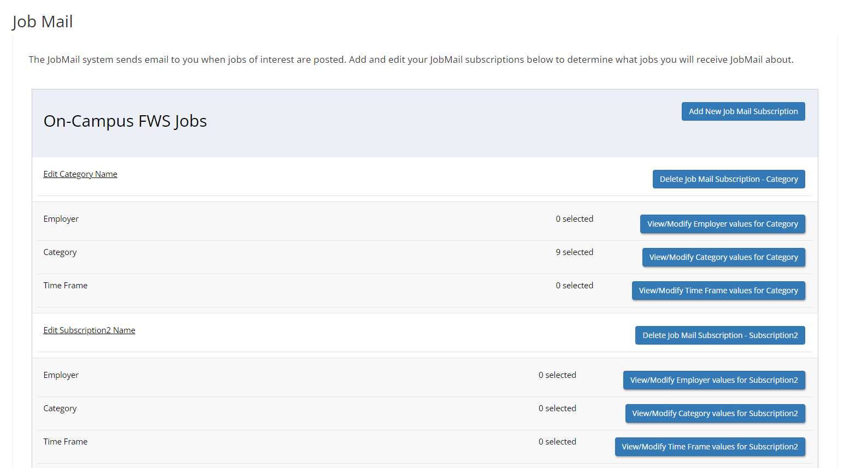
Configure your JobMail Subscription
You may create multiple subscriptions and name them as desired for each Job Type (On-Campus FWS, On-Campus Scholarship Hours) supported by JobX
  For Example: You can create a Summer Subscription that has different attributes than your Academic Year Subscription
For each subscription, you may set criteria
  Desired Departments (a.k.a. JobX Employers) you wish to work (e.g. Biology & English)
  Desired Job Categories you’re interested in (e.g. Tutoring, Clerical, etc.)
  Desired Time Frames you’re interested in working (e.g. Summer Only, Academic Year, etc.)

Slide 9
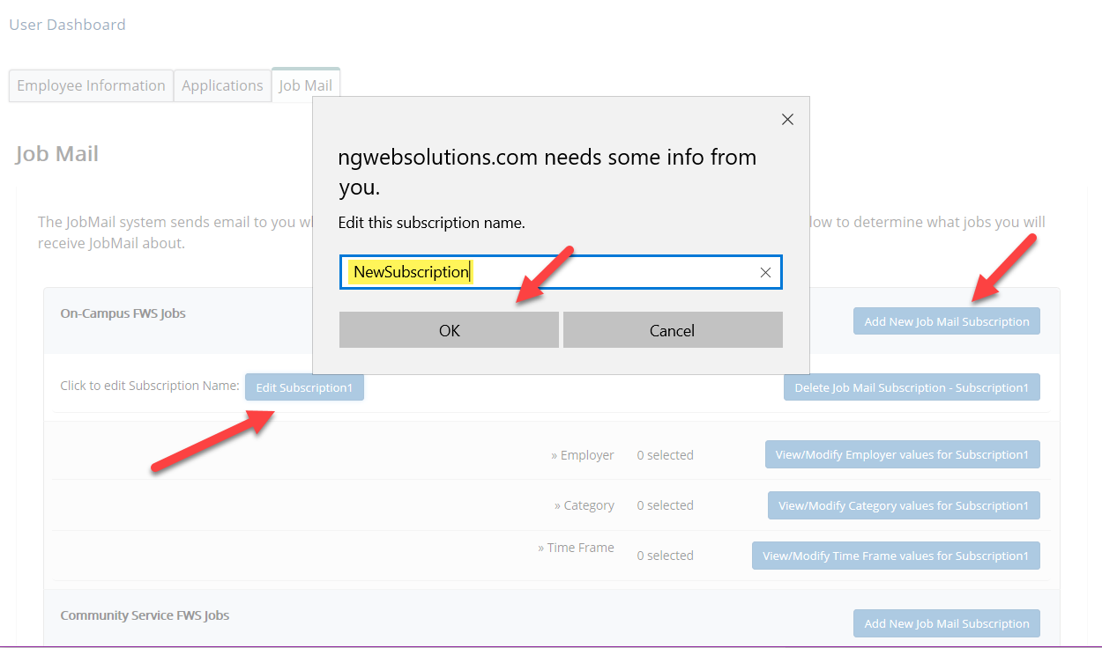
Configure your JobMail Subscription
Click ‘Add New JobMail Subscription’ button to start the setup process to creating a JobMail subscription.
When the subscription name window pops up, update to your desired name.
If you need to edit the scription name, click the ‘Edit Subscription’ button.

Slide 10
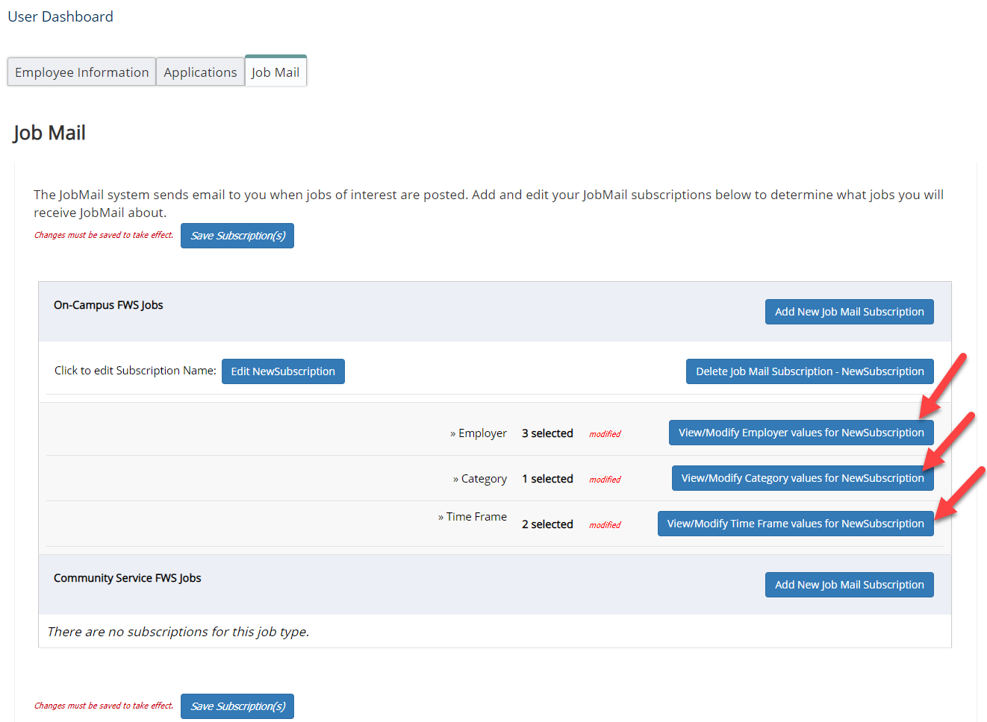
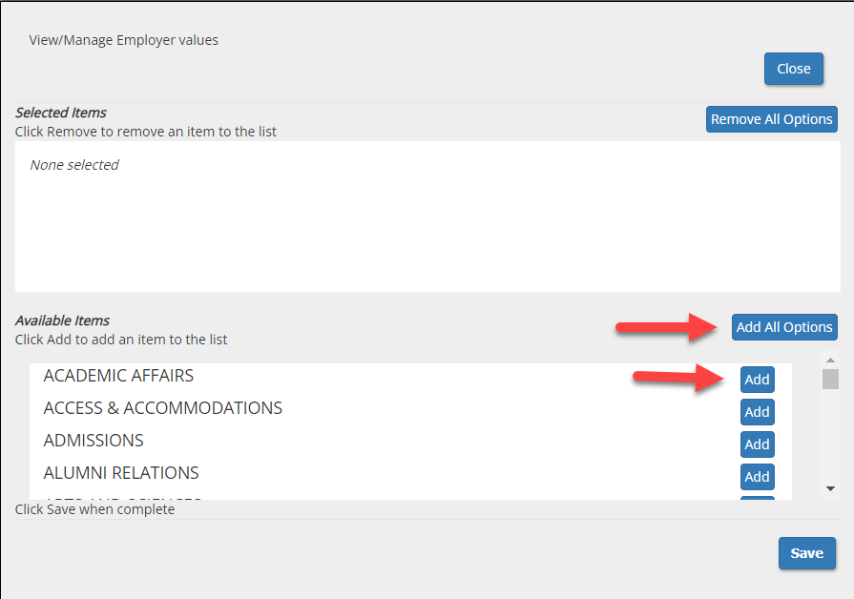
Configure your JobMail Subscription
Click ‘Add all Options’ or ‘Add’ next to each item you wish to add to your JobMail subscription.

Slide 11
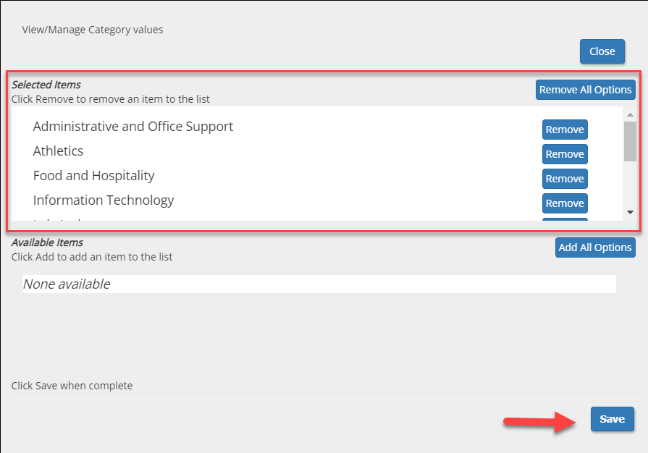
Configure your JobMail Subscription
Your selection(s) will appear in the top under ‘Selected Items’.
When you’re finished adding search criteria, click ‘Save’.
Repeat this step for each Job Type and Criterion (Department/Employer, Category, and Time Frame).
You may return to this screen any time to modify your subscription.

Slide 12

Find a Job

Slide 13
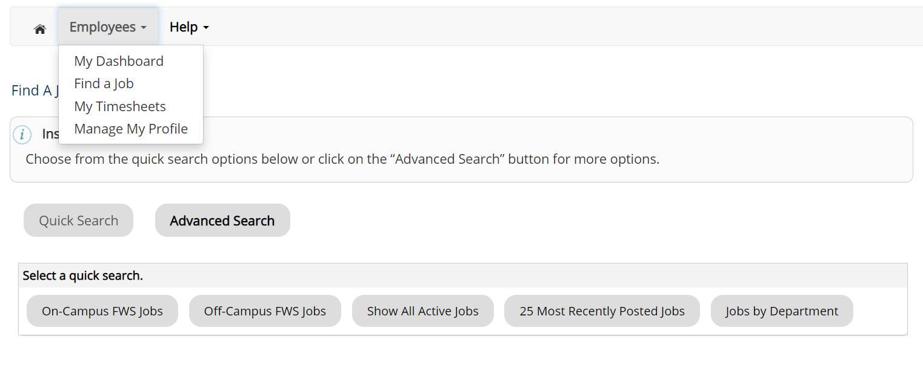
Quick Search
Click the ‘Find a Job’ function from the Employees Menu.
Select a specific pre-defined ‘Quick Search’ you would like to utilize to find a job.
Otherwise, to define your own custom job search filters click ‘Advanced Search’.

Slide 14
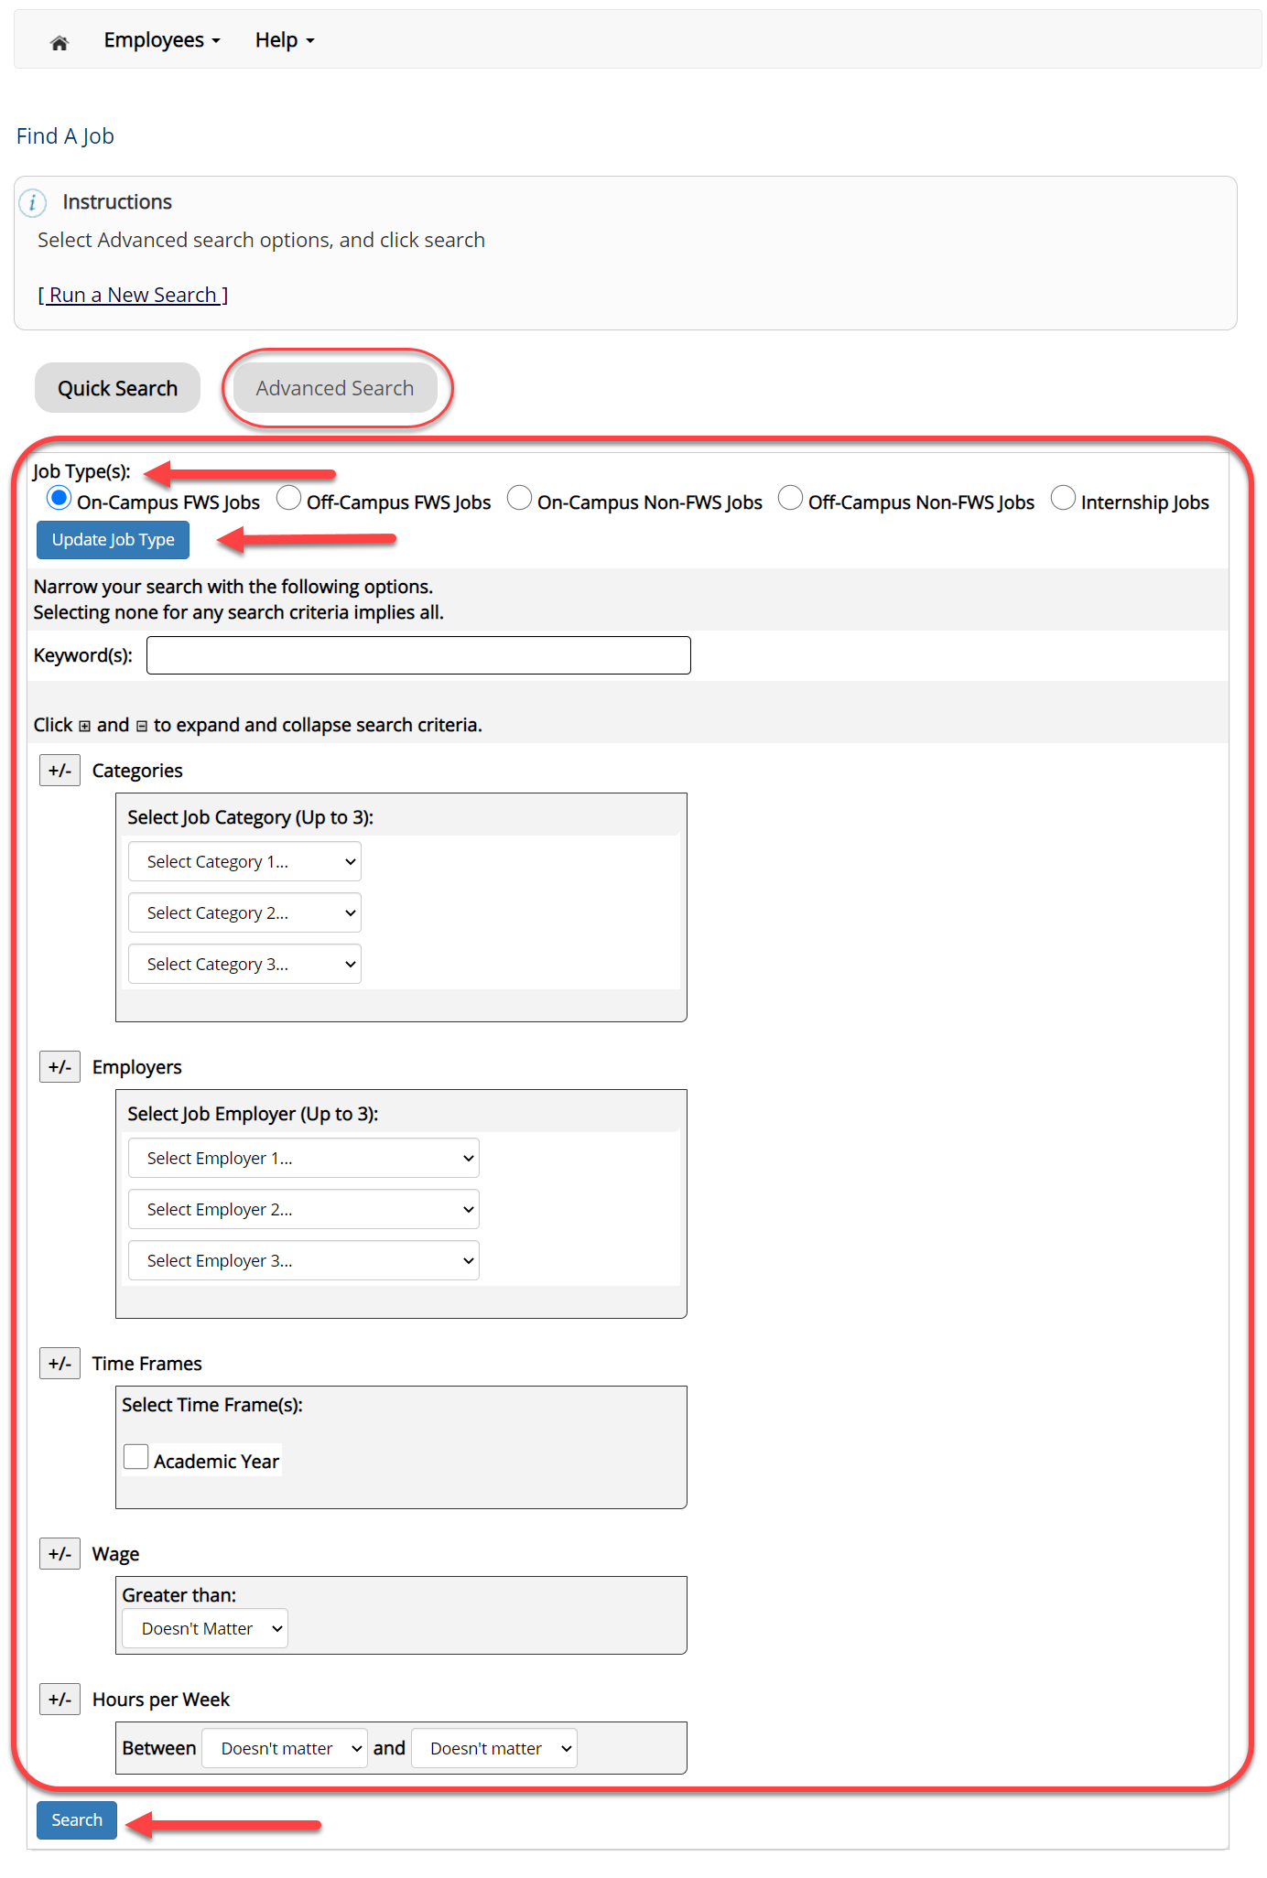
Advanced Search
Click the ‘Advanced Search’ button to define your own job criteria you wish to search.
Advanced Search enables you to search for jobs by the following:
  Search by Job Type Population (On-Campus FWS, Off-Campus FWS Jobs, etc.)
  Keyword(s) Search
  Job Category, Employers/Department, Time Frame, Wage, and Hours per Week

Slide 15

Apply for a Job

Slide 16
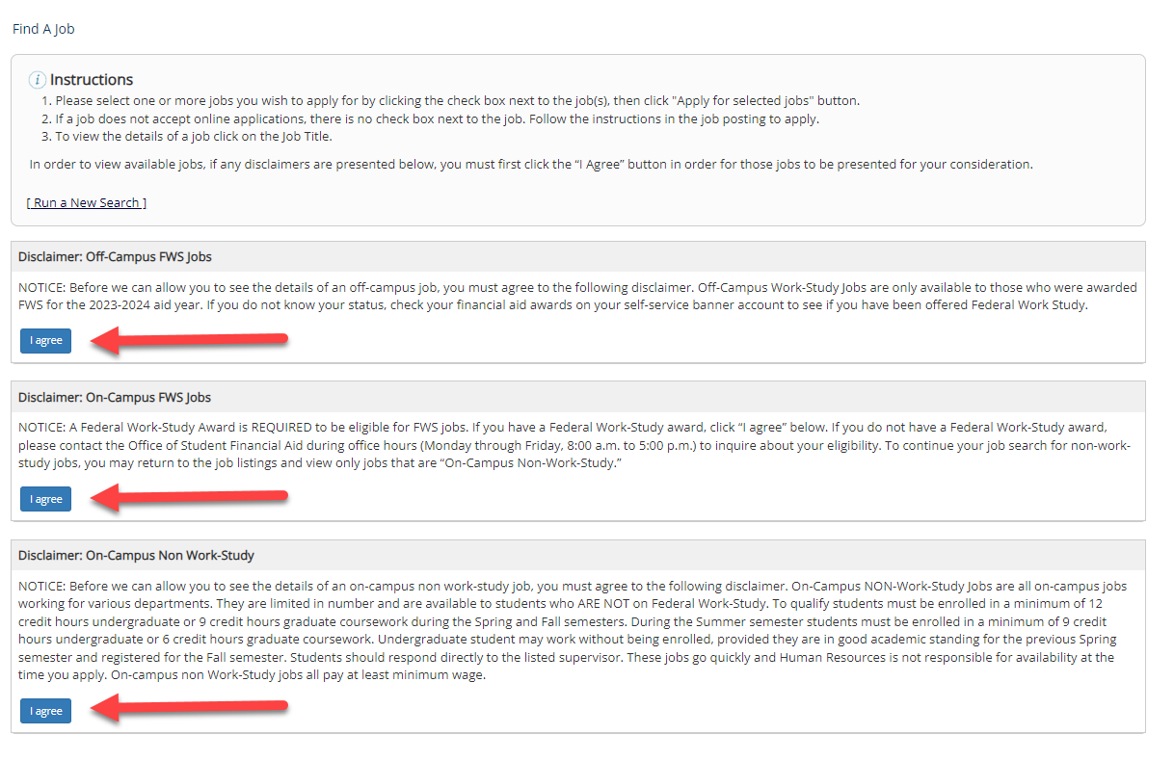
Disclaimer Statements
In order to view available job listings, you may be required to review and agree to one or more disclaimer statements.
A disclaimer statement will be presented for all Job Types you selected.
After you’ve successfully reviewed the applicable disclaimer statement(s), you will be required to click the ‘I agree’ button(s) before any available jobs of that Job Type population will be presented.

Slide 17
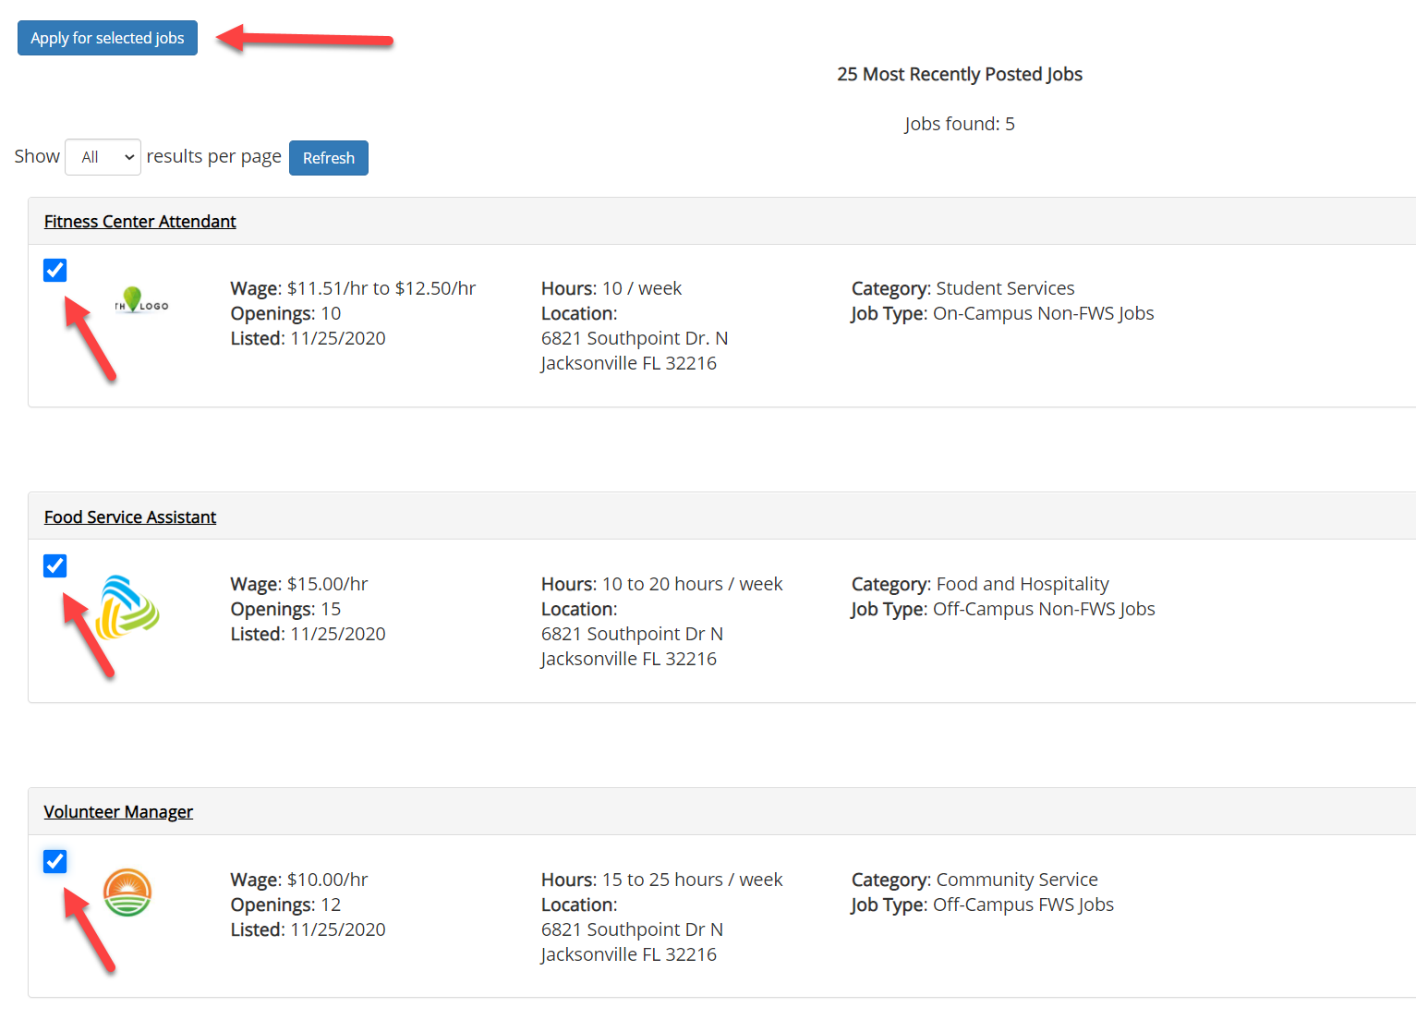
Apply for a Job! With One Click
Simply click the box next to the jobs you wish to submit an application.
If a job does not have a box or does not allow for the selection of the job, then you will need to click the Job Title to view the job details on how to apply for the job.
Then, click the ‘Apply for Selected Jobs’ button.

Slide 18
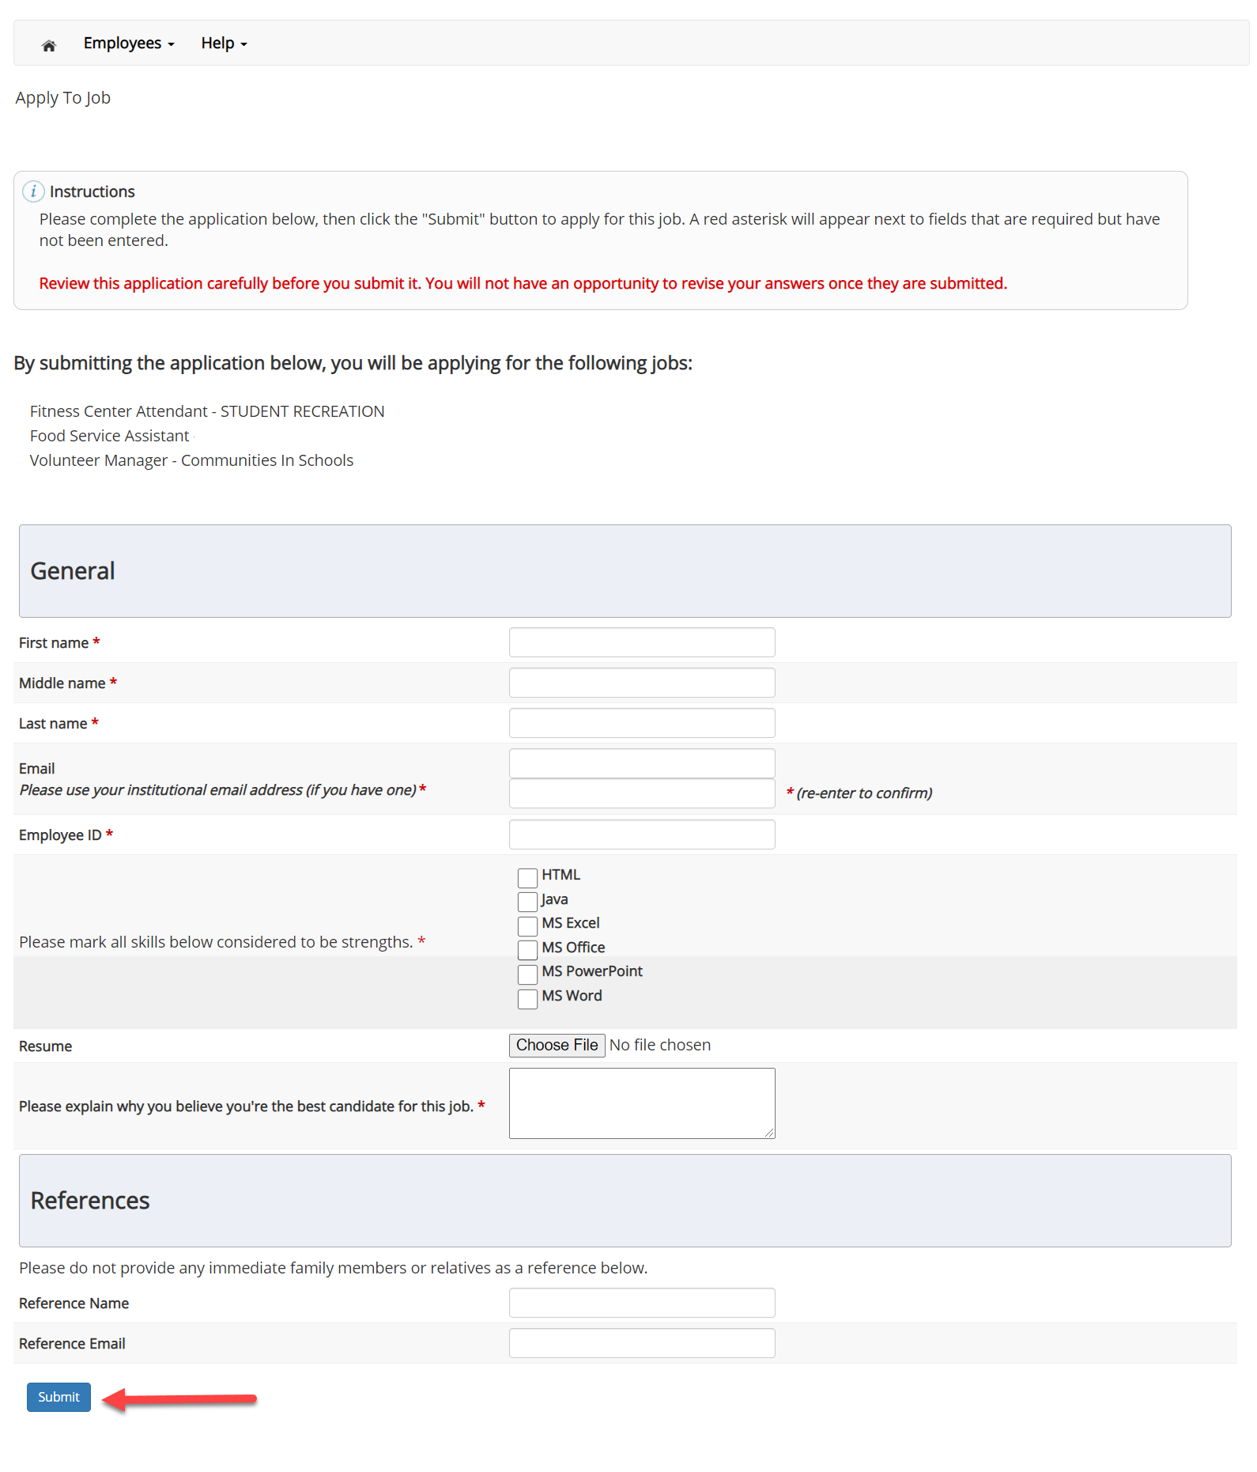
Job Application
Complete the questions on the application.
Fields with a red asterisk are required to be completed before your application can be successfully completed.
Some of the fields may have information pre-filled. Please be sure to review and update the information as needed.
You may upload a resume for the hiring employer to review, if desired. In order to do so, browse to that file on your computer and click ‘Open’.

Slide 19
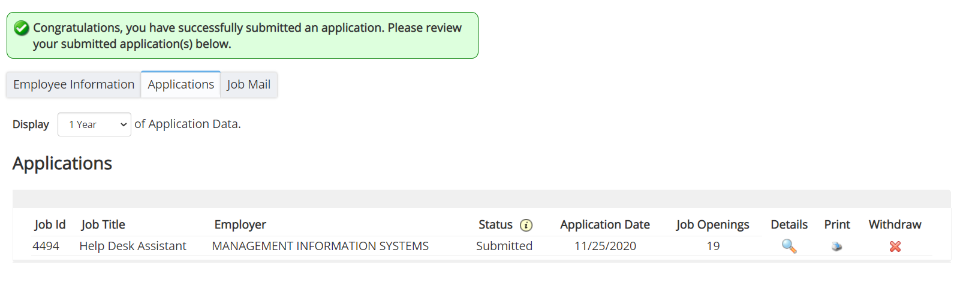
Application Successfully Submitted
Your application is successfully submitted when you received the Congratulations message.

Slide 20

Questions?
For Support Contact
Non Federal Work-Study Student and Graduate Assistants:
HR@sus.edu
Federal Work-Study Students:
financialaid@subr.edu

