Slide 1



Student Training

Slide 2

Mobile Device Access

Slide 3
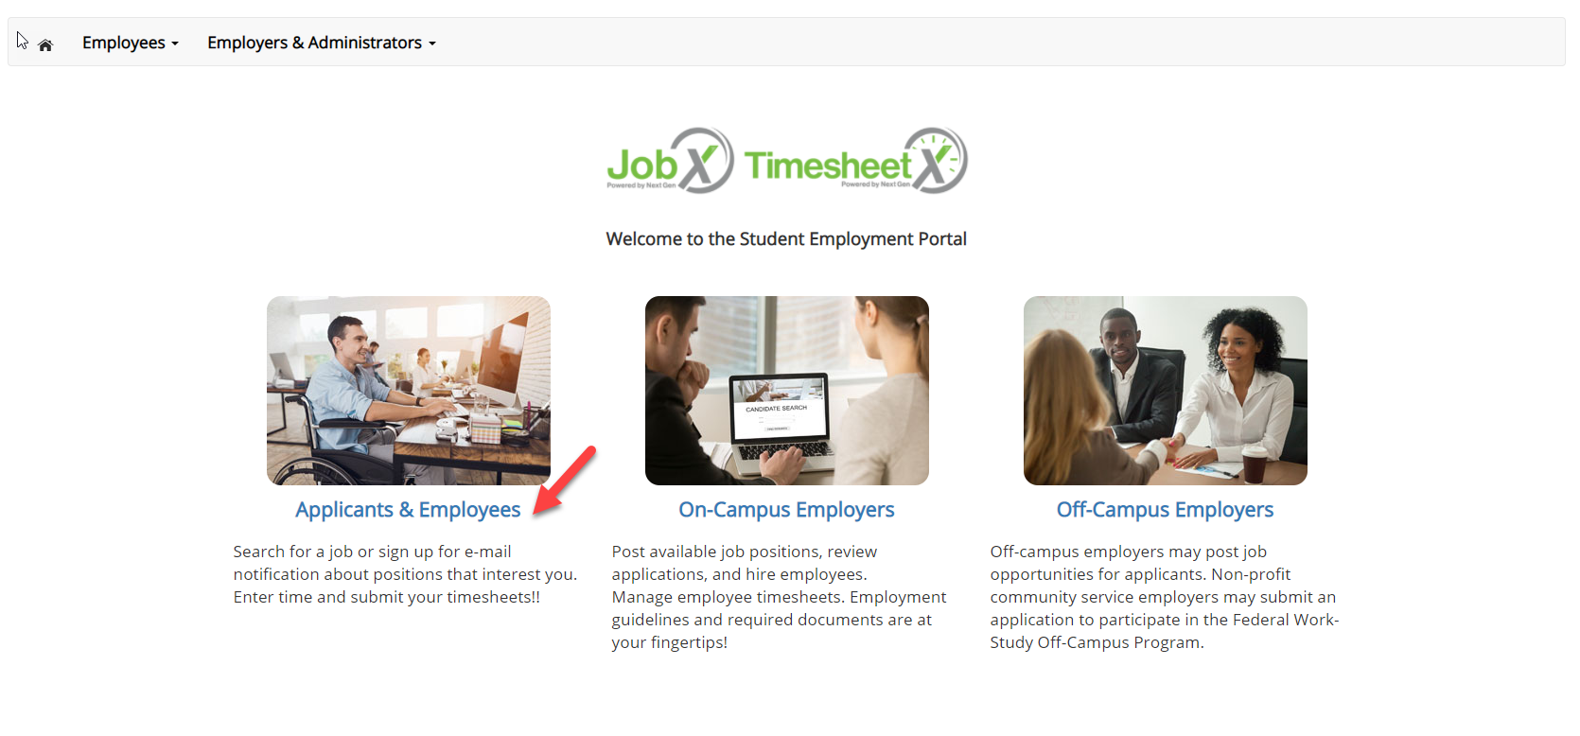
Login to TimesheetX Mobile
Navigate to your school’s customized JobX/TimesheetX Site.
Then click on the
‘Applicant & Employee’ link to access the area of your choice.
Sample School JobX/TimesheetX Site:
https://su.studentemployment.ngwebsolutions.com/

Slide 4
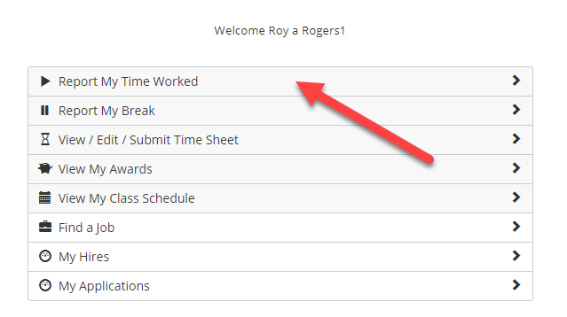
Mobile – Report My Time Worked
To report time worked, click the ‘Report My Time Worked’ menu option.

Slide 5
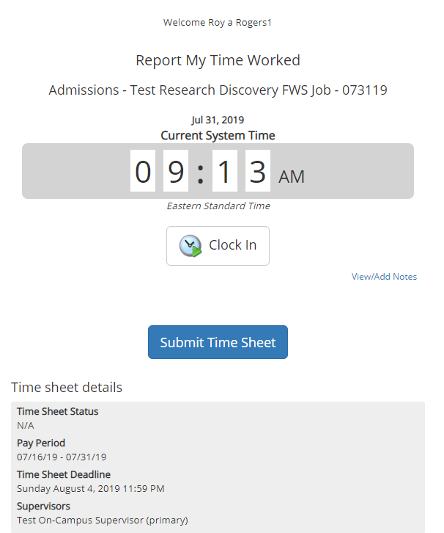
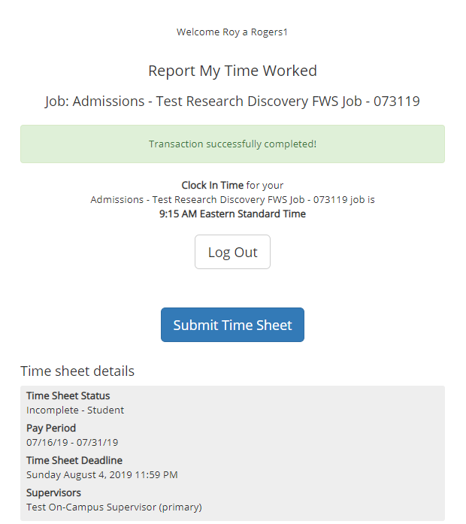
Mobile – Clock In
To clock in, click the ‘Clock In’ button.
The system time will be updated in the start field on your timesheet.
A confirmation screen with the exact ‘Clock In’ time is presented.

Slide 6
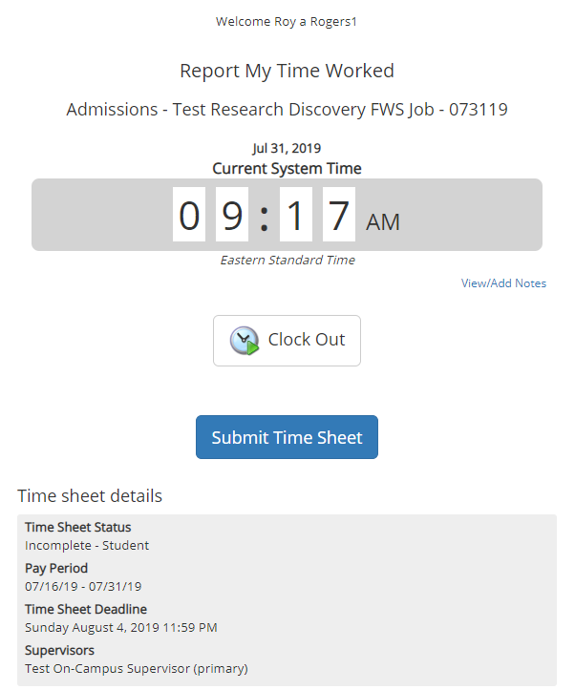

Mobile – Clock Out
To clock out, click the ‘Clock out’ button.
The system time will be updated in the end field on their timesheet.
A confirmation screen with the exact Clock Out time is presented.

Slide 7
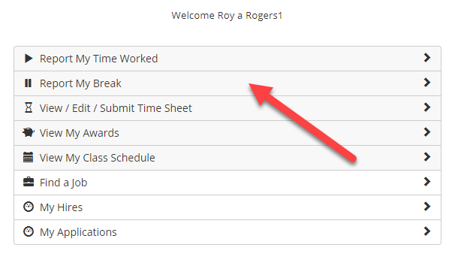
Mobile – Report My Break
If you have previously clocked into a job and now need to start your break, click the ‘Report My Break’ menu.

Slide 8
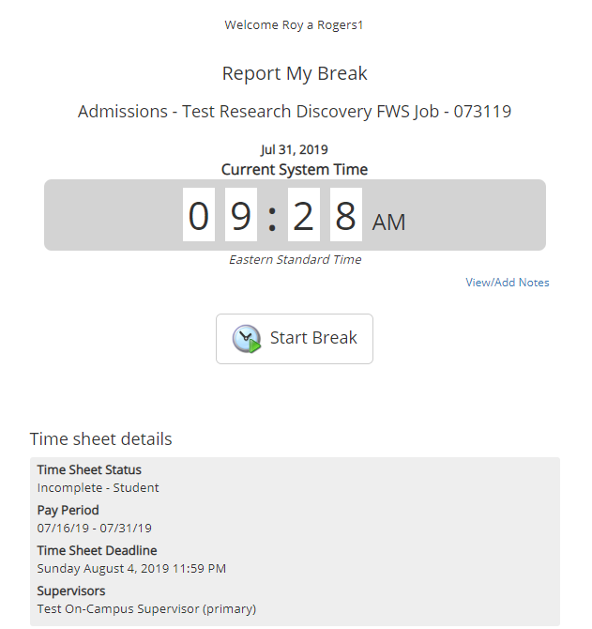
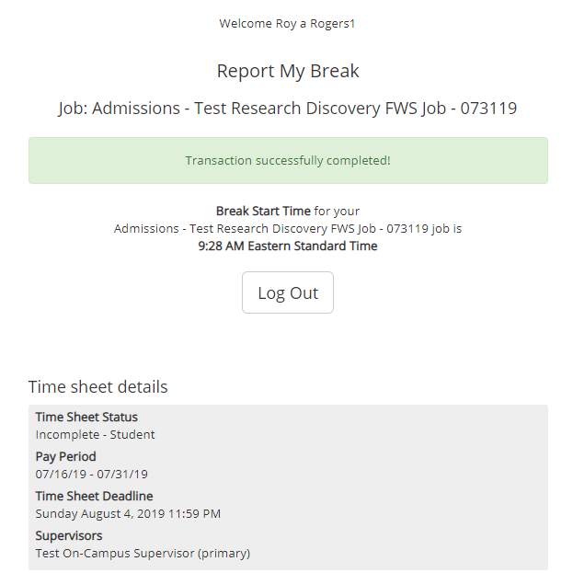
Mobile – Start Break
To start a break, click the ‘Start Break’ button.
A confirmation screen with the exact ‘Break Start’ time is presented.

Slide 9
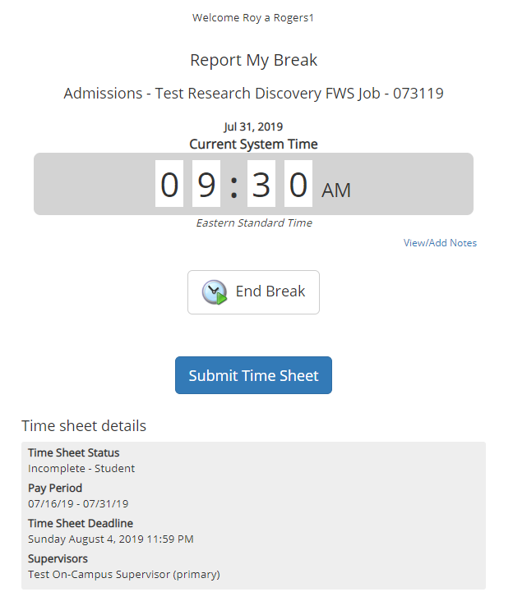

Mobile – End Break
To end a break, click the ‘End Break’ button.
A confirmation screen with the exact ‘Break End’ time is presented.

Slide 10
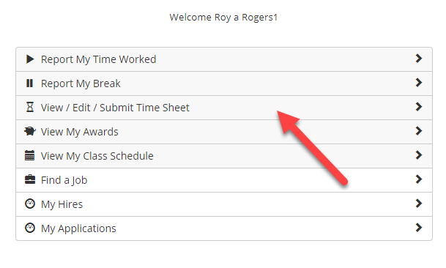
Mobile – View / Edit / Submit Time Sheet
To view/edit a timesheet or hand in a timesheet to the Supervisor for review/approval, click the ‘View/Edit/Submit Time Sheet’ menu option.

Slide 11
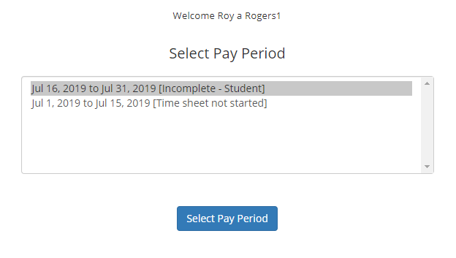
Mobile – View /Edit/ Submit Time Sheet
You must first choose the pay period for the timesheet they wish to view, edit, or submit.

Slide 12
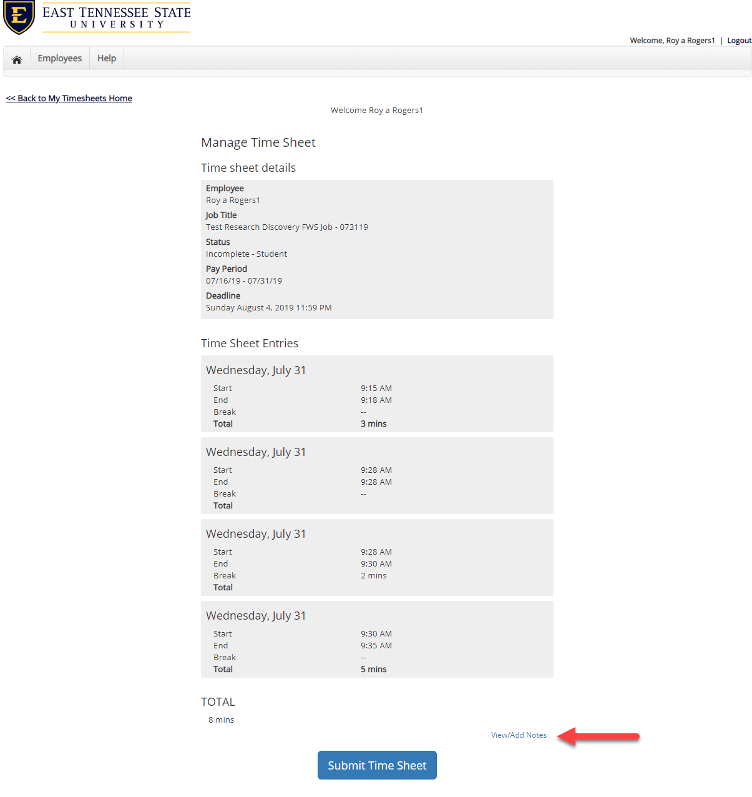
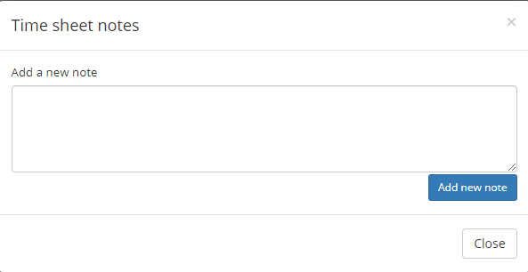
Mobile – View Timesheet
If you wish to view your timesheet for one or more jobs, you can view each timesheet entry for each job, as well as, the total hours entered for the entire timesheet.
If you wish to View/Add Notes on your timesheet click the View/Add Notes link.

Slide 13
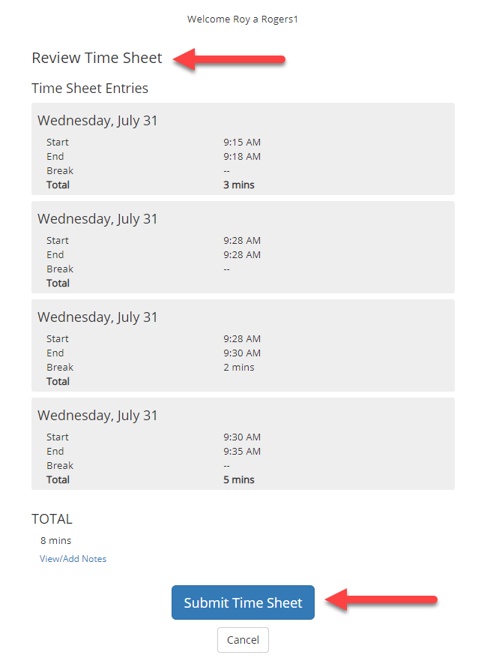
Mobile - Submit Time Sheet
Before clicking Submit Time Sheet, review your timesheet entries to ensure they are accurate.

Slide 14
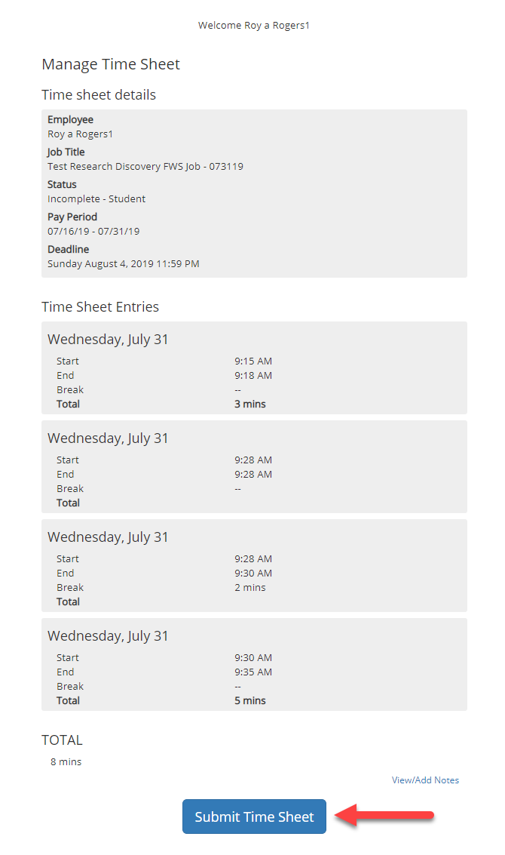
Mobile – Submit Time Sheet
Next, click ‘Submit Time Sheet’ button to submit your timesheet to your Supervisor to review and approve.

Slide 15
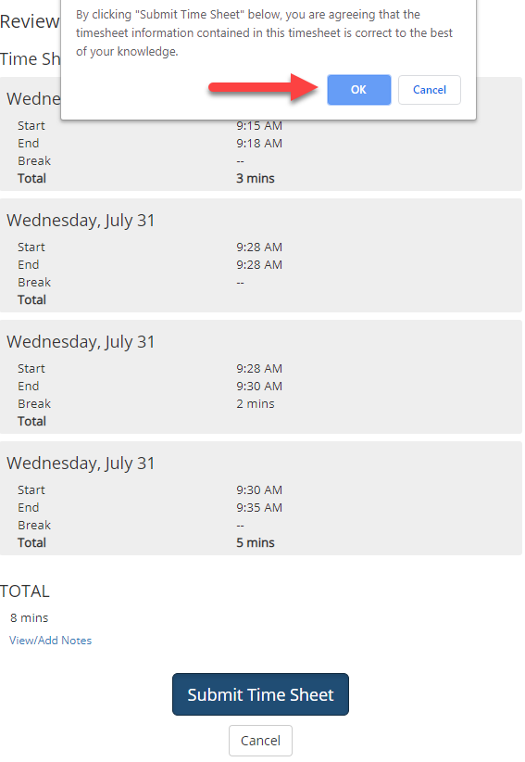
Mobile - Submit Time Sheet
Click ‘OK’ to confirm. By clicking the ‘OK’
button, you are agreeing the
timesheet information you’ve entered is
correct to the best of your knowledge.
This step replaces the wet signature on a paper timesheet with an electronic signature on this paperless timesheet.

Slide 16
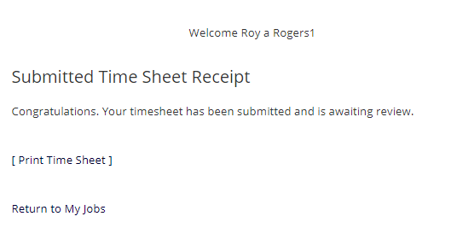
Mobile – Submitted Time Sheet Receipt
Your timesheet has been placed in your Supervisor’s TimesheetX pending approval queue waiting for review and approval.
You will not be able to access your timesheet again unless your supervisor rejects it back to you during the review process.

Slide 17
Other Mobile Features
What Else Can I view in Mobile access?

Slide 18
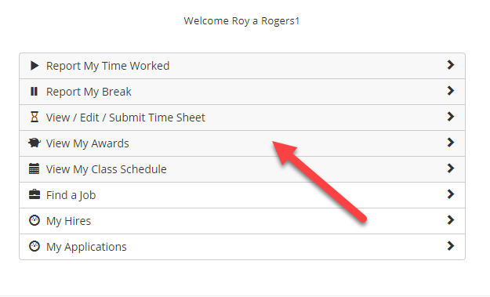
Mobile – View My Awards
To view awards and balances, click the ‘View My Awards’ menu option.

Slide 19
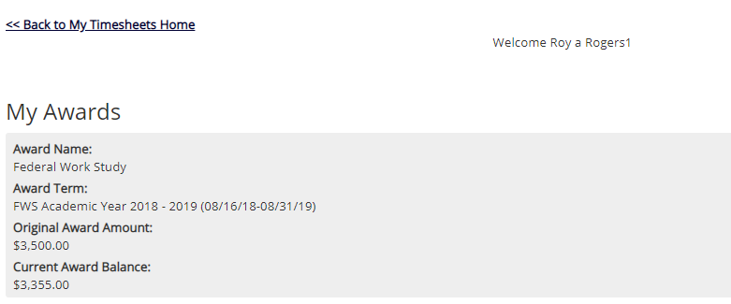
Mobile – View My Awards
You can view your award year, award type(s), original award amount(s) and remaining award balance(s).

Slide 20
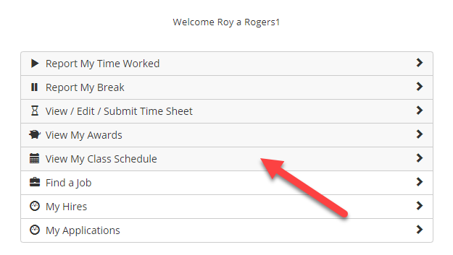
Mobile – My Class Schedule
To view your class schedule in TimesheetX, click the ‘View My Class Schedule’ menu option.

Slide 21
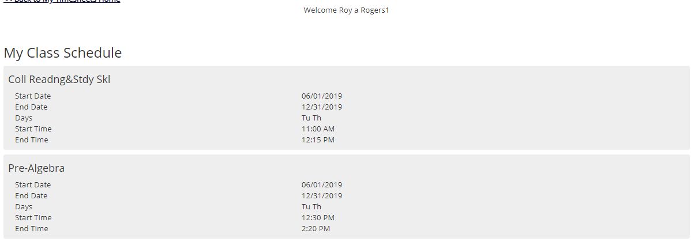
Mobile – My Class Schedule
This feature enables you to quickly access your current class schedule for reference to ensure time is not worked during a scheduled class.

Slide 22

Questions?
For Support Contact
Non-Federal Work-Study Student and Graduate Assistants:
Studentemployment@subr.edu
Federal Work-Study Students:
financialaid@subr.edu

