Slide 1
On-Campus Supervisor Training

Slide 2
=Total Solution
TimesheetX assists schools automate the timesheet submission and approval process while ensuring compliance with labor and FWS regulations for employees, supervisors, and administrators.

Slide 3
Next Gen Web Solutions
Next Gen Web Solutions offers web and mobile software solutions to enable administrators to efficiently manage online forms, scholarships, employment, online timesheets and other specialized processes that requires electronic management.
JobX & TimesheetX solutions in this training, assist institutions to automate the job posting, application review, timesheet administration and reporting process for employees, Supervisors, and site administrators. The solutions also assist in compliance validations based on various regulations and institutional policies.

Slide 4
TimesheetX Benefits
Easy online timesheet management
Consistent timesheet processing across all departments
Reduced compliance issues due to powerful edits that ensure timesheet entries comply with state/federal labor laws
Reduce math errors and illegible timesheet entries previously experienced with paper timesheets
Deadline reminders ensure timely submissions from employees and approvals for supervisors.
Powerful Supervisor Tools: Automated Warnings, Web Accessibility, E-Signatures, and Mobile Friendly

Slide 5
Training Agenda
Timesheets
Review Timesheet
Submit Time
Questions
Approve or Rejecting Timesheets

Slide 6
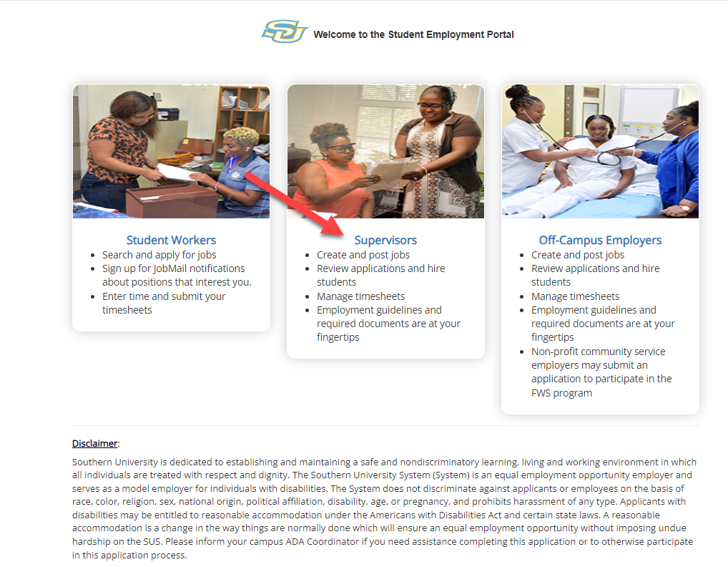
Access JobX & TimesheetX
Navigate to both JobX/TimesheetX Site for all campuses.
Then click on the
‘Supervisors’ link.
Southern University JobX/TimesheetX Site:
https://su.studentemployment.ngwebsolutions.com/

Slide 7
Timesheet Entry

Slide 8
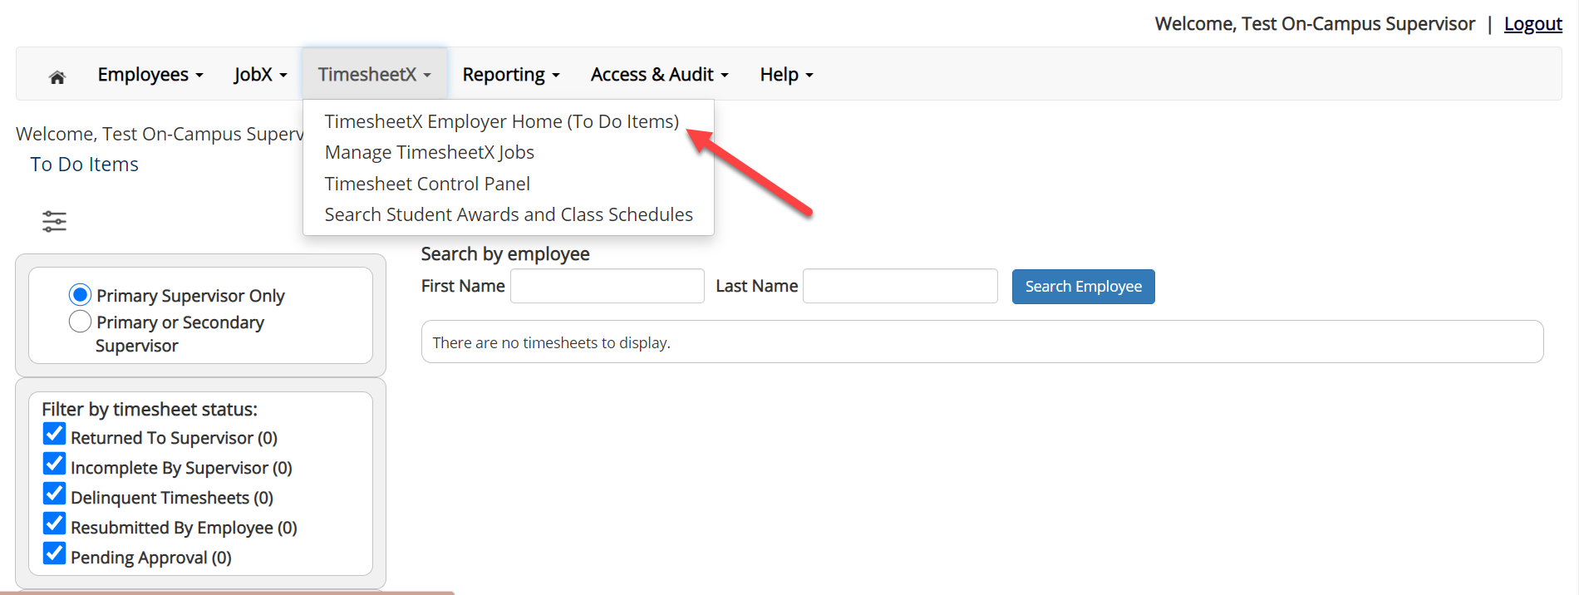
Review Timesheets
Review Timesheets, click ‘TimesheetX To-Do Items’ from the TimesheetX Menu.
Select a cost center from the drop-down box at the top (if you have permission to review/approve timesheets for more than one cost center).

Slide 9
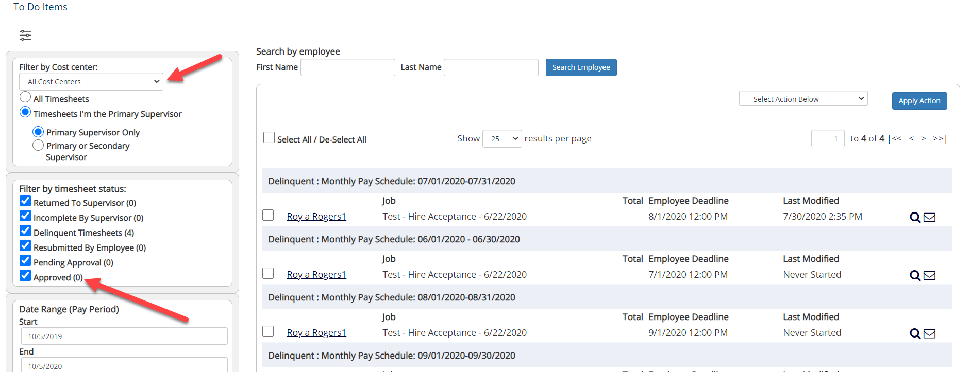
Review Timesheets
To locate timesheets requiring approval, uncheck the filter boxes next to all the timesheet statuses (e.g. Returned to Supervisor, Incomplete by Supervisor, Delinquent Timesheets, and Resubmitted by Employee) except for the “Pending Approval” box.

Slide 10
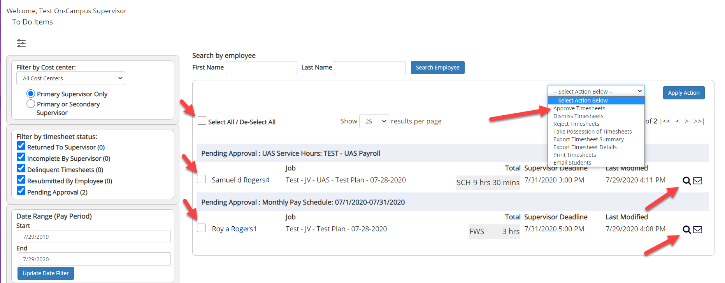
Review Timesheets
Once you’ve located the timesheet you wish to review/approve, you can either mouse over the magnifying glass to review the timesheet entries or click on the magnifying glass to review more details about this hire and/or timesheet or edit/approve/reject the timesheet individually.
If you have multiple timesheets you’d like to approve, simply click the box next to each timesheet you wish to approve. Then, click the “Approve timesheets” in the Action menu.

Slide 11
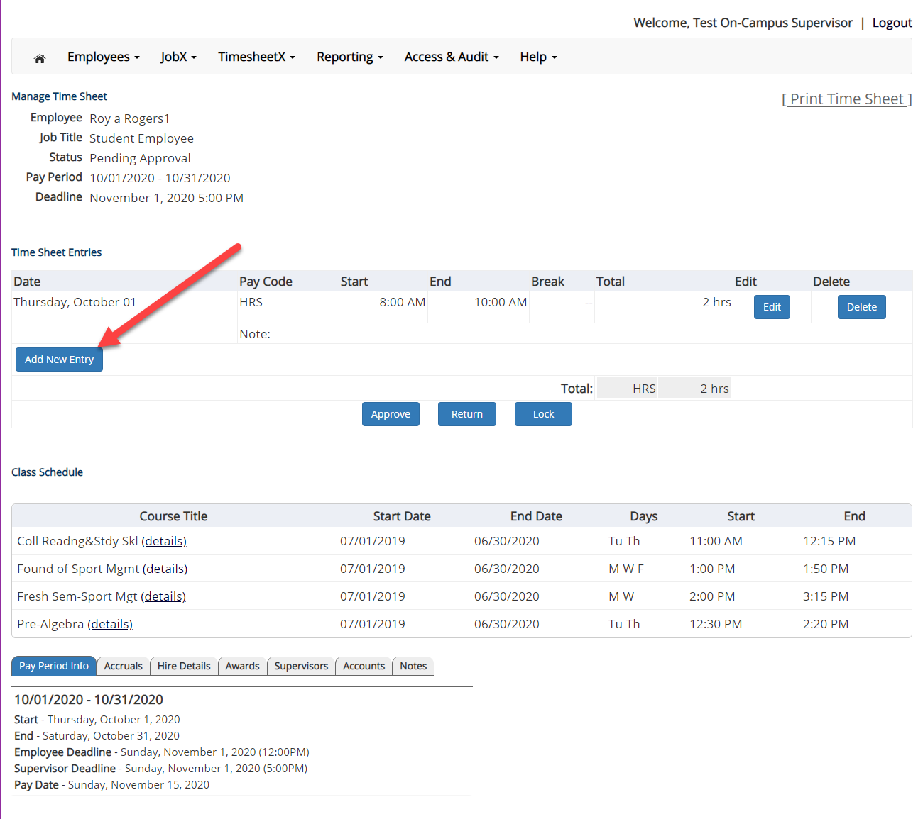
Add a New Timesheet Entry
Click ‘Add new Entry’ if you wish to add another entry.
Then click ‘Save’ to save the entry.

Slide 12
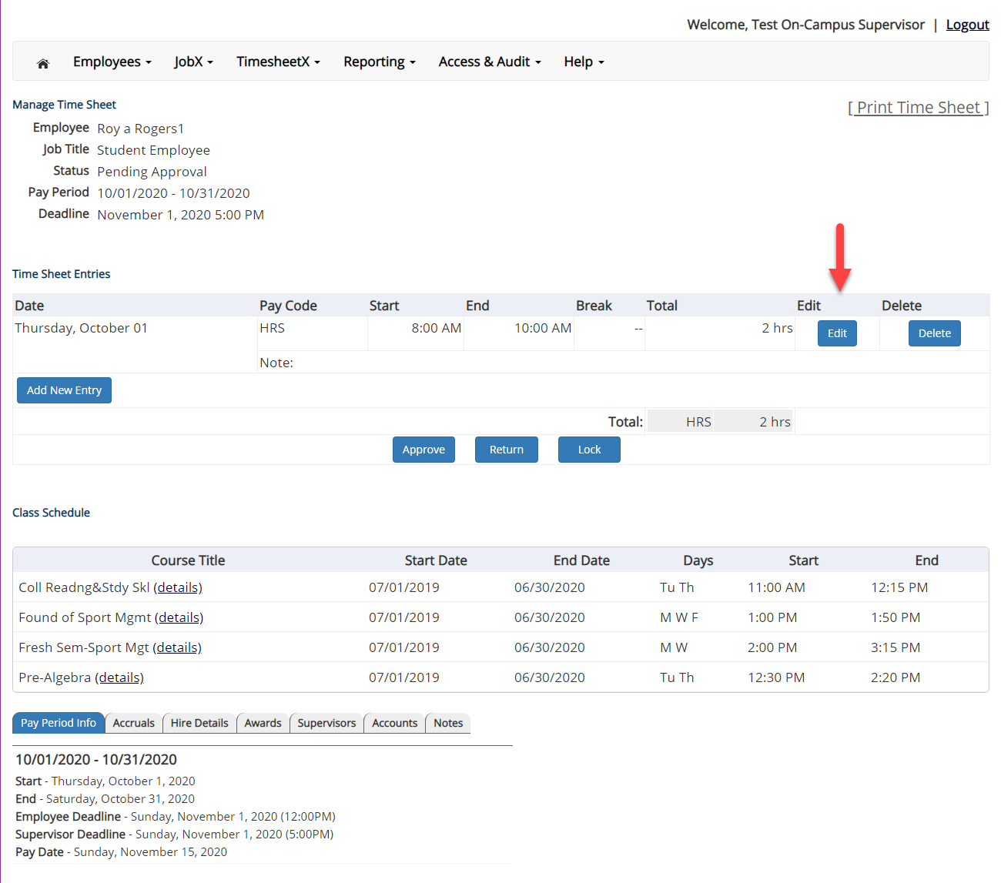
Edit an Individual Timesheet
Click ‘Edit’ next to the timesheet entry you wish to update.
The timesheet will now be locked to you until you save your changes.

Slide 13
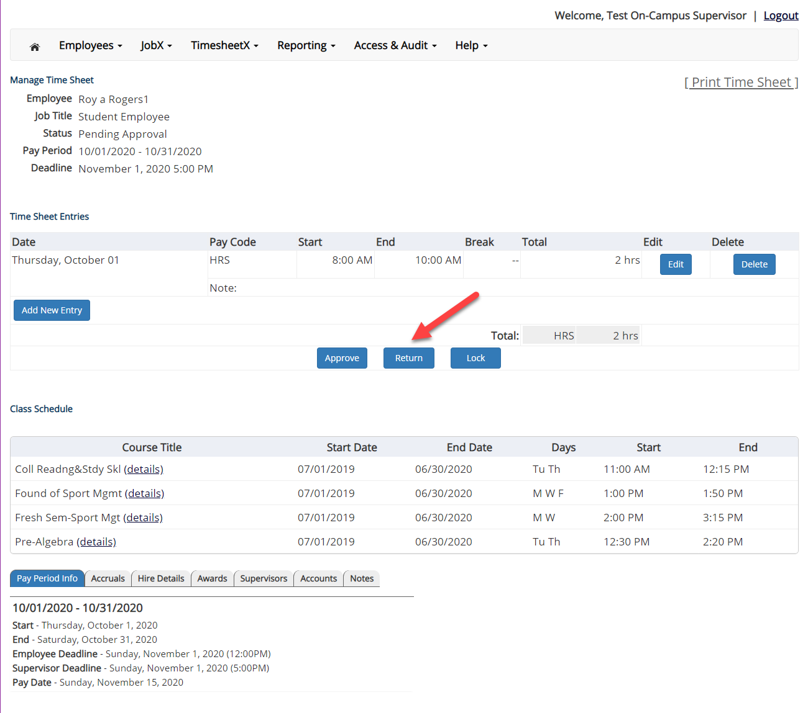
Return a Timesheet
If you need to return the timesheet back to the employee, click the ‘Return’ button.

Slide 14
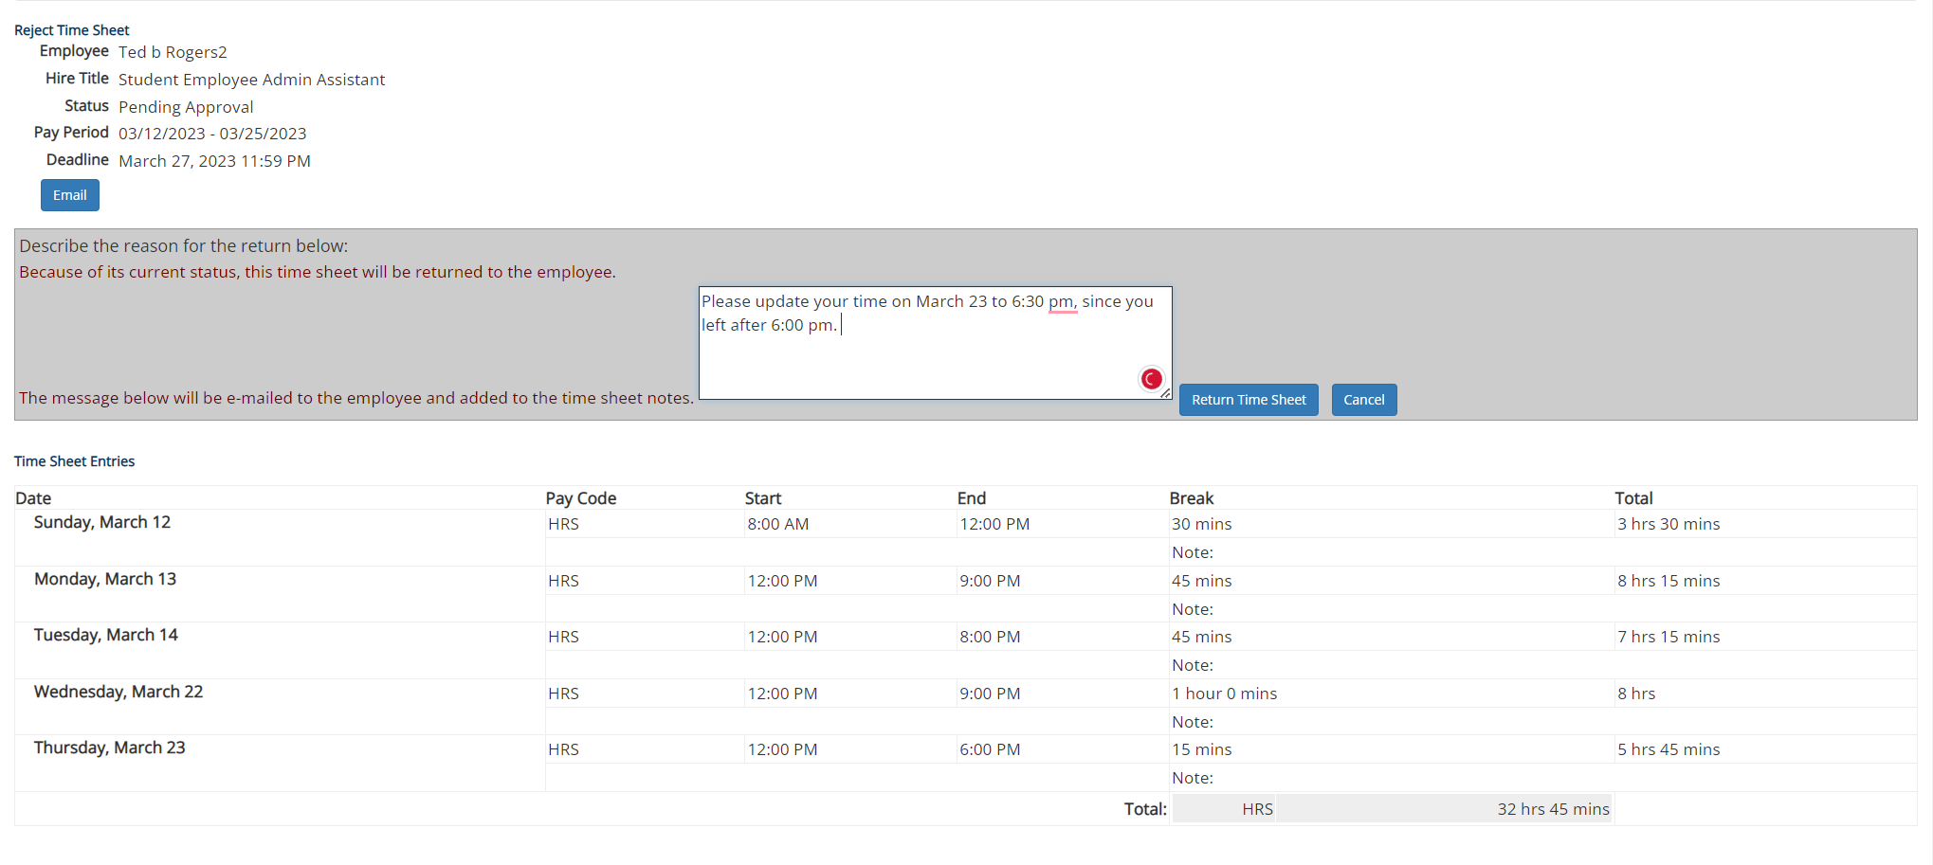
Return a Timesheet
Enter the reason you are returning the timesheet and click ‘Return Time Sheet’.
An e-mail will be sent to the employee notifying them that their timesheet has been return.

Slide 15
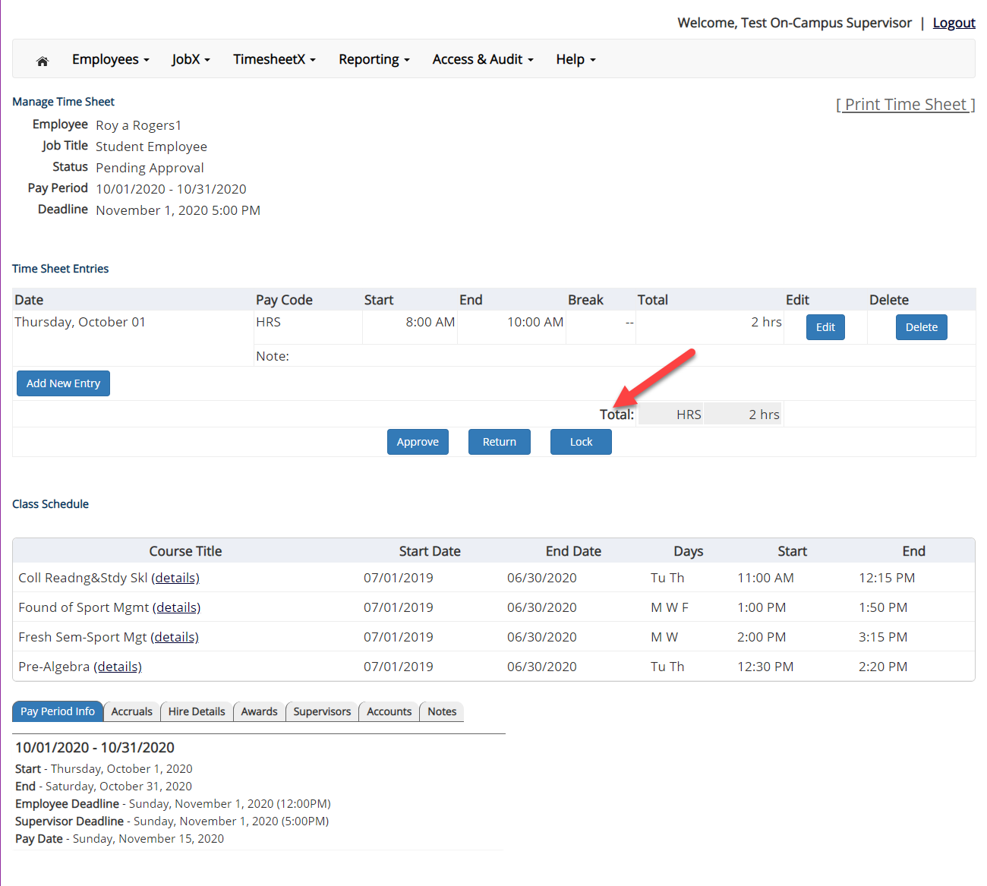
Lock a Timesheet
If you need to lock the timesheet back to prevent any further edits until you collect additional information, click the ‘Lock’ button.

Slide 16
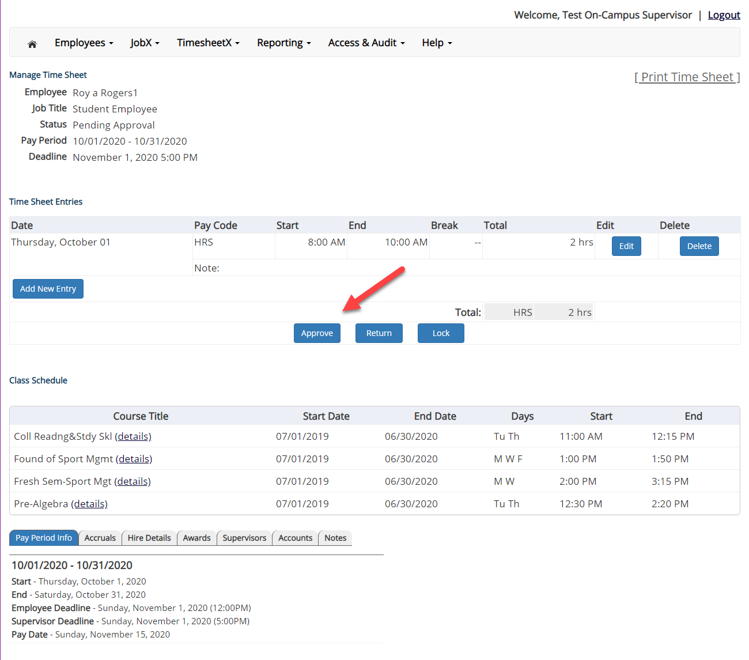
Approve a Timesheet
To approve a timesheet, click the ‘Approve’ button for final approval of the timesheet.

Slide 17
Other Timesheet Features
What Else Can I view on the timesheet?

Slide 18
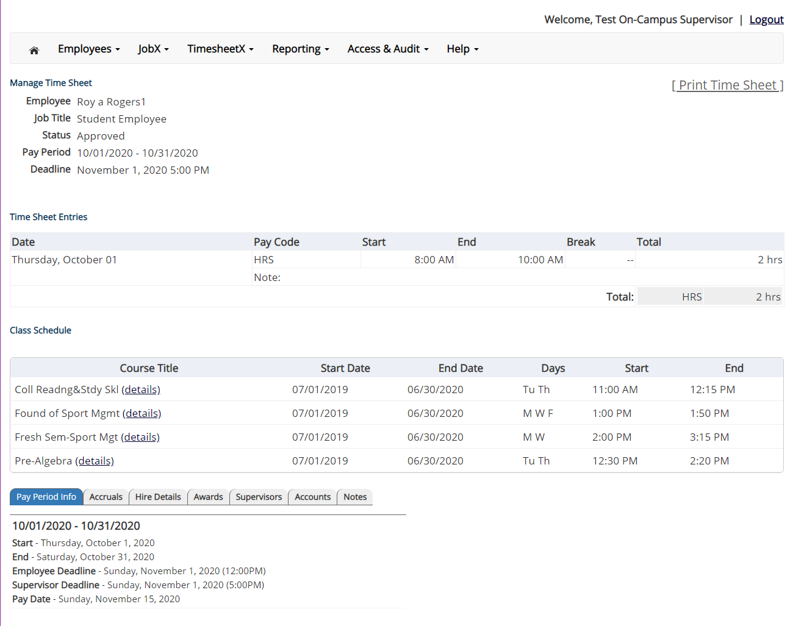
View Pay Period Information
To view Pay Period Details, click on the “Pay Period Info” tab.

Slide 19
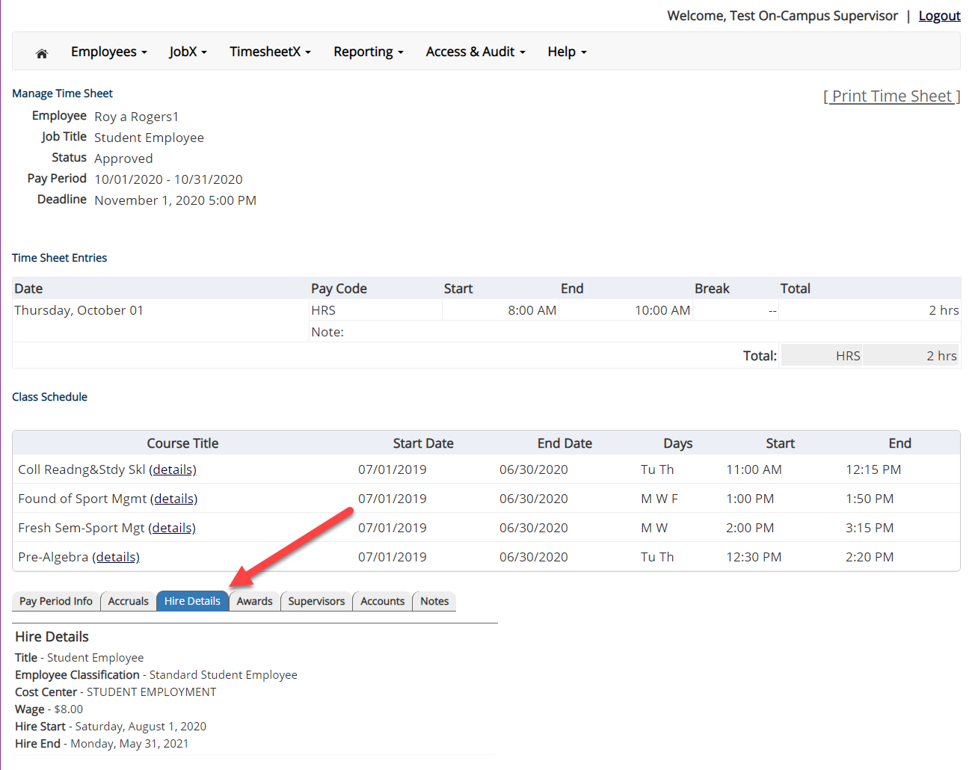
View Hire Information
To view an employee’s Hire Details, click on the “Hire Details” tab.

Slide 20
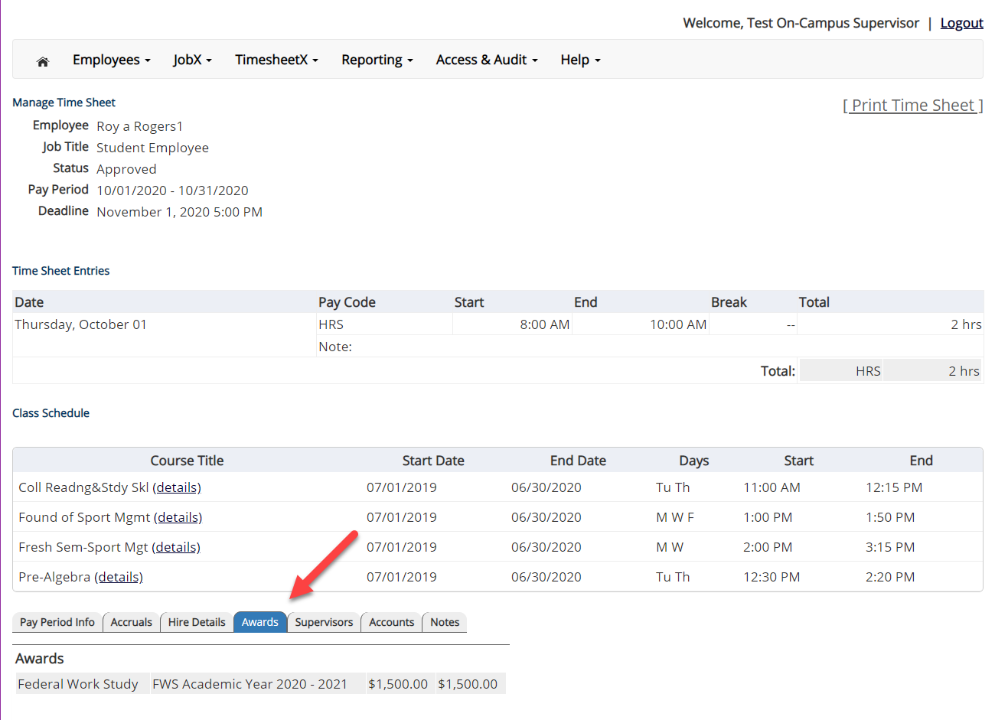
View Award Information
To view an employee’s Award information, click on the ‘Awards’ tab.

Slide 21
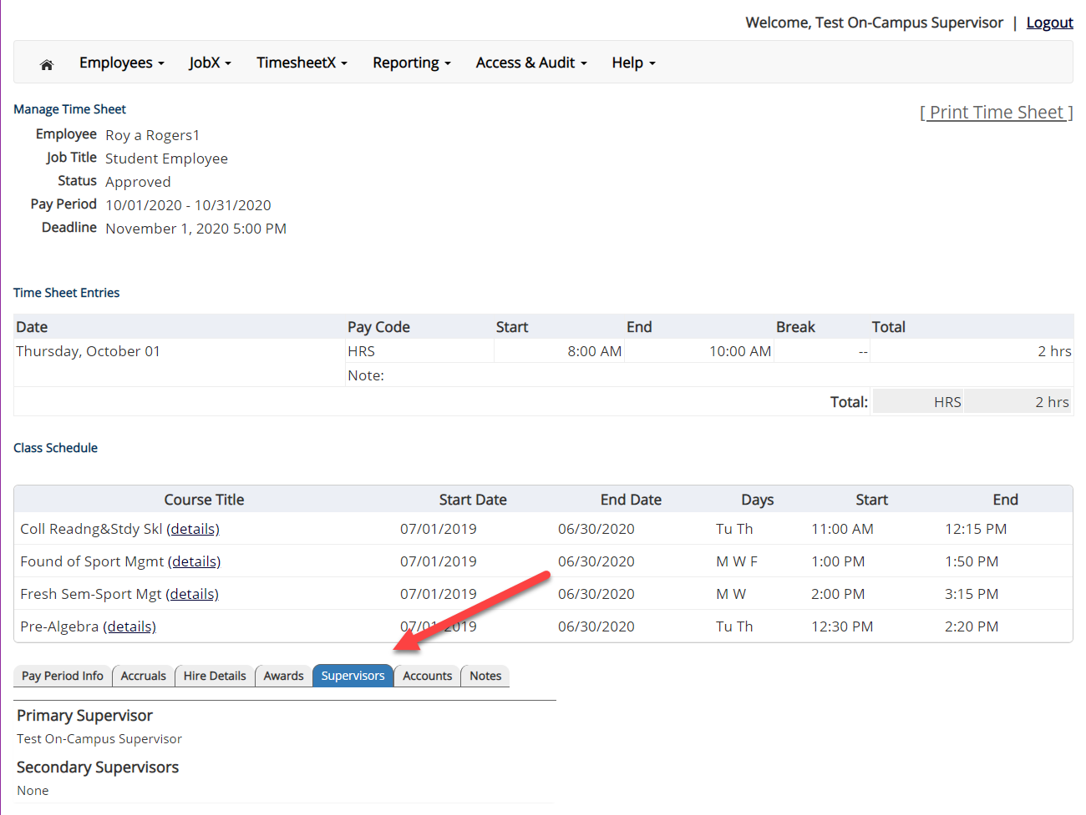
View Supervisor Information
To view an employee’s Primary & Secondary Supervisor information, click on the ‘Supervisors’ tab.

Slide 22
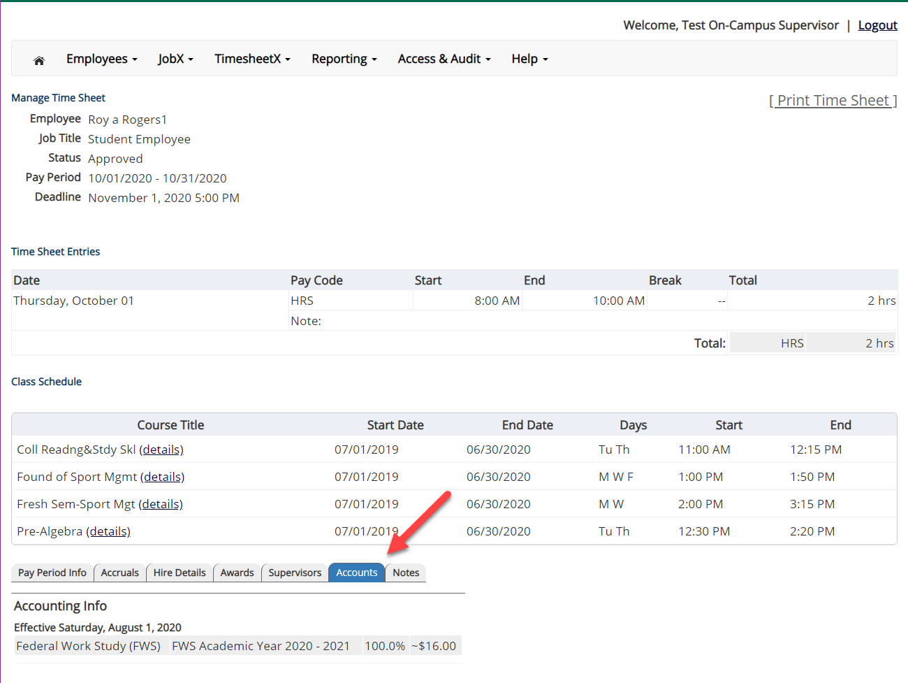
View Account Information
To view an employee’s Account information, click on the ‘Accounts’ tab.

Slide 23
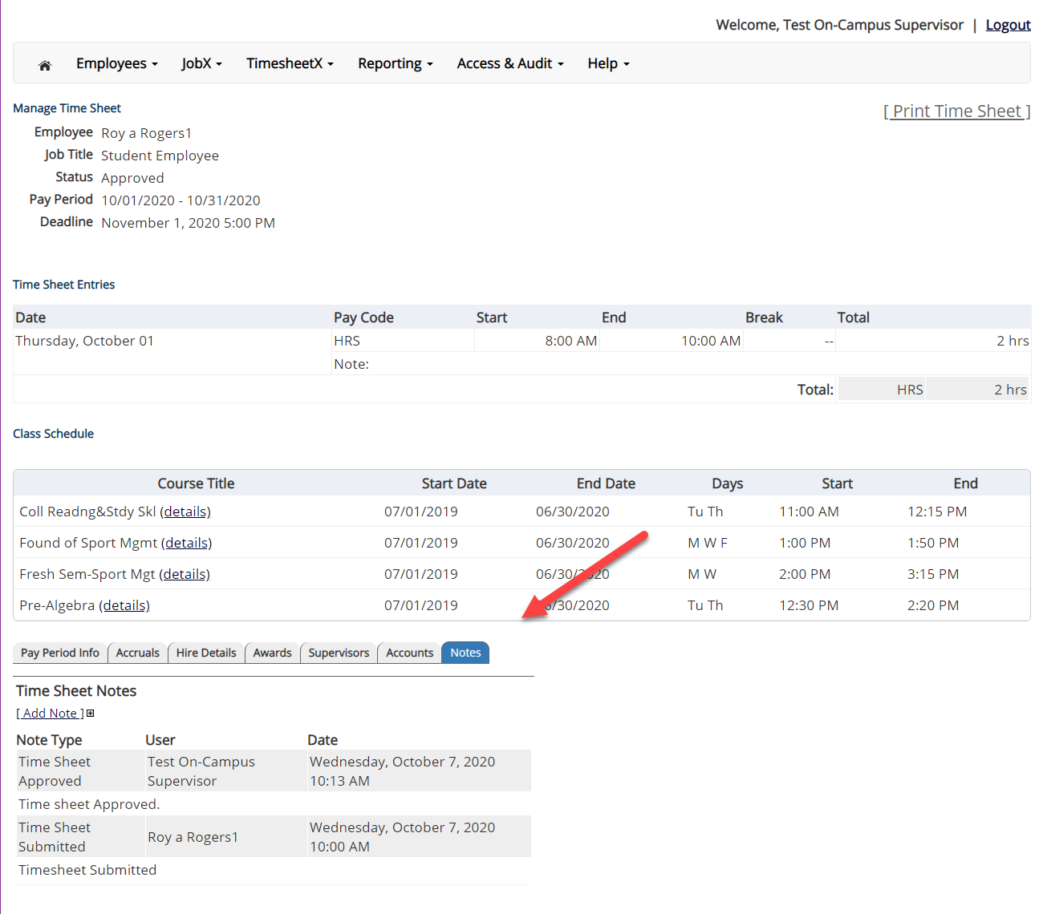
View Timesheet Notes & Audit History
To view an employee’s notes on the applicable timesheet, click on the ‘Notes’ tab.

Slide 24
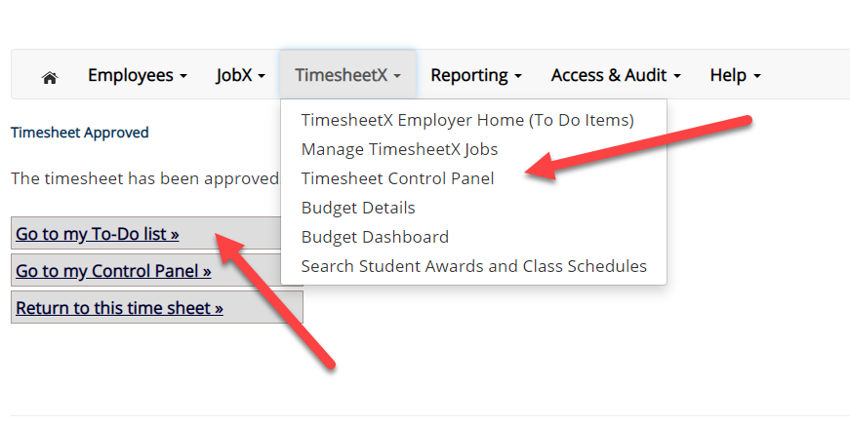
Approve Additional Timesheets
Click ‘Go to my To-Do List’ to review other timesheets.
To view the Supervisor Control Panel, click ‘Go to my Control Panel.’

Slide 25
Timesheet Control Panel

Slide 26
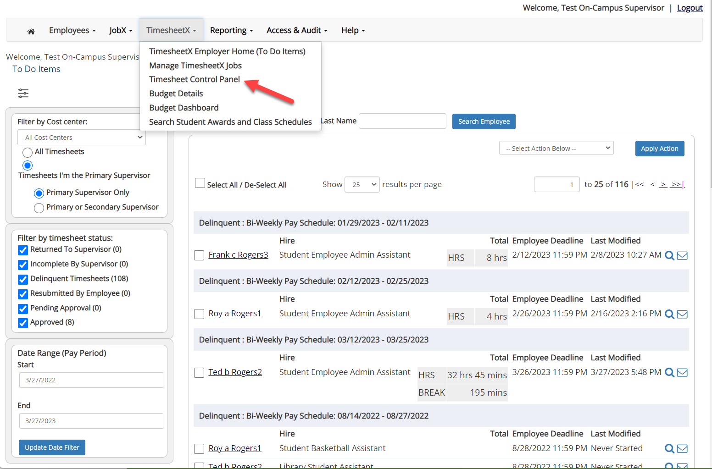
Timesheet Control Panel
To access the Timesheet Control Panel, select ‘Timesheet Control Panel’ from the TimesheetX menu at the top of your screen.

Slide 27
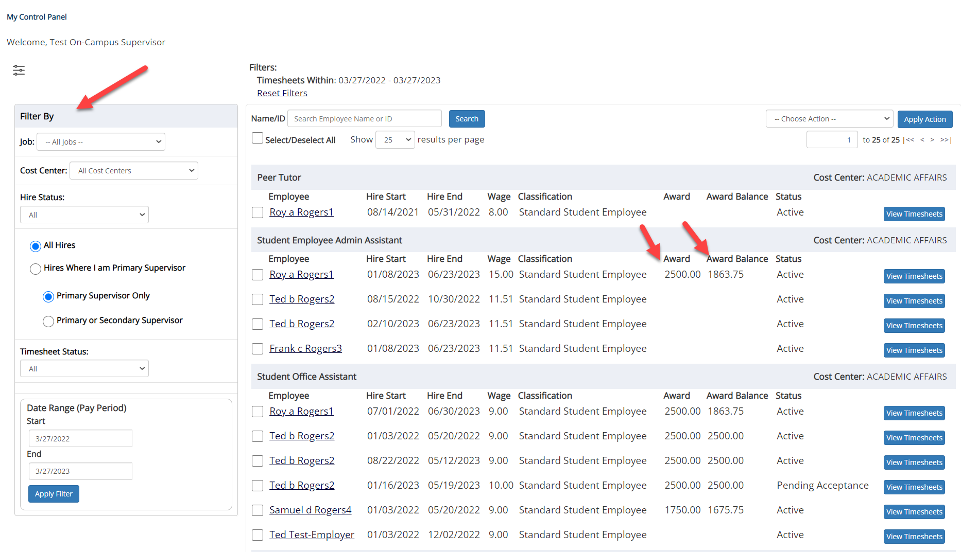
Timesheet Control Panel
On the Timesheet Control Panel you will have an overall view of your students, including awards, award balances, and timesheets.
If you have access to more than one department, you will be able to use the filter to search for your departments.

Slide 28
Timesheet Control Panel - Timesheets
Clicking ‘View Timesheets’ will provide a detail view of all the students’ timesheets. You may review individual timesheets by clicking the ‘Go to time sheet’ button.
If you see a ‘Start Time Sheet’ button, it means the students has not started the timesheet, do NOT click this button unless you need to take possession of the timesheet and enter time on behalf of the student.

Slide 29
Search Students

Slide 30
Search Student Awards & Class Schedule
To quickly view student’s award, employment eligibility flags, and/or class schedule information, click the ‘Search Student Awards & Class Schedules’ feature on the TimesheetX menu at the top of the screen.

Slide 31
Search Student Awards & Class Schedule
Type the employee’s last name or Employee ID, then click the ‘Find Employees’ button.
Next, click the Employee’s name to access their account.

Slide 32
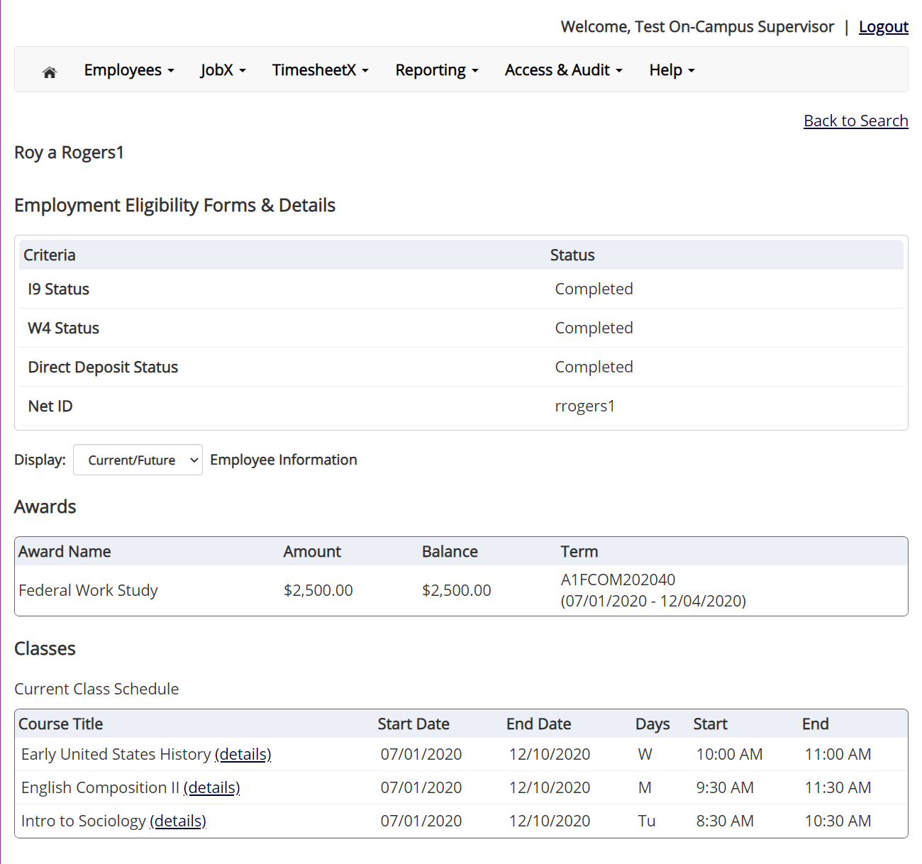
Search Student Awards & Class Schedule
To view current, future, or past awards use the ‘Display’ drop down menu to select your desired results.

Slide 33
Questions?
For Support Contact
Non Federal Work-Study Student and Graduate Assistants:
studentemployment@subr.edu
Federal Work-Study Students:
financialaid@subr.edu

